Slide 1
Software Architecture & Patterns
(Refresher)

Slide 2
Design Thinking
Design – Process of developing a product or service, considering the needs & wants of users
Thinking – A mindset where users are kept in mind at each stage of development of a product or service
In summary, Design Thinking is human centrix approach to solve complex problems.

Slide 3
Design Thinking
Complex Problems Examples –
Improving Customer Satisfaction for Onboarding
Improving the adoption of Solar Energy in any country
Reducing the Attrition Rate in a Team to X%
Reducing the churn rate of customers in some retail platform

Slide 4
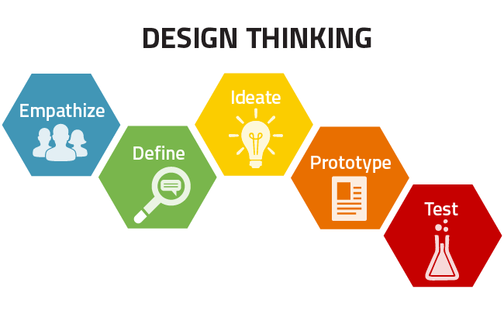
Design Thinking - Steps

Slide 5
Design Thinking - Steps
Empathize – During this stage, we empathize with the users to understand the real problem(s).
Key Points –
Focus to understand the user’s point of view
Ask users how they interact with the product and service
Engage with a diverse group of users(highly satisfied & highly dissatisfied), Mainstream users etc
The focus is on divergent thinking(creating choices)

Slide 6
Design Thinking - Steps
Define – During this stage, we define the problem statement by synthesizing all the observations we gathered during the Empathize phase.
Key Points –
Prioritize the major issues & frame the problem statement
Focus on solving the selected & most impactful issues instead of solving all in one single statement
Focus on convergent thinking(making choices)
The problem statement framed in this stage is also called “Point of View”

Slide 7
Design Thinking - Steps
Ideate – Brainstorming to come up with Solution Ideas.Gather as many solution ideas as possible and synthesize all of them for further brainstorming
Key Points –
Let the ideas flow, do not interrupt even if the ideas are irrelevant, instead accumulate the feasible ideas & build upon them
Do both create choices by divergent thinking(coming up with as many ideas as possible) & make choices through convergent thinking(concluding a few ideas)

Slide 8
Design Thinking - Steps
Prototype – Develop a prototype of the ideas. Usually a quick prototype but capable enough to interact with users & get their feedback. It’s more of Thinking with your hands. If a picture is worth of thousand words, a prototype is worth of thousand meetings.
Key Points –
Do not try to develop the final product itself
Objective here is to share it with users and get an early feedback
Focus on aesthetics

Slide 9
Design Thinking - Steps
Test – During this stage we share the prototype with the users and gather their feedback. This, helps in understanding if we are on the right track, or some correction is required. After getting the feedback we may need to go back to any of the first 4 stages.
Key Points –
Test the users with all the users we interacted in the 1st stage.
Gather feedback to make adjustments & even be ready to discard the idea
Maintain a history of all the prototypes for future reference

Slide 10
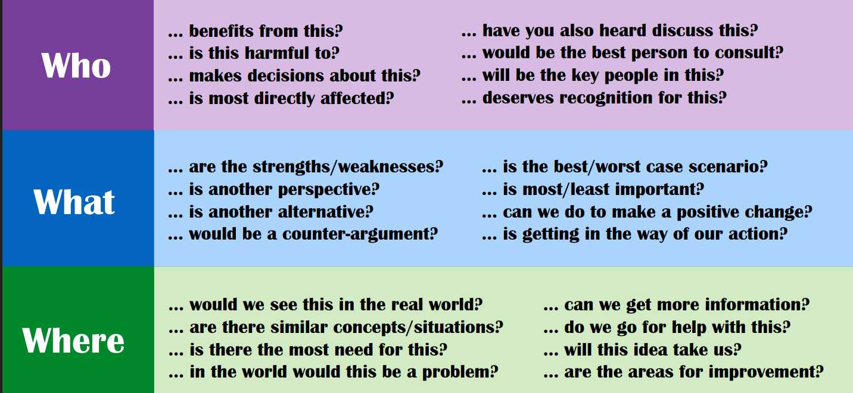
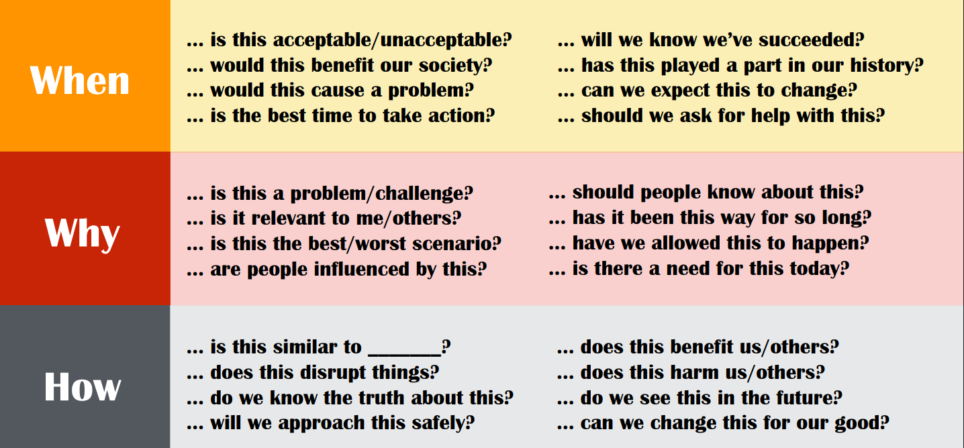
Critical Thinking – A Soft skill needed across almost any IT Role

Slide 11
Architectural Discovery Checklist
1. Business Context & Goals.
🎯 Business Objectives.
What are the core business goals or drivers for this initiative?
What business outcomes are expected (e.g., cost savings, scalability, new capabilities)?
How will success be measured (KPIs, OKRs)?
What are the critical timelines or milestones?
💼 Stakeholders.
Who are the key stakeholders (business, IT, operations, compliance)?
Who are the decision makers and approvers?
Who are the end users or consumers of the solution?
What are their pain points and expectations?
🧩 2. Current State (As-Is) Architecture.
🔍 Systems & Integrations.
What are the existing systems, services, and integrations involved?
What are their interfaces (APIs, events, files, message queues)?
What data flows currently exist between systems?
⚙️ Technology Landscape.
What technologies, languages, and frameworks are used today?
What infrastructure is in place (cloud, on-prem, hybrid)?
What are the dependencies and technical debt areas?

Slide 12
Architectural Discovery Checklist
📊 Operational Metrics.
What are the current performance, availability, and scalability metrics?
How are monitoring and alerting handled today?
What SLAs/SLOs/SLIs exist?
🧱 3. Target State (To-Be) Vision.
🧠 Strategic Direction.
What is the target vision for the system or platform?
What capabilities or features are required?
What architectural qualities (scalability, modularity, portability) are desired?
🧭 Non-Functional Requirements (NFRs).
Category Key Questions.
Performance Expected response times, throughput, latency?
Scalability Vertical/horizontal scaling needs? Auto-scaling?
Availability Required uptime, failover mechanisms?
Security Authentication, authorization, encryption, compliance?
Maintainability How easily can the system evolve?
Observability Logging, tracing, metrics collection requirements?
Cost Efficiency Budget limits, cost-optimization constraints?

Slide 13
Architectural Discovery Checklist
📊 🧰 4. Data & Integration Discovery.
📦 Data Landscape.
What are the key data entities and their relationships?
What is the volume, velocity, and variety of data?
What data sources (internal, external, streaming) are used?
What are the data quality and governance concerns?
🔄 Integration Patterns.
What integration mechanisms are required (APIs, events, ETL, messaging)?
Is there a need for real-time vs batch processing?
Are there legacy interfaces to modernize?
☁️ 5. Infrastructure & Deployment.
🧱 Environment Discovery.
Where will workloads run? (On-prem, Azure, AWS, GCP, Hybrid, Edge).
What environments exist (Dev/Test/Prod)?
How is infrastructure provisioned (manual, IaC – Terraform/Bicep)?
What are the network and connectivity constraints?
What compute, storage, and network resources are available?
🚀 Deployment & Operations.
What is the CI/CD pipeline strategy?
How are rollouts, rollbacks, and versioning handled?
What’s the monitoring, logging, and alerting setup?
Who handles incident response and SRE functions?

Slide 14
Architectural Discovery Checklist
🔐 6. Security, Compliance & Governance.
🔒 Security.
How is identity and access management (IAM) handled?
Are there encryption requirements (at rest, in transit)?
How are secrets managed?
Any known vulnerabilities or threats?
🧾 Compliance.
What regulatory frameworks apply (GDPR, HIPAA, ISO, RBI, etc.)?
What are the audit and logging requirements?
Are there data residency or sovereignty constraints?
🧠 7. People, Process & Change Management.
Who will own and maintain the solution post-deployment?
What skills are available in-house vs. need upskilling?
Are there existing DevOps/SRE or MLOps practices?
What change management or training plans are required?
📈 8. Risks, Constraints & Assumptions.
Category Example.
Risks Legacy dependency, integration complexity, unclear requirements.
Constraints Budget, licensing, regulatory, cloud choice.
Assumptions APIs available, data access permitted, team resources allocated.

Slide 15
Architectural Discovery Checklist
📊 9. Architecture Decision Inputs.
Prepare to capture Architecture Decision Records (ADRs) based on:
Chosen architecture style (Microservices, Event-driven, Data , etc.).
Key trade-offs (complexity vs flexibility, performance vs cost).
Tooling & framework selection rationale.
Cloud or platform strategy (Azure, AWS, hybrid).
🧩 10. Artifacts to Produce.
During or after discovery, architects should aim to deliver:
Current-State (As-Is) architecture diagram.
Target-State (To-Be) architecture diagram.
Strategy Diagram to transform from As-Is to To-Be
Context and container views (C4 model).
Integration/data flow diagrams.
NFR matrix.
Risk and mitigation log.
Architecture Decision Records (ADRs)

Slide 16
Requirement Analysis – Soft Skills
Is some As-Is(/Current-State) Architecture/Design/Implementation available?
If yes, how things are done currently – the whole process.
Is there any To-Be(/Target) diagram?
If needed, ask why transforming from As-Is to To-Be? And why now?
Being Customer Centric rather than just Requirements Centric i.e. if needed, modify the requirements for better customer satisfaction.
Proactively ask relevant queries in Requirements Analysis phase & envision (design) tasks which can turn out to be really very helpful to make the product/service better in the Product Engineering landscape.

Slide 17
Requirement Analysis – NFRs
QPS/RPS/TPS(Queries/Requests/Transactions per second) – As thumb rule, assume(/start with) 1K QPS can be handled by a standard server (& API(s) response time within 100ms in general).
Read/Write Ratio – Calculate the tentative/assumed Read/Write
Ratio. This can be helpful in scaling the reads & writes separately.
Infra Considerations - Number of Servers/VMs needed & CPU/Disk/RAM Size needed in each Server/Vm. Network Bandwidth considerations are also important here.
Storage Size – Evaluate the size of blobs, DBs etc needed.
YoY(Year on Year [including Day 0,1…N]) Growth[for all the above] – Can be helpful in capacity planning for initial cloud assessment or full on-premise assessment
Also known as “Capacity Planning”/”Back of the Envelope” Calculations – ByteByteGo | Back Of the Envelope Estimation

Slide 18
Estimation
WBS(Work Breakdown Structure) – Used for normal User Stories in most agile projects. Infact when you do Story-Pointing, you are implicitly using WBS.
Use Case Estimation – Used for whole new or Enhancement projects. WBS can be used for each use case for better granularity.
Function Point Estimation – Used in some migration projects if source code of existing project is available.
N.B. -> If its some totally new concept/technology, do a PoC using Design Thinking approach and then give the overall estimate using WBS.
SAFe Estimation Techniques - Estimation & Prioritization : Agile & SAFe Framework | LinkedIn
Some Most Important “Common-Sense” points to keep in consideration while doing any estimate are(although common sense but sometimes we forget these the most) –
Work Load(as per Granular Scoping & Prioritization as per need of the hour), Complexity & Uncertainty.
Always consider 20-30% buffer on overall base estimates you give. It’s always better to commit less & deliver more than vice versa. Check Arpit Bhayani’s Post on Estimation| LinkedIn
Team Capacity or Timelines may be needed to be increased/decreased as per need of the hour.

Slide 19
Modelling & Documentation(& Tools)
UML –
Use Case & Activity Diagrams – Used for interaction between Dev team and BAs/POs.
Difference Between Use Case Diagram and Activity Diagram | Compare the Difference Between Similar Terms
Component Diagrams – To show how components/services interact with each other
What is Component Diagram?
Class Diagrams – To show how components/services are build using class(es)/interface(s).Can be helpful in Reverse Engineering as well.
UML Class Diagram Tutorial | Lucidchart

Slide 20
Modelling & Documentation(& Tools)
UML contd… –
Sequence(& Collaboration Diagrams) – Can be used to show interactions flow between classes/components/services.
Difference between Sequence diagram and Collaboration diagram – GeeksforGeeks
Other Diagramming Models –
C4 Model - Visualize Your Software Architecture With The C4 Model
BPMN - BPMN Specification - Business Process Model and Notation
Archimate - ArchiMate – Wikipedia
N.B. – Use Colour Coding(border or full box) for Legends for Architectural Components like “New”, “Existing To Be used”, “Modified” or “To be Decomissioned”

Slide 21
Modelling & Documentation(& Tools)
Important Architecture Diagrams and Documentation
Vision & Strategy using Roadmaps/Milestones/TimeLines
Enterprise Landscape – for overall high-level view of the entire Enterprise Landscape
Business Architecture – Shows the high-level Business Components & flows/interactions between them
Application Architecture – Various components(showing clearly what technologies are used to build the app) and interactions between them in project(s).
Technology Architecture – Showing the Infra & Deployment strategies

Slide 22
Modelling & Documentation(& Tools)
Important Architecture Diagrams and Documentation contd …
Integration Architecture – Showing the major internal/external integrations.
DB Architecture – Showing the conceptual, logical & physical DB models and ER diagrams & the DB Tables metadata structure.
Also important is to document the NFRs(Non Functional Requirements), ADRs(Architecture Decision Records) & AIRs(Architecture Improvement Logs). For ADRs & AIRs, do check the gotchas associated with any (new) Technology tool.
Other Stuffs to Document –
Architecture Principles
Governance Processes
Development Architecture
N.B. – In general, search/google/chatGPT for templates of the aforementioned docs & refer them to prepare your own project specific template.

Slide 23
Modelling & Documentation(& Tools)
A Good Modelling compilation Resource –
Modeling - Awesome Software Architecture
Software Architecture As Code Tools –
From Text to Models
Application Architecture as Code - The Architect Elevator
How to automate software-architecture, using architecture-as-code (SAaC) approach
Likec4
Reverse Engineering Tools –
UML - Are there good tools for C# reverse engineering? - Stack Overflow
Software Design Diagrams Using GitHub Copilot – YouTube
Other Related Tools –
Diagram to Code using Amazon Q | LinkedIn
How to use GitHub Copilot? A Detailed, Comprehensive Guide 2025

Slide 24
Modelling & Documentation(& Tools)
Some closing points w.r.t Documentation -
Analyze the as-is & to-be system state e2e thoroughly from product requirements perspective. If needed, clarify all your queries/doubts, pro-actively.
Document the Business Architecture in as detail as possible for both as-is & to-be states based on 1 above (maybe using FlowCharts, State Diagrams, SwimLanes, Component/Sequence Diagrams etc.). Also check if the to-be processes can be made better, process-wise(maybe simpler or providing some tactical solution instead of strategic solution or providing additional capabilities).
Document the Application[including Integration] Architecture in as detail as possible(mainly for the to-be state) along-with associated NFRs(ideally both as-is & to-be). Try to use technologies(old or emerging) that suits your contextual requirements & not based on hype associated with some technology. Again, can use FlowCharts, State Diagrams, SwimLanes, Compoinent/Sequence Diagrams etc.
Document the Infra(also called Technology) Architecture[including DevSecOps & SRE] in as detail as possible(mainly for the to-be state) along-with associated NFRs(ideally both as-is & to-be with comparison if needed). Try to use technologies(old or emerging) that suits your contextual requirements & not based on hype associated with some technology. Again, can use FlowCharts, State Diagrams, SwimLanes, Component/Sequence Diagrams etc.
Document the Data Architecture[including Data Engineering & Data Science needs with explicit Data Models{ER Diagrams & DB Tables}], in as detail as possible(mainly for the to-be state) along-with associated NFRs(ideally both as-is & to-be with comparison if needed). Try to use technologies(old or emerging – e.g. NoSql/RDBMS) that suits your contextual requirements.
Maybe after all the above, document the ADRs & AIRs. We may need AIRs since we might be going for some tactical solution & thereby create technical debts.

Slide 25
Modelling & Documentation(& Tools)
For Further Exploration -
Documenting Software Architectures - by Dr Milan Milanović
The Ultimate Guide To Software Architecture Documentation
Architecture-Document-Template
High Level Design Template
WebMethods - Software AG Tech Community & Forums
Writing an effective End-to-End High-Level Design
System-Design-Templates-Excalidraw
Free Software architecture review template | Confluence
Practical-Architecture
Architecture-Decision-Record
Enterprise Architecture: How to Design Models & Diagrams
Communication Patterns[Book]
Practical Model-Driven Enterprise Architecture
Modeling Enterprise Architecture with TOGAF[Book]

Slide 26
Architecture(/Design) Principles
Architecture(/Design) Principles -
Architectural Design Principles - Awesome Software Architecture
Reactive Design-
Code repo for Functional and Reactive Domain Modeling
Reactive Design Patterns
Reactive Messaging Patterns with the Actor Model

Slide 27
Architecture(& Design) Trade-Offs
Architecture(/Design) is mainly taking decisions based on trade-offs wherein the goal is to build the Least Worst Architecture(/Design).
ATAM(Architecture Trade-Off Analysis Method) –
Architecture Tradeoff Analysis Method (ATAM) - GeeksforGeeks
Architecture Trade-Off Examples –
How to make software architecture trade-off decisions | by Alex Wauters | Medium
How do you evaluate and communicate the trade-offs of different architectural choices?

Slide 28
Architecture(& Design) Trade-Offs
For Further Exploration –
Fitness function-driven development | Thoughtworks
Enforcing Software Architecture With Architecture Tests
Software Architecture: Foundations, Theory, and Practice – Resources
The Semantic Design Toolbox - Semantic Software Design [Book]
Design It!: From Programmer to Software Architect by Michael Keeling
Building Evolutionary Architectures · GitHub
Evolutionary-Architecture-by-example
Evolutionary Architectures. This is a summary of some interesting…
Geek read: Building Evolutionary Architectures 2nd edition
Notes on Building Evolutionary Architectures. | Irrational Exuberance
Building Evolutionary Architectures
Software Architecture Metrics[Book]
Solutions-Architect-metrics-cheatsheet
Metrics For Software Architects and Designers
Designing Software Architectures – notes
System Design TradeOff Series | LinkedIn

Slide 29
Enterprise Architecture Process using TOGAF
What is TOGAF?
TOGAF (The Open Group Architecture Framework) is a framework for designing, planning, implementing, and governing enterprise architecture. The heart of TOGAF is the ADM (Architecture Development Method) — a step-by-step, iterative process for developing and evolving enterprise architecture.
ADM (Architecture Development Method) – Overview
The ADM is a cycle that you repeat continuously. Each iteration can update one layer or the entire architecture.
Preliminary
↓
A. Architecture Vision
↓
B. Business Architecture
↓
C. Information Systems Architecture
(Data + Application)
↓
D. Technology Architecture
↓
E. Opportunities & Solutions
↓
F. Migration Planning
↓
G. Implementation Governance
↓
H. Architecture Change Management
↺ (back to A/B/C etc.)
Additionally, the Requirements Management phase runs through all phases.

Slide 30
Enterprise Architecture Process using TOGAF
Preliminary Phase – Prepare & Set the Stage
Purpose
Define:
Why we are doing architecture
Scope of transformation
Architecture principles
Governance model
Tools and repository
Key Outputs
Organizational context
Architecture principles (e.g., reuse before buy before build)
Architecture governance framework
EA repository structure
Phase A: Architecture Vision
Purpose
Create a high-level vision to:
Align stakeholders
Secure funding and approval
Set initial scope and boundaries
Activities
Identify stakeholders
Define business context and drivers
Form a high-level Target Architecture (not detailed yet)
Develop the Business Case
Create Architecture Vision Document

Slide 31
Enterprise Architecture Process using TOGAF
Outputs
Statement of Architecture Work
Architecture Vision (with high-level diagrams)
Stakeholder maps and communication plan
Phase B: Business Architecture
Purpose
Define the Target Business Architecture:
Business capabilities
Processes
Organization structure
Value streams
Business rules
Inputs
Architecture Vision
Business strategies
Activities
Baseline Business Architecture (current state As-Is)
Target Business Architecture (future state To-Be)
Identify gaps (Gap Analysis)
Outputs
Business Capability Model
Value Stream Maps
Business Process Models
Business Domain/Data impact analysis

Slide 32
Enterprise Architecture Process using TOGAF
Phase C: Information Systems Architectures
Divided into:
Data Architecture
Application Architecture
C1. Data Architecture
Define:
Data entities & relationships
Data ownership
Data flows & lifecycle
Master data boundaries
C2. Application Architecture
Define:
Application components & services
Integration patterns (e.g., API, ESB, events)
Application-to-capability mapping
Outputs (combined)
Logical Data Model
Application Interaction Diagram
Data/Application Gap Analysis
Phase D: Technology Architecture
Purpose
Define the technical platform needed to realize the applications & data.
This includes:
Infrastructure
Networking

Slide 33
Enterprise Architecture Process using TOGAF
Security
Cloud Platforms (IaaS/PaaS)
DevOps / CI/CD environments
Runtime environments (EKS/AKS, App Service, VMs, Containers, etc.)
Outputs
Platform Reference Architecture
Infrastructure designs (logical > physical)
Tech standards and policies
Phase E: Opportunities & Solutions
Purpose
Convert architectures into solution direction.
Identify:
Projects
Work packages
Reusable building blocks
Technology enablers
Outputs
Solution Architecture Roadmap
Work Package Definitions
Phase F: Migration Planning
Purpose
Create a phased implementation roadmap based on:
Business priorities
Dependencies

Slide 34
Enterprise Architecture Process using TOGAF
Budget
Risk
Outputs
Prioritized Migration Roadmap (e.g., Phase 1, Phase 2…)
Implementation Plan aligned with PMO governance
Phase G: Implementation Governance
Purpose
Ensure that implementation follows the architecture.
Activities
Architecture review boards
Design approvals
Solution alignment checks
Outputs
Compliance assessment reports
Waivers / justification logs (when deviation required)
Phase H: Architecture Change Management
Purpose
Keep architecture live and relevant.
Actions
Monitor changes in business, technology, regulations
Decide whether to update architecture or start new ADM cycle
Outputs
Updated architecture repository
Architecture Change Requests
Requirements Management

Slide 35
Enterprise Architecture Process using TOGAF
Operates across all phases:
Collects, stores, traces, updates requirements
Ensures traceability from strategy → architecture → implementation
Artifacts (Documents) Produced Across ADM
Phase Key Deliverables
Preliminary Architecture Principles, Governance Model
A: Vision Architecture Vision, Statement of Work, Business Case
B: Business Capability Map, Value Streams, Business Process Models
C: Data/App Logical Data Model, Application Interaction Diagrams
D: Technology Platform Reference Architecture, Tech Standards
E: Opportunities Solution Building Blocks, Roadmap
F: Migration Migration Plan, Dependency Map
G: Governance Architecture Compliance Report
H: Change Change Request Log
How Iteration Works
TOGAF does not expect you to finish everything then move on.
Each phase:
Can be revisited
Can be done in domain-specific cycles (e.g., only Application Architecture)
Can be scaled (lightweight for small projects, detailed for large)
In Simple Terms
TOGAF Step Practical Meaning
Vision Why are we doing this? What is the high-level target?
Business Architecture What the business needs to do.
Data + Application What systems and data are needed.

Slide 36
Enterprise Architecture Process using TOGAF
TOGAF Step Practical Meaning
Technology Which platforms and tech we will use.
Opportunities & Solutions How to translate architecture to executable solutions.
Migration Planning When and in what order.
Governance Ensure execution follows design.
Change Management Keep architecture relevant over time.
Example - TOGAF EA Deliverables for BFSI Core Banking Modernization
Phase A – Architecture Vision
Objective: Define high-level target architecture, stakeholders, and business case.
Key Artifacts:
Architecture Vision Deck (PPTX) – includes:
Business drivers: legacy monolith, slow product launches, regulatory pressure, digital channels
Stakeholder map: CIO, CTO, Business Heads, Risk & Compliance, PMO
High-level Target Architecture Diagram (Cloud + Microservices + API layer)
Business case & KPIs (time-to-market, cost reduction, reliability)
Phase B – Business Architecture
Objective: Map current and target business capabilities.
Artifacts:
Business Capability Map (PPTX)
Key domains: Retail Banking, Corporate Banking, Treasury, Risk, Compliance, Payments
Highlight which capabilities are enhanced, migrated, or modernized
Value Streams & Process Models
Example: Account Opening, Loan Origination, Transaction Processing

Slide 37
Enterprise Architecture Process using TOGAF
Example - TOGAF EA Deliverables for BFSI Core Banking Modernization
Business Gap Analysis
Manual processes → automated microservices
Siloed product lines → integrated product platform
Phase C – Information Systems Architecture
Data Architecture
Canonical data model for Customer, Account, Transaction, Loan, Product, KYC
Master Data Management boundaries
Data flow diagrams showing source systems → microservices → reporting
Application Architecture
Domain-driven microservices mapped to business capabilities
API Gateway for internal/external integration
Event-driven architecture (Kafka, RabbitMQ)
Integration with legacy core for phased migration
Artifacts:
Logical Data Model Diagram (PPTX)
Application Interaction Diagram (PPTX)
Gap Analysis Table (XLSX)
Phase D – Technology Architecture
Objective: Define platform to support microservices and hybrid cloud.
Components:
Hybrid cloud: On-prem DC + Azure/AWS for microservices
Kubernetes (AKS/EKS) clusters for microservices
CI/CD pipeline with Jenkins/GitHub Actions

Slide 38
Enterprise Architecture Process using TOGAF
Example - TOGAF EA Deliverables for BFSI Core Banking Modernization
Security, IAM, monitoring, disaster recovery
Artifacts:
Technology Reference Architecture Diagram (PPTX)
Infrastructure Components Heatmap
Phase E – Opportunities & Solutions
Objective: Map architectures to executable projects.
Artifacts:
Solution building blocks
Work packages:
Domain microservices development (Customer, Account, Transaction, Loan)
API Gateway implementation
Hybrid cloud platform provisioning
Data migration & MDM rollout
Roadmap for each domain
Phase F – Migration Planning
Objective: Define phased implementation.
Artifacts:
Migration roadmap (XLSX)
Phase 1: Customer & Account services
Phase 2: Loan & Transaction services
Phase 3: Payments & Treasury services
Dependencies, cost estimates, resource planning
Phase G – Implementation Governance
Objective: Ensure compliance with architecture.

Slide 39
Enterprise Architecture Process using TOGAF
Example - TOGAF EA Deliverables for BFSI Core Banking Modernization
Artifacts:
Architecture compliance checklist
Review board schedule
Deviation approval templates
Phase H – Architecture Change Management
Objective: Ensure EA evolves with business.
Artifacts:
Change management log template (DOCX)
Architecture update guidelines
Periodic assessment metrics
Requirements Management
Central repository linking business drivers → capabilities → data → applications → technology → solutions
Traceability ensured for audit & regulatory compliance.

Slide 40
Enterprise Architecture Process using TOGAF
For Further Exploration -
Day One as an Enterprise Architect | LinkedIn
Standard 10.0 - Level 1 Enterprise Architect Course | Udemy
Standard 9.2 - Part 2 Certified Enterprise Architect Course | Udemy
Enterprise Architecture Practitioner with TOGAF 10 Standard | Udemy
Practical Solution Architecture | Udemy
The Practice of Enterprise Architecture (Part III) | Udemy
Enterprise Architecture by Example | Udemy
Enterprise Architecture Governance | The Definitive Guide | LeanIX
Enterprise Design Patterns Book — Enterprise Design Patterns
Enterprise Architecture at Work
TOGAF Skill Guide. When I started my TOGAF Learning…
CloudGAF - A Tailored TOGAF Framework for Cloud Adoption
Complex Enterprise Architecture: A New Adaptive Systems Approach
EAWheel
Fundamentals of Enterprise Architecture[Book]
Free Enterprise Architecture Resources – Conexiam
Realize Enterprise Architecture with AWS and SAFe
Technology Strategy Patterns[Book]

Slide 41
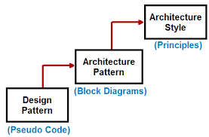
Architectural Styles vs Patterns
For Further Exploration –
Is ASP.NET MVC a framework, architecture, or a design pattern? – Quora
Are Architectural Styles, Patterns & Design Patterns Different | LinkedIn

Slide 42
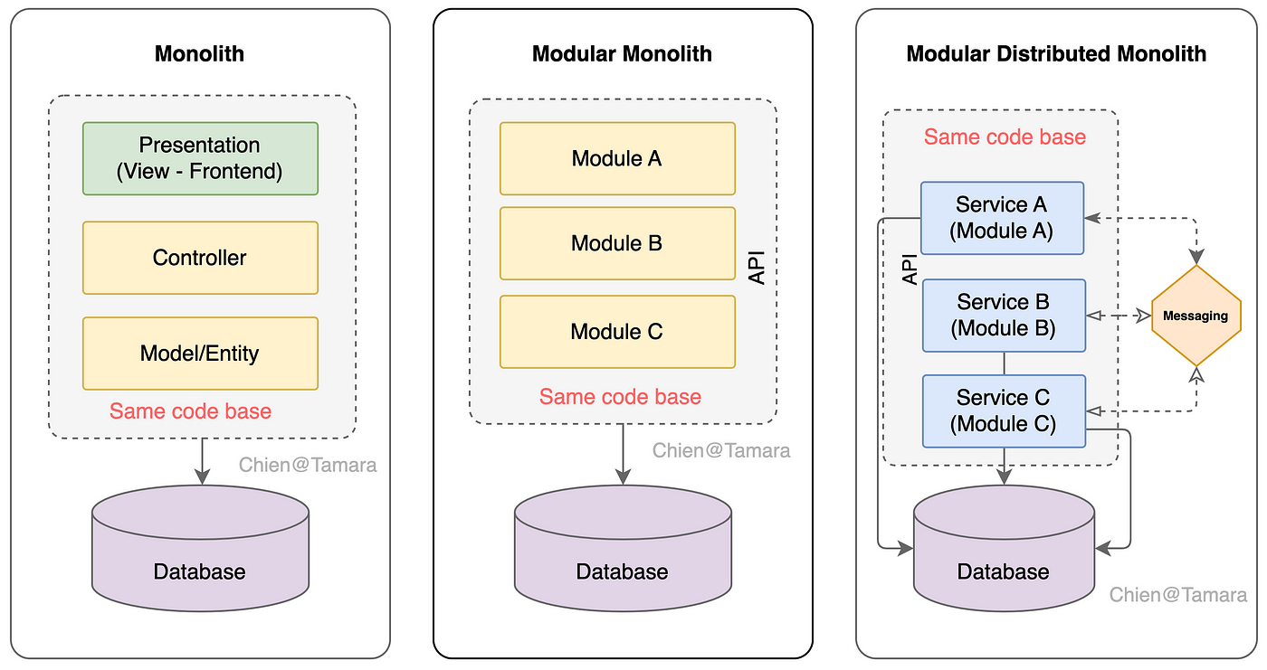
Architectural Styles
(Modular/Distributed) Monolith Architecture –
For Further Exploration –
Modular Monolith - Awesome Software Architecture /

Slide 43
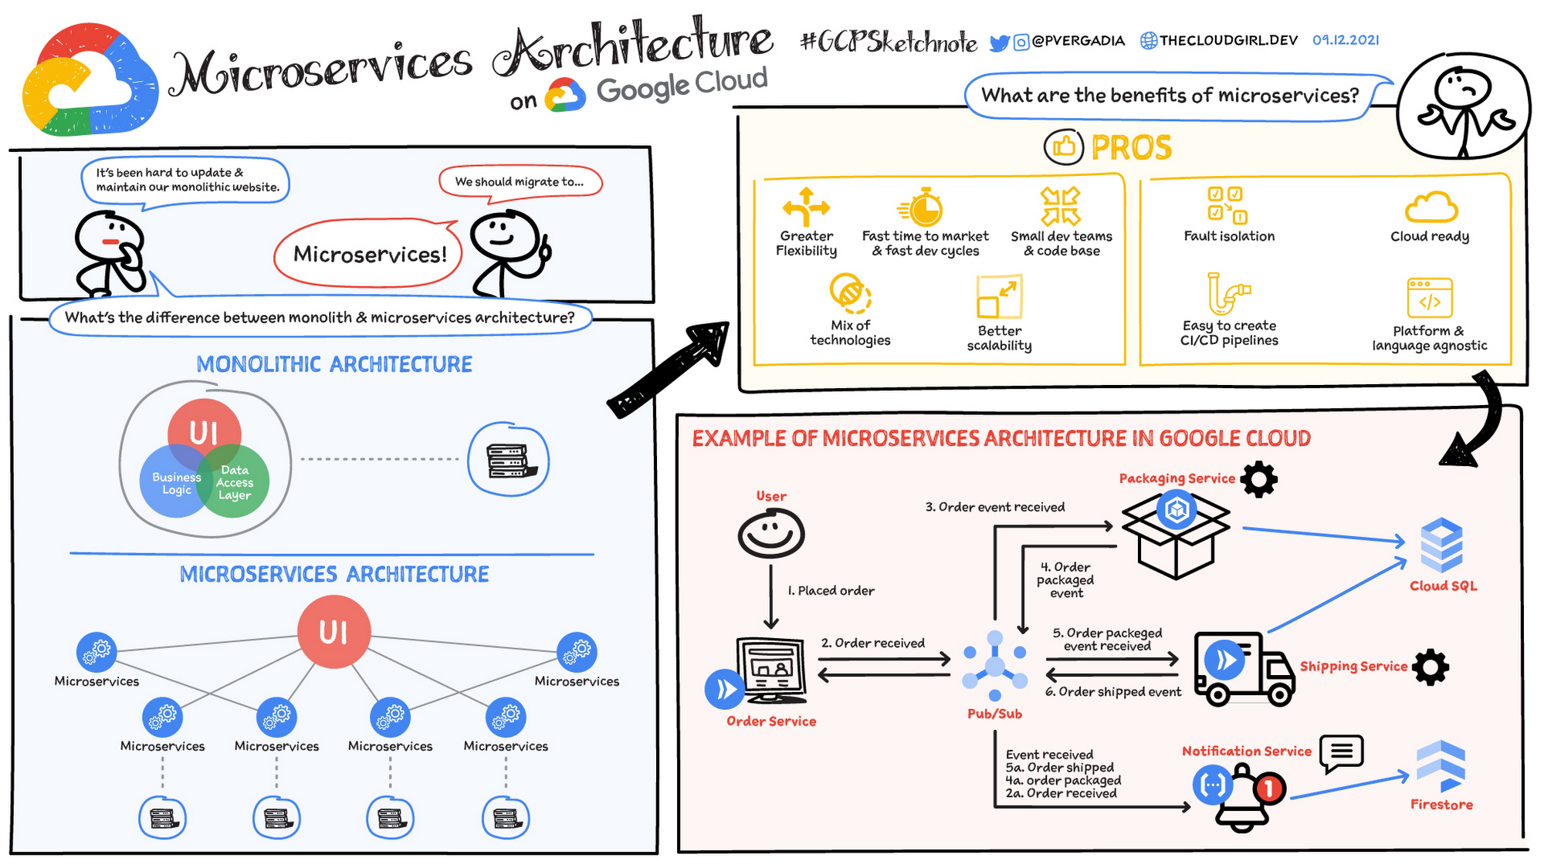
Architectural Styles
Microservices Architecture –

Slide 44
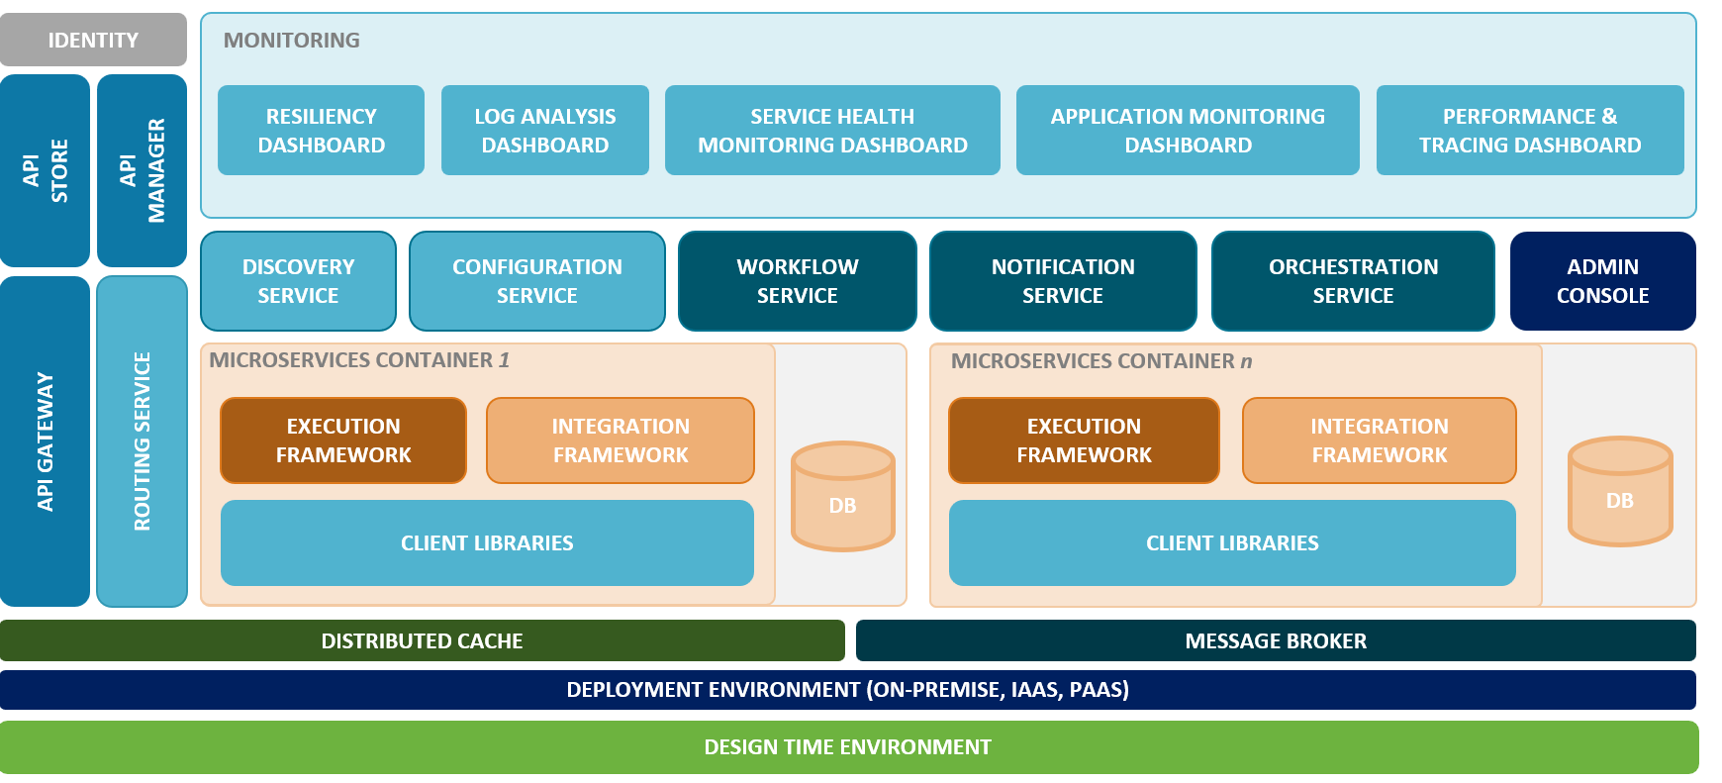
Architectural Styles
Microservices Architecture –
Reference Architecture -

Slide 45
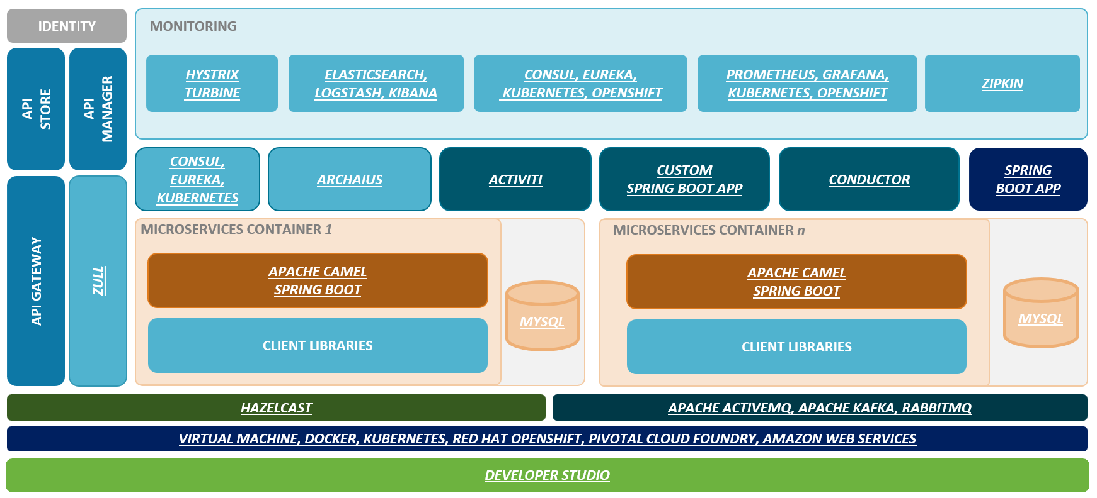
Architectural Styles
Microservices Architecture –
(Typical Java Based) Technology Architecture -
For Further Exploration –
Perfect-Roadmap-To-Learn-Java-SpringBoot-In-2024: Roadmap To Learn Java Springboot in 2024
Microservices-with-Spring-Boot-and-Spring-Cloud-Third-Edition: Microservices with Spring Boot and Spring Cloud
Practical-Microservices-Architectural-Patterns
Patterns' by Binildas Christudas
Architecture · OpenZipkin
Service Discovery with Zookeeper
Service discovery in .NET - .NET | Microsoft Learn

Slide 46
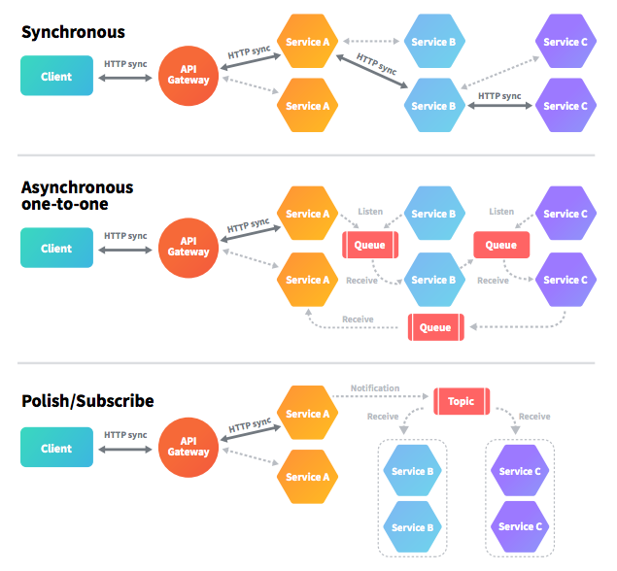
Architectural Styles
EDA(Event Driven Architecture) using Messaging –
Erratum – Polish/Subscribe above is a typo mistake. Should be Publish/Subscribe.
For Further Exploration –
Message Broker vs. Event Broker: When to Use Each One Of Them | Riskified Tech
Bytebytego on X: "IBM MQ -> RabbitMQ -> Kafka ->Pulsar,
Azure Service Bus messaging - queues, topics, and subscriptions - Azure Service Bus | Microsoft Learn
Best practices for improving performance using Azure Service Bus - Azure Service Bus | Microsoft Learn
Service Bus asynchronous messaging - Azure Service Bus | Microsoft Learn
AMQP 1.0 in Azure Service Bus and Event Hubs - Azure Service Bus | Microsoft Learn
AMQP 0-9-1 Model Explained | RabbitMQ

Slide 47
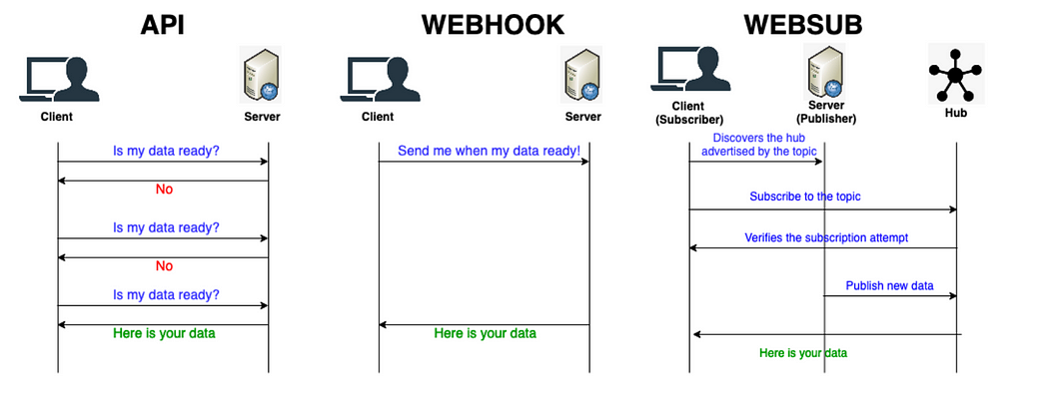
Architectural Styles
EDA(Event Driven Architecture) using WebHooks & WebSub –
Notes-
Seems, most legacy/old MQ or Service bus based approaches can be replaced by WebHooks & WebSubs respectively as part of App Modernization, to do most of the tasks in event driven way.
For Further Exploration –
Event-Driven APIs With Webhook and WebSub
ASP.NET WebHooks Succinctly

Slide 48
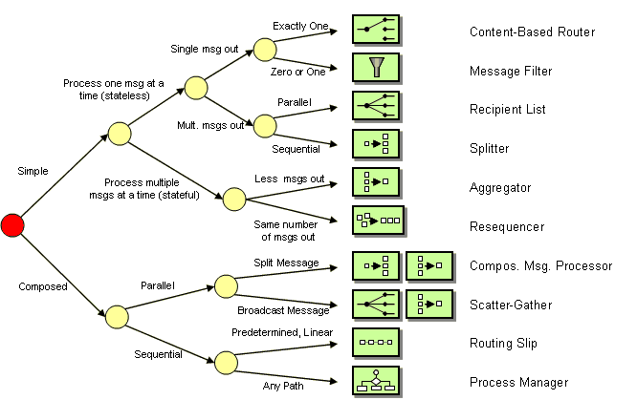
EAI(Enterprise Application Integration) Patterns -
For Further Exploration-
Enterprise Integration Patterns
Choosing a Message Exchange Pattern - WCF | Microsoft Learn
Enterprise Integration Patterns on Azure - Introduction | pacodelacruz.io
Implementing enterprise integration patterns with AWS messaging services

Slide 49
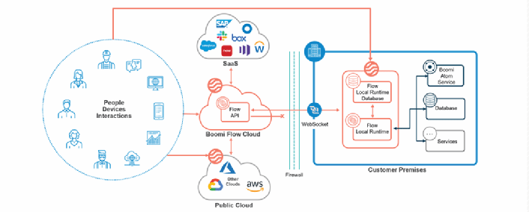
EAI(Enterprise Application Integration) Patterns -
iPaaS(Integration Platform as a Service) –
For Further Exploration –
What is iPaaS? Guide to Integration Platform as a Service

Slide 50
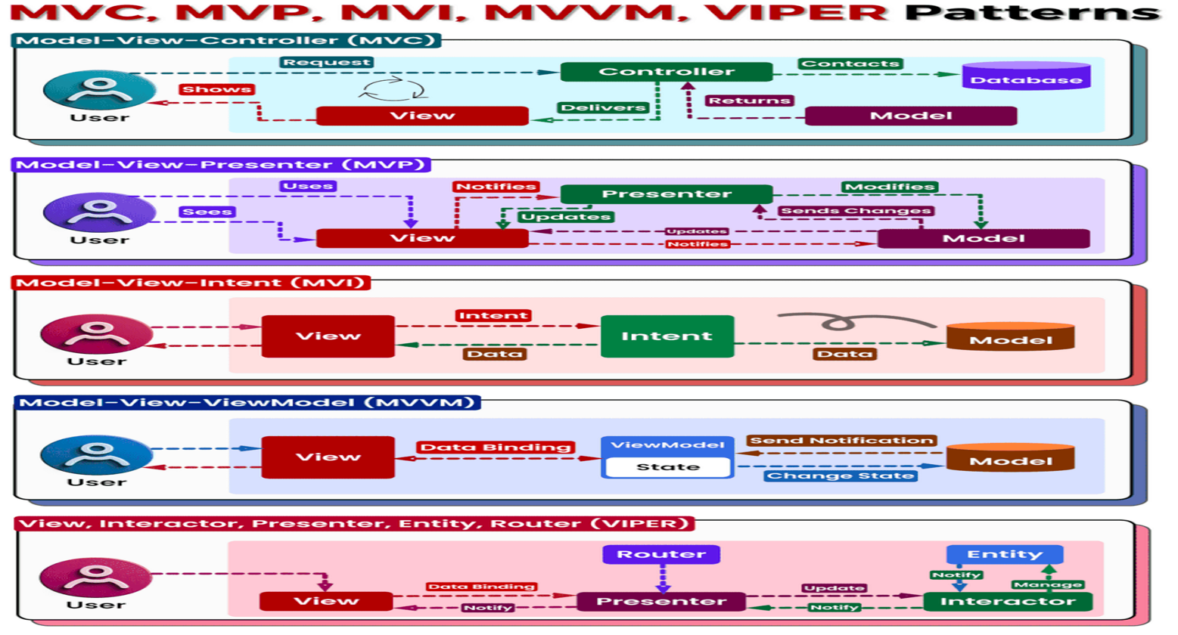
Application Architecture Patterns

Slide 51
Application Architecture Patterns
MVC vs MVP vs MVI vs MVVM vs VIPER contd… -
𝗠𝗩𝗖 (𝗠𝗼𝗱𝗲𝗹-𝗩𝗶𝗲𝘄-𝗖𝗼𝗻𝘁𝗿𝗼𝗹𝗹𝗲𝗿):
- Classic pattern separating code into three layers:
- 𝗠𝗼𝗱𝗲𝗹: Data and business logic
- 𝗩𝗶𝗲𝘄: Presentation of data to the user
- 𝗖𝗼𝗻𝘁𝗿𝗼𝗹𝗹𝗲𝗿: Handles user input and updates model/view - Simple and familiar, but can lead to tightly coupled components in complex applications.
- Can be used for normal Web based MVC Apps(e.g. ASP.NET MVC)
𝗠𝗩𝗣 (𝗠𝗼𝗱𝗲𝗹-𝗩𝗶𝗲𝘄-𝗣𝗿𝗲𝘀𝗲𝗻𝘁𝗲𝗿):
- Introduces a Presenter to mediate between view and model.
- Improves separation of concerns and testability.
- Requires additional boilerplate code compared to MVC.
- Can be used for Winforms based Apps
𝗠𝗩𝗜 (𝗠𝗼𝗱𝗲𝗹-𝗩𝗶𝗲𝘄-𝗜𝗻𝘁𝗲𝗻𝘁):
- Built for reactive programming.
- View emits intents, handled by the model, updating state and view.
- Promotes unidirectional data flow and simplifies UI logic.
- May require a steeper learning curve.
- Can be used for normal SPA based Web Apps

Slide 52
Application Architecture Patterns
MVC vs MVP vs MVI vs MVVM vs VIPER contd… -
𝗠𝗩𝗩𝗠 (𝗠𝗼𝗱𝗲𝗹-𝗩𝗶𝗲𝘄-𝗩𝗶𝗲𝘄𝗠𝗼𝗱𝗲𝗹):
- View binds to a ViewModel holding data and display logic.
- ViewModel updates by the model, then updates the view.
- Well-suited for reactive frameworks and complex UIs.
- Requires additional ViewModel setup compared to MVP.
- Can be used for WPF Apps & Mobile Native Apps
𝗩𝗜𝗣𝗘𝗥 (𝗩𝗶𝗲𝘄, 𝗜𝗻𝘁𝗲𝗿𝗮𝗰𝘁𝗼𝗿, 𝗣𝗿𝗲𝘀𝗲𝗻𝘁𝗲𝗿, 𝗘𝗻𝘁𝗶𝘁𝘆, 𝗥𝗼𝘂𝘁𝗲𝗿):
- Designed for large and complex applications.
- Five layers: View, Interactor (business logic), Presenter (data preparation), Entity (data models), Router (data flow coordination).
- Enhances modularity and maintainability for massive projects.
- Requires meticulous planning and understanding due to its complexity.
- Can be used for Real Time Web Apps(& Mobile Native Apps & Embedded Systems)

Slide 53
Application Architecture Patterns
MVC vs MVP vs MVI vs MVVM vs VIPER contd… -
𝗖𝗵𝗼𝗼𝘀𝗶𝗻𝗴 𝘁𝗵𝗲 𝗥𝗶𝗴𝗵𝘁 𝗣𝗮𝘁𝘁𝗲𝗿𝗻:
The optimal pattern depends on various factors, including:
- 𝗣𝗿𝗼𝗷𝗲𝗰𝘁 𝘀𝗶𝘇𝗲 𝗮𝗻𝗱 𝗰𝗼𝗺𝗽𝗹𝗲𝘅𝗶𝘁𝘆: MVC/MVP for simple apps, MVI/MVVM for reactive apps, VIPER for large projects.
- 𝗧𝗲𝗮𝗺 𝗲𝘅𝗽𝗲𝗿𝗶𝗲𝗻𝗰𝗲: Choose a pattern familiar to your team to avoid learning curves.
- 𝗣𝗲𝗿𝘀𝗼𝗻𝗮𝗹 𝗽𝗿𝗲𝗳𝗲𝗿𝗲𝗻𝗰𝗲: Experiment and find what works best for you and your team.
For Further Exploration-
MVVM-pattern-.NET-MAUI
Swift_VIPER_Demo: A Sample App Demoing the VIPER Architecture Pattern
The-Book-of-VIPER

Slide 54
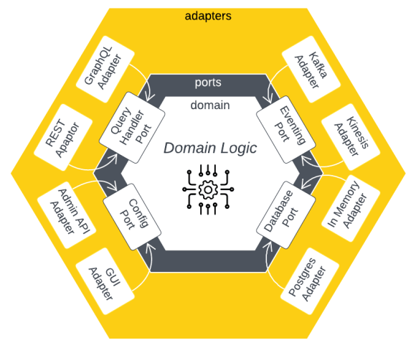
Application Architecture Patterns
Hexagonal Architecture –
For Further Exploration –
Hexagonal Architecture - Awesome Software Architecture

Slide 55
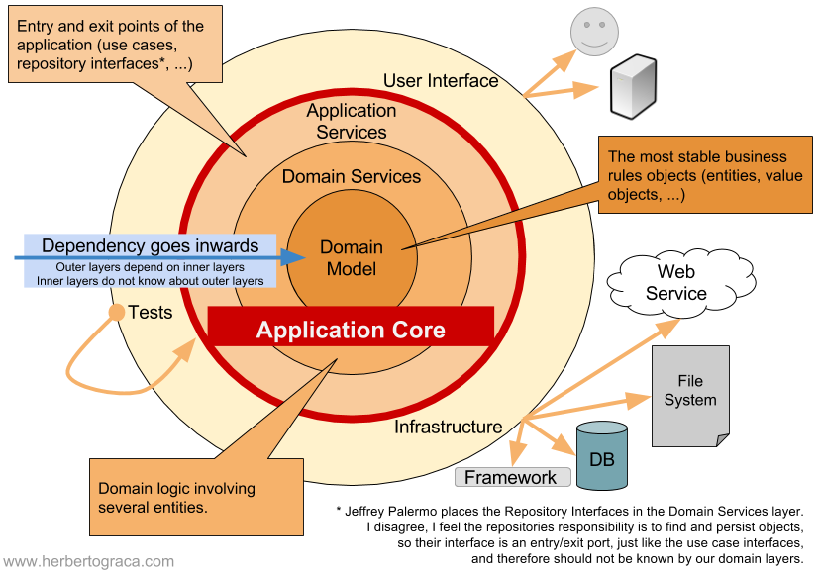
Application Architecture Patterns
Onion Architecture –
Onion Architecture adds layers to the core of Hexagonal Architecture with the rule that each layer can only depend on more central layers, and the most central layer – the domain model – only depends on itself.
For Further Exploration –
Onion Architecture - Awesome Software Architecture

Slide 56
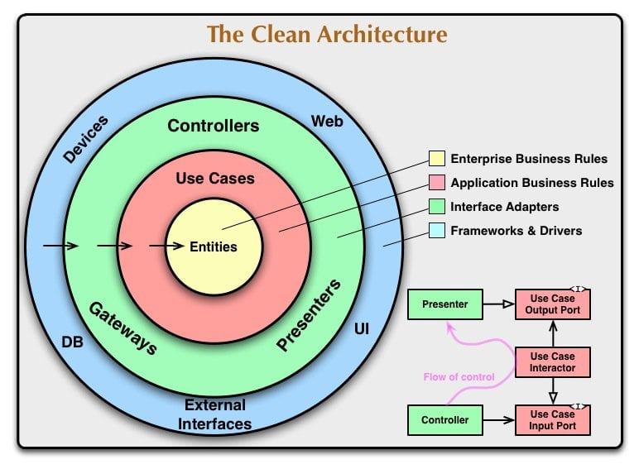
Application Architecture Patterns
Clean Architecture –
Clean Architecture almost equates Onion Architecture with some equivalent alternate names.
For Further Exploration –
Pragmatic Clean Architecture | Milan Jovanović
Clean Architecture - Awesome Software Architecture
Hexagonal vs Onion vs Clean Architecture | LinkedIn

Slide 57
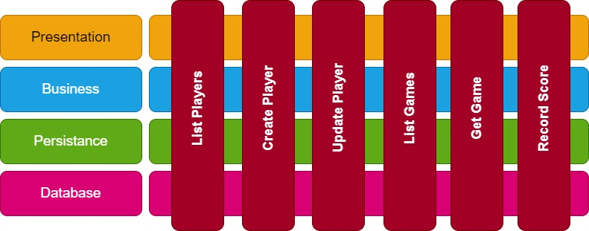
Application Architecture Patterns
Vertical Slice Architecture –
For Further Exploration –
Vertical Slice Architecture
Vertical Slice Architecture - Awesome Software Architecture

Slide 58
Application Architecture Patterns
DDD(Domain Driven Design) Concepts – 🔍 Understanding the Domain: At the heart of DDD is a deep dive into the business domain you're dealing with. It's all about comprehending the intricacies, rules, and intricacies of the problem space.
🧩 Ubiquitous Language: DDD encourages the development of a common, shared language between developers and domain experts. This shared vocabulary ensures everyone is on the same page, fostering better collaboration.
🏗️ Bounded Contexts: DDD suggests dividing complex systems into smaller, manageable "bounded contexts." These contexts have their own rules and definitions, providing a clean way to manage complexity.
📦 Aggregates and Entities: DDD promotes modeling the domain using aggregates and entities, which encapsulate business rules and ensure data integrity. This helps create maintainable and understandable code.
🛠️ Value Objects: Value objects, another DDD concept, represent immutable elements within the domain, such as currency, addresses, or date ranges. They promote simplicity and code reusability.
🌌 Repositories: Repositories provide a way to access domain objects without exposing their underlying details. They are crucial for abstracting data access.
🧬 Event-Driven Architecture: DDD aligns well with event-driven architectures, allowing systems to respond to domain events and changes.
For Further Exploration –
Understanding Domain Objects, Entities, DTOs & Models
Domain Driven Design - Awesome Software Architecture
DDD-Based-Enterprise-Application-Framework: A Domain Driven Design Based Enterprise Application Framework
Event Driven Architecture - Awesome Software Architecture

Slide 59
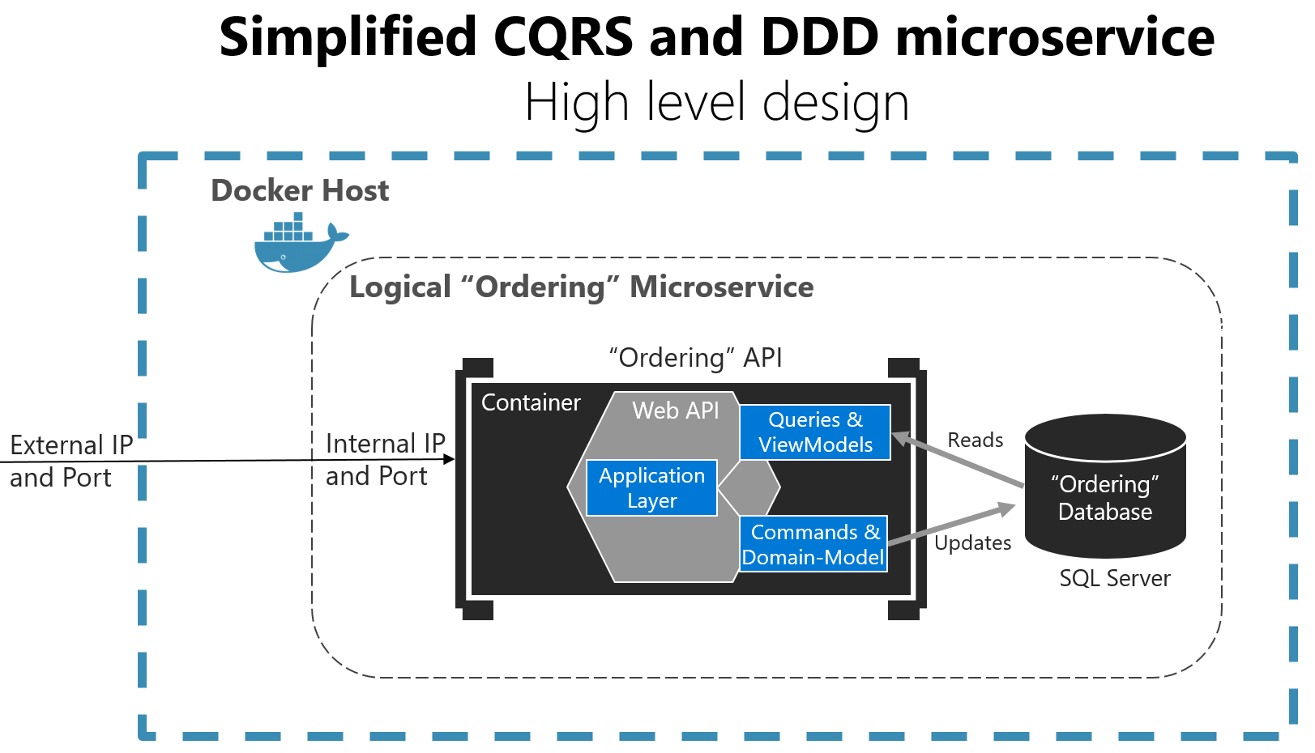
Application Architecture Patterns
CQRS(Command Query Responsibility Segregation) -
For Further Exploration –
Applying simplified CQRS and DDD patterns in a microservice - .NET | Microsoft Learn
CQRS - Awesome Software Architecture

Slide 60
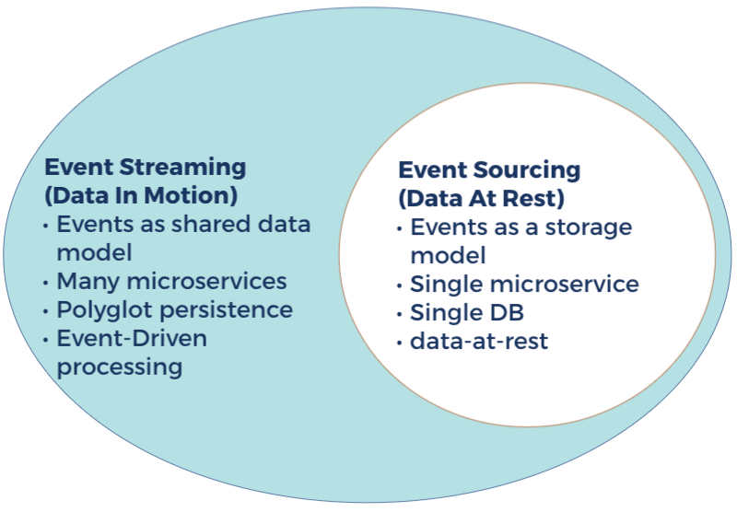
Application Architecture Patterns
Event Storming vs Event Sourcing -
For Further Exploration –
Event Storming - Awesome Software Architecture
Event Sourcing - Awesome Software Architecture

Slide 61
Application Architecture Patterns
For Further Exploration(some are legacy/old patterns though) –
Catalog of Patterns of Enterprise Application Architecture
Martin Fowler: eaaDev
Core J2EE Patterns
.NET application architecture guides | .NET

Slide 62
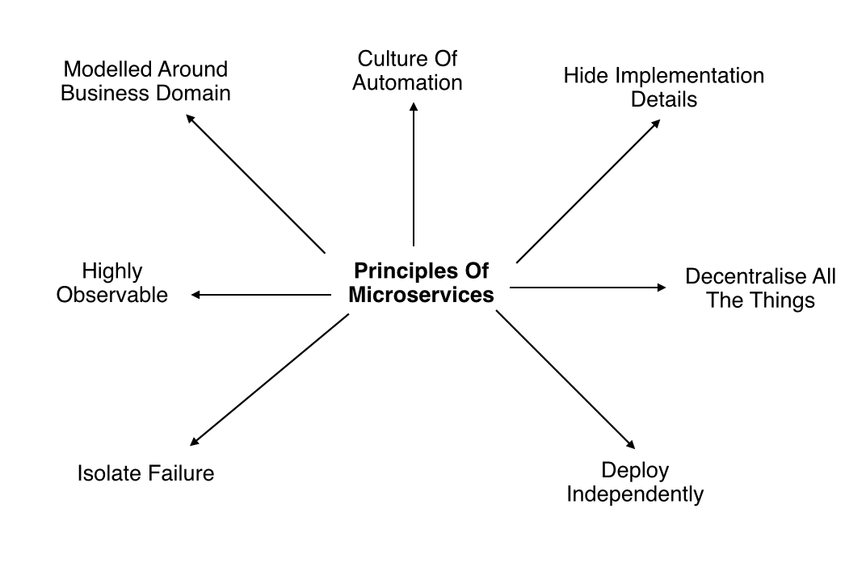
Microservices Architecture – A bit more in depth
For Further Exploration –
Microservices - Awesome Software Architecture
Microservices vs APIs - Difference Between Modular Software Design Approaches - AWS
Microservices vs Service-Oriented Architecture by Mark Richards | Goodreads

Slide 63
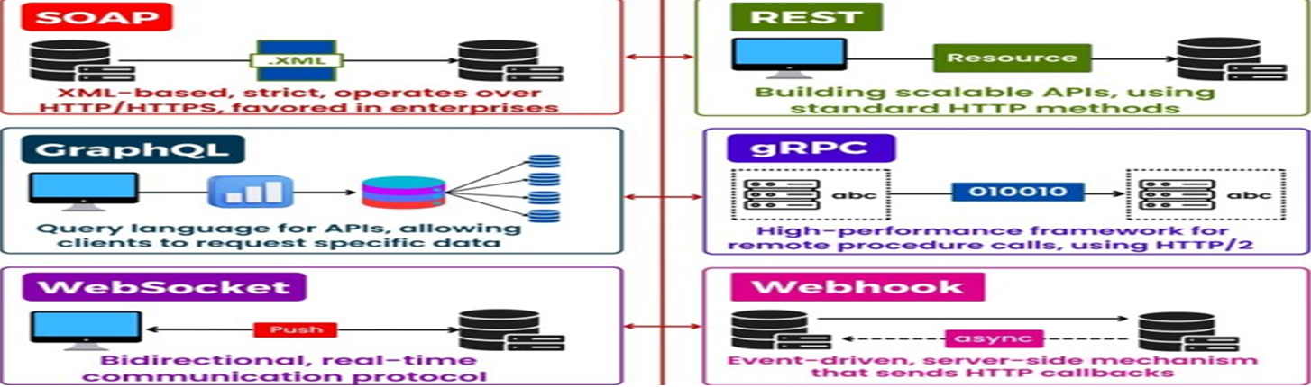
Microservices Architecture – A bit more in depth
API Styles –

Slide 64
Microservices Architecture – A bit more in depth
API Styles –
For Further Exploration –
HTTP Requests, body vs param vs headers vs data - Stack Overflow
API Design Roadmap
Patterns for API Design
Functional Error Handling in .NET With the Result Pattern
Mastering API Architecture[Book]
API Guidelines in the Wild | API Guidelines
REPR Pattern - For C# developers | TheCodeMan
Api-Design-Patterns-Notes
Simone Chiaretta’s ASP.NET Books | Syncfusion
JSON Web Tokens - jwt.io
Refit
Generate Refit interfaces from OpenAPI specifications using Refitter
Refit Client using a dynamic base address - Stack Overflow
Richardson Maturity Model
Implementing HATEOAS in ASP.NET Core Web API - Code Maze
Difference Between Streaming and Downloading
What is http multipart request? - Stack Overflow

Slide 65
Microservices Architecture – A bit more in depth
API Styles –
For Further Exploration contd… –
How to upload file to server with HTTP POST multipart/form-data
Multipart Downloading in C#? - Stack Overflow
GraphQL Roadmap
When to use GraphQL, gRPC, and REST?
Comparing GraphQL and OData: Which is Best and When
GraphQL & Under/Over Fetching Problems | LinkedIn
Building Microservices Architecture Using GraphQL and ASP.NET 7 Core
Overview - Hot Chocolate v13 - ChilliCream GraphQL Platform
Rest vs gRPC LinkedIn
How to build gRPC applications in ASP.NET Core | InfoWorld
Microservices Communication in .NET Using gRPC
Enterprise API Management | Web Development | Print
API Management: An Architect's Guide to Developing and Managing APIs for Your Organization | SpringerLink
DFE-Digital/eapim-platform-api

Slide 66
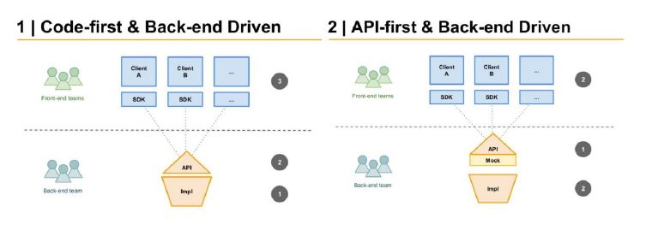
Microservices Architecture – A bit more in depth
OpenAPI – You can write an OpenAPI(Swagger) specification & generate the code in your choice of language. This is called Contract(/API) First Development. Things can be done other way around as well.
For Further Exploration –
Contract-First API Development with OpenAPI Generator and Connexion | by Anıl Can Aydın | Commencis | Medium
OpenAPI.Tools - an Open Source list of great tools for OpenAPI.
Contract Testing in Action
Swashbuckle.Examples: Adds the [SwaggerRequestExample] and [SwaggerResponseExample] attributes to Swashbuckle
NSwag: The Swagger/OpenAPI toolchain for .NET, ASP.NET Core and TypeScript.
Documenting GraphQL APIs with Swagger - GeeksforGeeks

Slide 67
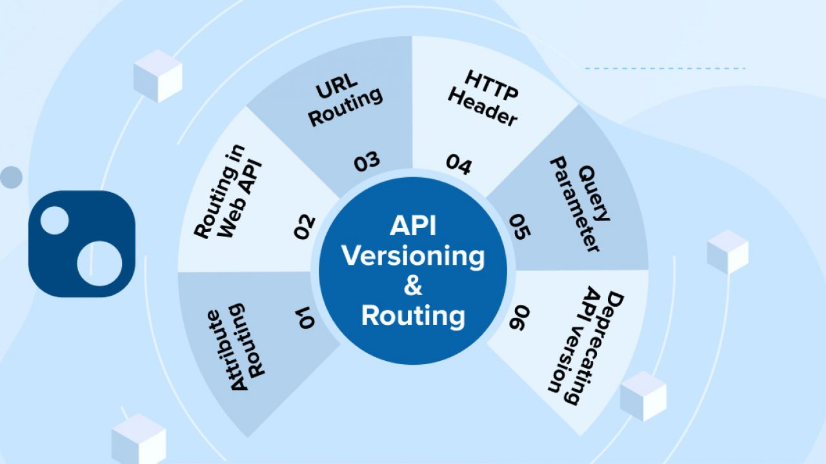
Microservices Architecture – A bit more in depth
Evolution/Versioning(App Level using ASP.NET Web API) -
The #1 rule w.r.t API versioning is not to use versions in API until & unless you really need it.In some projects there can be a mandate that the API should have v1(the default version) within the API even if they don’t forsee that going forward further API versions will be required. That’s also kind of a best practice since most APIs evolve.
For Further Exploration –
Different Methods of API Versioning & Routing in ASP.Net Core - TatvaSoft Blog
API Versioning Strategies | LinkedIn
API Versioning Approach With AWS API Gateway

Slide 68
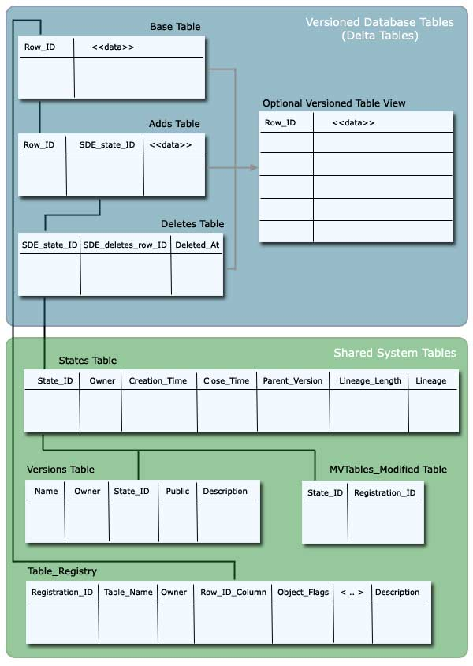
Microservices Architecture – A bit more in depth
Evolution/Versioning(Schema Versioning) -

Slide 69
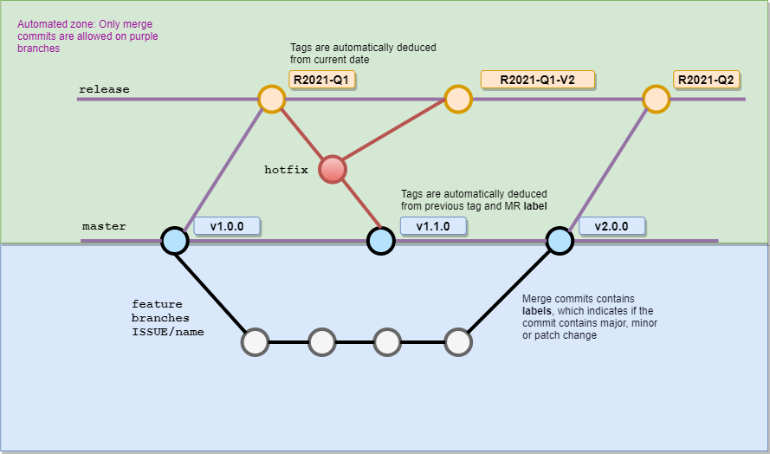
Microservices Architecture – A bit more in depth
Evolution/Versioning(Build Level) –

Slide 70
Microservices Architecture – A bit more in depth
Idempotency –
An example – Say a UI page button click calls an API. What if the user clicks the button twice? One solution can be to disable the button in the UI once clicked & keeping the button disabled until & unless the request completes. But then what if javascript is disabled? A better & more robust solution is to have server side idempotency based handling alongwith the client side handling.
For Further Exploration
Idempotence in HTTP Methods – Explained with CRUD Examples
Ways to Achieve Idempotency | LinkedIn
Idempotency and ordering in event-driven systems
Azure Service Bus duplicate message detection - Azure Service Bus

Slide 71
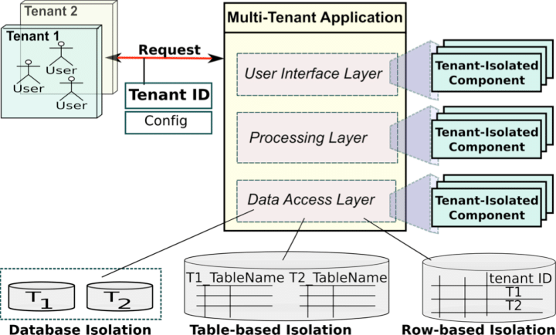
Microservices Architecture – A bit more in depth
Application Multitenancy -
For Further Exploration -
Inevitability of Multi-Tenancy & SAAS in Product Engineering | prashanthpanduranga
ASP.NET Multitenant Applications Succinctly
Building Multi-Tenant SaaS Architectures: Principles, Practices, and Patterns Using AWS
Commercial-Marketplace-Client-Dotne

Slide 72
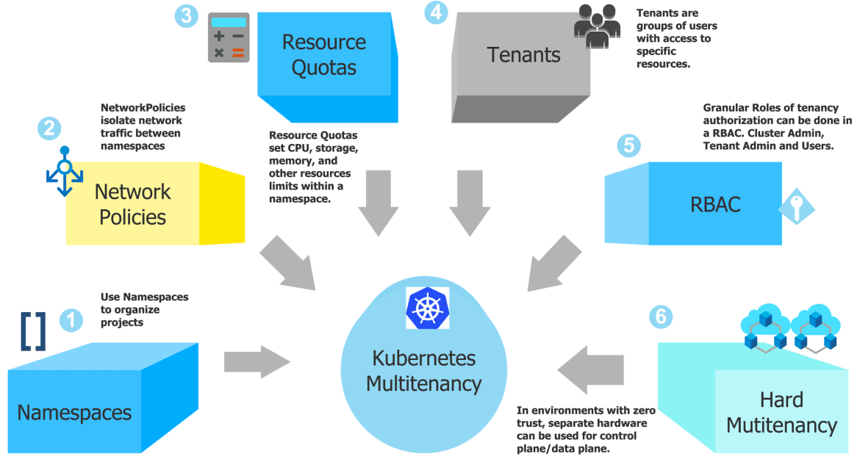
Microservices Architecture – A bit more in depth
Microservices Architecture – A bit more in depth
Infrastructure Multitenancy(using K8s) -
For Further Exploration –
Kubernetes Multi-tenancy Best Practices & Architecture Model..(2/2) - Vamsi Talks Tech
Multi-tenancy | Kubernetes
Multi-tenancy in Kubernetes: implementation and optimization | CNCF

Slide 73
Microservices Architecture – A bit more in depth
Monolith to Microservices Migration –
For Further Exploration –
Refactor a monolith into microservices | Cloud Architecture Center | Google Cloud
Monolith to Microservices — Migration patters | by Priyal Walpita | Medium

Slide 74
Microservices Architecture – A bit more in depth
Service Mesh
What is a service mesh ?
A service mesh is an infrastructure layer that transparently manages service-to-service communication for microservices. It provides traffic management, security (zero-trust / mTLS), observability (metrics/traces/logs), and policy enforcement without changing application code. Typical architecture splits responsibilities into a data plane (proxies that handle actual traffic) and a control plane (configures those proxies).
Core architecture & building blocks
1. Data plane
Usually implemented by sidecar proxies (one proxy per service instance/pod) that intercept all inbound/outbound traffic and apply routing, retries, timeouts, circuit breakers, telemetry, and security controls. Envoy is the most common sidecar proxy.
2. Control plane
Centralized components that translate high-level policies (traffic rules, security, telemetry sampling) into low-level configuration for the proxies and distribute it dynamically (via xDS or similar APIs). Istio, Linkerd, Consul, Kuma, Open Service Mesh are examples of control planes.
3. Gateways / Ingress/Egress
Specialized proxies that handle traffic entering or leaving the mesh (TLS termination, external routing, ingress policies). They are often Envoy or an API gateway integrated with the mesh.
4. Service identity & CA
The mesh issues identities/certificates (short-lived) to workloads and enforces mTLS between proxies for confidentiality and authentication.

Slide 75
Microservices Architecture – A bit more in depth
Service Mesh
Core architecture & building blocks
5. Observability pipeline
The data plane emits metrics, logs, and traces to collectors (Prometheus, Jaeger/Tempo, Fluentd/Vector). The control plane often provides telemetry adapters and sampling controls.
Main features / capabilities (with patterns)
Traffic management & routing
Layer-7 routing (host/path/headers): route requests to specific versions or subsets.
Traffic splitting for canary, A/B testing (percentage-based).
Request mirroring (shadowing) for testing without impacting production.
Retries, timeouts, and circuit breakers for resiliency.
Load balancing strategies: round robin, least request, ring/hash, locality aware. Envoy implements many of these.
Patterns: blue/green, canary, staged rollouts (percentage splits), A/B testing, shadowing, traffic shaping.
Resiliency
Circuit breaker pattern (open/half-open/closed) to prevent cascading failures.
Bulkhead (isolate failures by service or instance).
Retries with backoff and timeouts to avoid resource contention.
Fault injection for chaos testing (delay, abort responses).
Security
mTLS between proxies to provide encryption and workload identity.

Slide 76
Microservices Architecture – A bit more in depth
Service Mesh
Core architecture & building blocks
Main features / capabilities (with patterns)
Security
Authentication & Authorization policies (RBAC, JWT/OAuth integration, OIDC).
Service identity lifecycle using a mesh CA or external CA (short-lived certs).
Fine-grained access control (who can call which service/method).
Observability & Telemetry
Metrics (per route/service latency, success rates, bytes).
Distributed tracing (context propagation, traces per request).
Structured logging and request/response captures for debugging.
SLA/SLI monitoring derived from service metrics. Envoy and meshes emit detailed L7 telemetry.
Policy and configuration
Centralized policies for rate limiting, quotas, retries, timeouts, auth.
Policy enforcement can be done in control plane or via WebAssembly filters in proxies.
Admission/sidecar injection mechanisms in Kubernetes to deploy proxies next to workloads automatically.
Service discovery & identity
The mesh integrates with service discovery (Kubernetes API, Consul, DNS) to map logical service names to endpoints.
Identity provisioning ties service identity to the underlying platform (pod identity, VM identity).

Slide 77
Microservices Architecture – A bit more in depth
Service Mesh
Core architecture & building blocks
Common technologies / projects (short overview)
Envoy — high-performance L7 proxy used as the default data plane for many meshes.
Istio — popular, feature-rich control plane that uses Envoy sidecars. Strong in policy, telemetry, and traffic management.
Linkerd — lightweight service mesh focusing on simplicity and performance; uses its own proxy (Rust/Go versions historically).
Cilium — eBPF-based data plane that can implement mesh capabilities at kernel level (agentless or hybrid), avoiding sidecar overhead in some deployments.
Open Service Mesh (OSM) — CNCF project implementing SMI; lightweight.
Open Service Mesh
SMI (Service Mesh Interface) — a Kubernetes API specification that provides a standard, provider-agnostic interface for traffic, metrics, and policies. Useful for interoperability.
Commercial/managed: AWS App Mesh, Kong Mesh, Tetrate, Solo.io’s Gloo Mesh, etc. (they build on Envoy/Istio/Cilium variants).
Deployment models & alternatives
Sidecar model (classic)
Pros: full L7 visibility and control; feature-rich (routing, headers, tracing).
Cons: resource overhead (one proxy per pod), complexity in operations.

Slide 78
Microservices Architecture – A bit more in depth
Service Mesh
Deployment models & alternatives
Gateway + sidecar (hybrid)
Use gateway proxies for north/south traffic and sidecars for east/west.
eBPF / kernel-level mesh (Cilium)
Implements packet interception in kernel (via eBPF), reducing per-pod sidecar overhead and sometimes improving performance and simplicity for L3/L4 and some L7 features. Trades off some L7 flexibility compared to full Envoy sidecar.
VM & multi-platform support
Meshes support VMs by running proxies on VMs and joining them to the mesh; useful for hybrid cloud or legacy workloads.
Multi-cluster / multi-mesh
Patterns for multi-cluster include: federation, gateway peering, service replication, global control plane vs per-cluster control plane. These add complexity in identity and routing.
Design patterns & anti-patterns (practical)
Use-cases & patterns
Progressive delivery — canary / percentage-based traffic splitting + health checks + rollback. (Traffic management + observability)
Fault isolation — circuit breakers + bulkheads to prevent cascading failure.
Service authorization — zero-trust: mTLS for authn and RBAC/ABAC in the control plane for authz.
Multi-tenant isolation — network policies + namespace scoping + policies per tenant.

Slide 79
Microservices Architecture – A bit more in depth
Service Mesh
Design patterns & anti-patterns (practical)
Use-cases & patterns
Observability-first design — inject tracing and metrics at the proxy level to instrument apps without code change.
Policy as code — express access/network policies declaratively in the control plane and version them.
Anti-patterns
"Mesh everything" immediately — don’t flip the switch for all services; adopt incrementally starting with a few critical services.
Heavy-handed policies — applying global strict retries/timeouts without tuning can worsen latency or amplify load.
Ignoring the data plane cost — sidecars increase CPU/memory; evaluate eBPF or lightweight proxies if overhead matters.
Treating mesh as a silver bullet — it solves many cross-cutting concerns, but adds complexity and operational overhead.
Practical operational concerns
Performance & resource use
Sidecars add CPU/memory overhead; measure latency and resource usage during rollout.
Use explicit L7 vs L4 needs to decide proxy and features (full Envoy vs simpler proxies).

Slide 80
Microservices Architecture – A bit more in depth
Service Mesh
Practical operational concerns
Upgrades & compatibility
Control plane upgrades must be coordinated with proxy versions; use canaries for mesh upgrades themselves.
Observability pipelines
Ensure sampling and metric aggregation are tuned to avoid overwhelming collectors.
Use correlation IDs / trace context — the mesh can propagate these automatically.
Security
Short-lived certificates, automated rotation, and proper trust anchors are essential.
Plan for CA compromise scenarios (rotation, revocation).
Policy management & compliance
Keep policy definitions in git (GitOps) and validate with conformance tools (Meshery, SMI conformance).
When to adopt a service mesh — quick checklist
Adopt a mesh when you have:
Many microservices with complex communication patterns.
Need for consistent security (mTLS) and identity.
Requirements for advanced traffic control (canary, blue/green).
Need for centralized telemetry for SLIs/SLOs.

Slide 81
Microservices Architecture – A bit more in depth
Service Mesh
When to adopt a service mesh — quick checklist
Avoid if:
You have a tiny set of services (added complexity not worth it).
Strict resource constraints where sidecar overhead is unacceptable (consider eBPF or selective injection).
Example: progressive delivery flow using a mesh (concrete)
Deploy sidecar to service A (v1) and B (v1).
Deploy B v2 alongside v1.
Use control plane rule to split 90/10 traffic to v1/v2.
Monitor success rate and latency via mesh telemetry.
If OK, gradually shift percentages to 100%; if not, rollback by changing traffic split.
Use request mirroring to test B v2 with real traffic before switching.
Standards & interoperability
SMI (Service Mesh Interface) provides a common set of APIs for traffic spec, telemetry and policies so apps can be portable across meshes. Use it to avoid vendor lock-in where possible.
Emerging trends
eBPF-based meshes reducing or eliminating sidecars (Cilium, Isovalent).
WASM filters in proxies for custom logic without rebuilding proxies.
Service mesh for non-Kubernetes environments and unified meshes across VMs and Kubernetes clusters.
Policy federation and multi-mesh control planes for global governance.

Slide 82
Microservices Architecture – A bit more in depth
Service Mesh
Emerging trends
Quick list of useful references (official docs)
Istio architecture & traffic management (control/data plane concepts): Istio docs.
Envoy proxy (data plane capabilities): Envoy docs.
Cilium eBPF service mesh overview: Cilium docs.
SMI (Service Mesh Interface) spec & GitHub: SMI site and repo.
Meshery / SMI conformance: Layer5 / Meshery pages.
Practical advice
Start small: pick a pilot team/service, enable sidecar, validate traffic management and telemetry.
Choose tooling by priorities: Istio for features & policy, Linkerd for simplicity & performance, Cilium if you want minimal sidecar overhead or kernel-level enforcement.
Use GitOps for mesh configuration, tune sampling & resource use, and treat the mesh as an operational component that needs testing and upgrades.

Slide 83
Well Architected Framework & Runtime NFRs
Service Mesh
For Further Exploration
What is a Service Mesh? | Definition from TechTarget
Microservice Service Discovery: Service Mesh vs API Gateway Explained
How to implement security for microservices
Kubernetes-Service-Mesh-with-Istio
Service Mesh Interface Conformance with Meshery · Actions · GitHub Marketplace · GitHub
The Enterprise Path to Service Mesh Architectures (2nd Edition)
Service Mesh Patterns | Service Mesh Patterns
Service Mesh in Microservices | Feed | LinkedIn
What Is Istio? | Google Cloud
Istio Succinctly
Istio
Mastering-Service-Mesh: Mastering Service Mesh, published by Packt
Mastering-Service-Mesh-Architecture
Bootstrap-Service-Mesh-Implementations-with-Istio

Slide 84
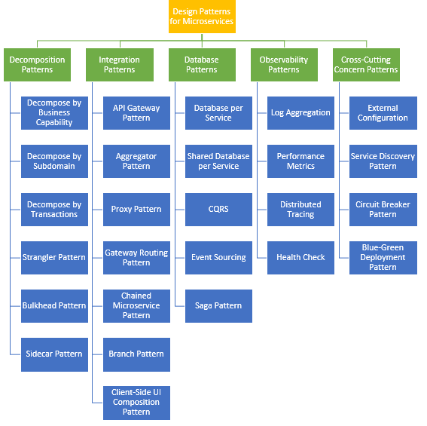
Microservices(& Cloud) Architecture Patterns
Microservices Architecture Patterns –
Cloud Architecture Patterns –
Cloud-design-patterns

Slide 85
Microservices(& Cloud) Architecture Patterns
For Further Exploration –
A pattern language for microservices
SOA: Patterns
Microservices with Netflix OSS, Spring Boot, and non-JVM applications
Ribbon
Kubernetes Components | Kubernetes
Services, Load Balancing, and Networking | Kubernetes
Service Discovery in Microservices with C# and .NET | LinkedIn
.NET Microservices with Steeltoe | Microsoft Learn
Resilient Microservices with Steeltoe
Fan-out/fan-in scenarios in Durable Functions - Azure | Microsoft Learn
Design Patterns for Cloud Native Applications[Book]
Design Patterns used Across Various Software Layers | LinkedIn
Cloud Native Architecture and Design: A Handbook for Modern Day Architecture and Design with Enterprise-Grade Examples | SpringerLink
Microservices And Orchestration Lessons | LinkedIn

Slide 86
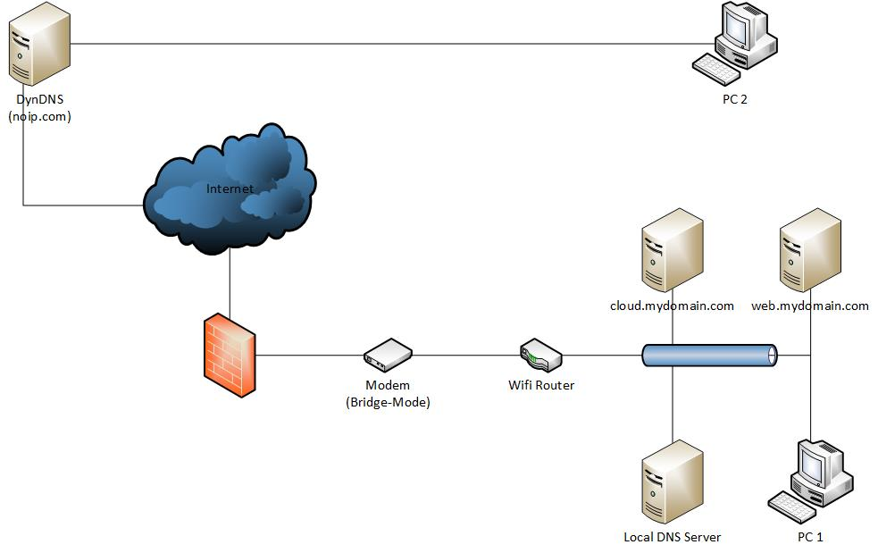
System Design(a.k.a Distributed Systems) Basics
DNS –

Slide 87
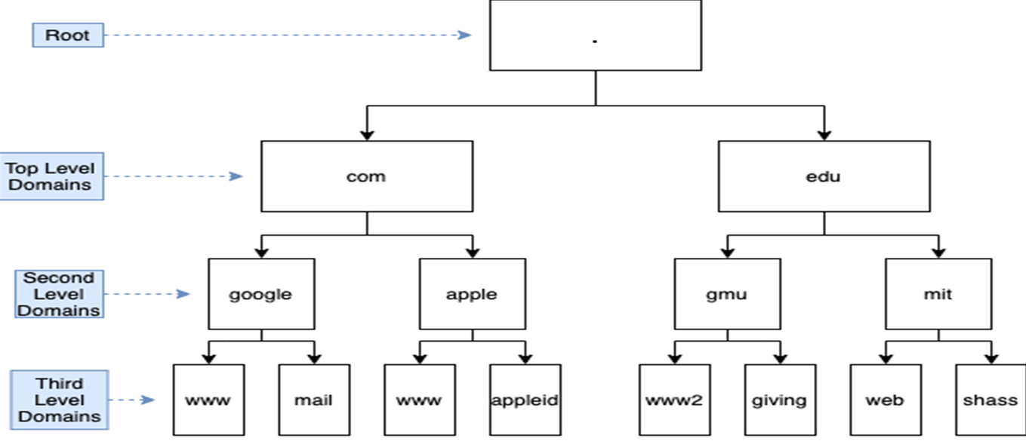
System Design(a.k.a Distributed Systems) Basics
DNS –
Hierarchy -

Slide 88
System Design(a.k.a Distributed Systems) Basics
DNS -
For Further Exploration –
Local DNS – i.e. via Host File(c# - How do i change the hosts file in a windows program? - Stack Overflow)
Hierarchical DNS(using physical servers) –
Introduction to Domain Name System (DNS)
How the Domain Name System Works
DNS Resolution – How the internet find its way | LinkedIn

Slide 89
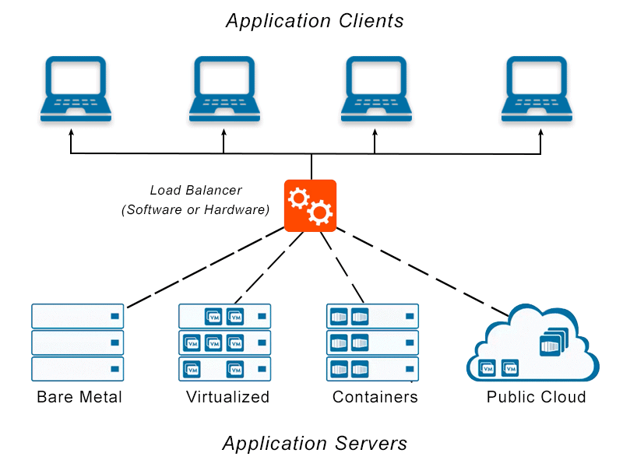
System Design(a.k.a Distributed Systems) Basics
Load Balancer–

Slide 90
System Design(a.k.a Distributed Systems) Basics
Load Balancer (Types)–
LB Type | Layer(s) | Feature(s) | Use Case(s)
GLB(Global Load Balancer) | Layer 3 | Multi-Region: Allows for global load balancing across multiple Cloud Regions. DNS-Based: GLB primarily relies on DNS for routing decisions. Failover and Latency-Based Routing: GLB solutions often use these techniques for resilience and performance optimization. | — GLB is used to distribute traffic across multiple Cloud Regions or data centers to achieve global redundancy and disaster recovery. — It involves configuring DNS-based solutions with failover policies and latency-based routing to direct traffic to the nearest healthy endpoint.
ALB(Application Load Balancer) | Layer 7 | SSL Termination: ALB can terminate SSL/TLS connections from clients, offloading SSL processing from backend servers. Health Checks: Supports health checks at the application layer. Sticky Sessions: Provides support for sticky sessions. WebSockets: Supports WebSocket traffic. HTTP/2: Supports HTTP/2, providing better performance for modern web applications. | — Best suited for routing HTTP and HTTPS traffic. — Ideal for load balancing multiple applications or microservices on a single port, as it supports content-based routing and can route requests to different target groups based on URL paths or hostnames. — Provides advanced features like host-based routing, path-based routing, and support for container-based applications.

Slide 91
System Design(a.k.a Distributed Systems) Basics
Load Balancer (Types) contd …–
LB Type | Layer(s) | Feature(s) | Use Case(s)
NLB(Network Load Balancer) | Layer 4 | High Throughput: NLB is designed for high throughput and low-latency use cases. TLS Termination: NLB supports TLS termination, but it’s not as feature-rich as ALB in handling HTTPS traffic. Health Checks: Supports health checks at the transport layer. | — Ideal for handling TCP/UDP traffic, including custom protocols, non-HTTP protocols, and high-performance workloads. — Commonly used for load balancing databases, gaming applications, and other services that rely on raw transport layer connections. — Works well for scenarios where source IP preservation is important.

Slide 92
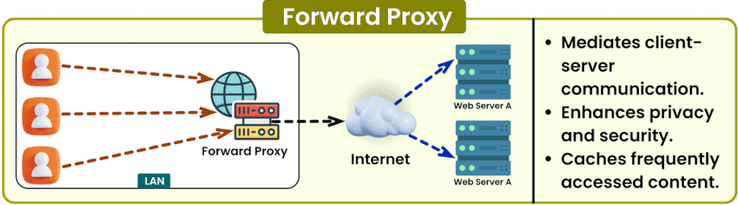
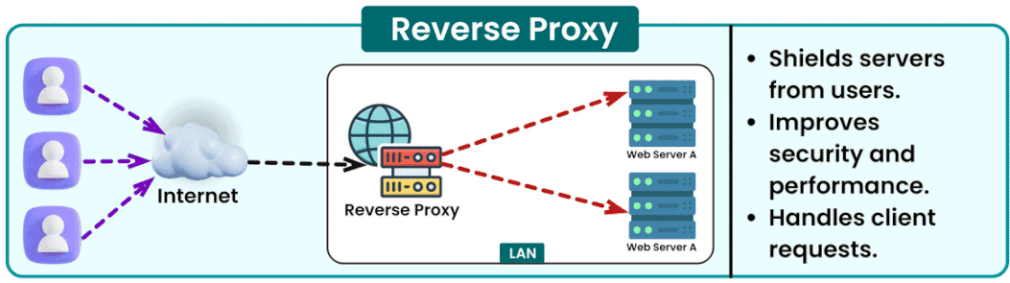
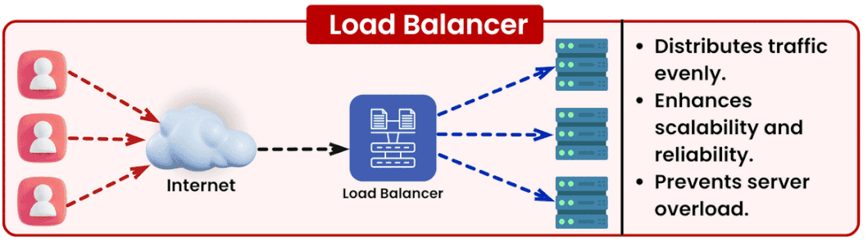
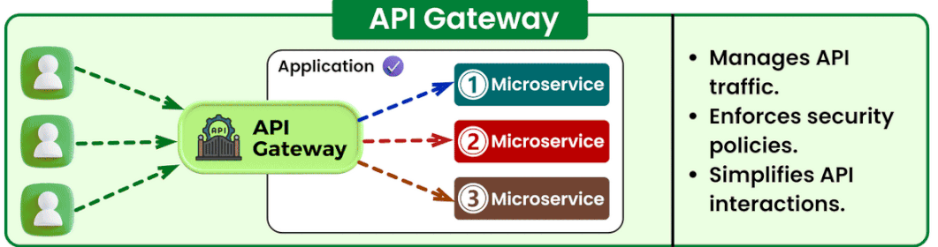
System Design(a.k.a Distributed Systems) Basics
Forward Proxy vs Reverse Proxy (vs Load Balancer vs API Gateway)–

Slide 93
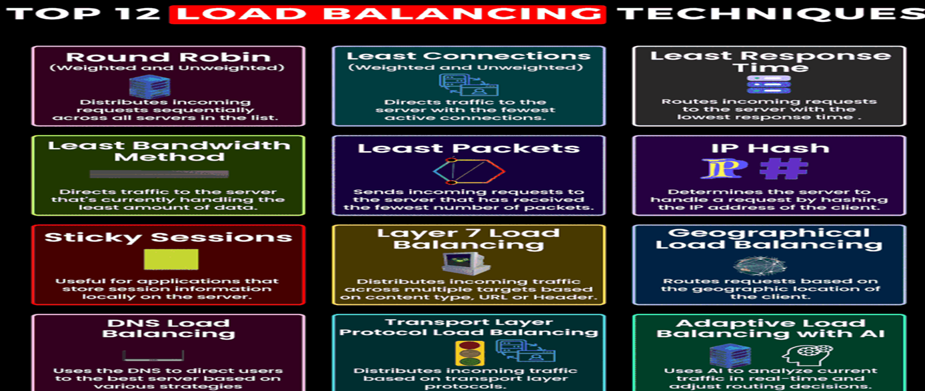
System Design(a.k.a Distributed Systems) Basics
Load Balancing Techniques –
For Further Exploration –
Top 12 Load Balancing Techniques to keep on your Radar | LinkedIn

Slide 94
System Design(a.k.a Distributed Systems) Basics
For Further Exploration –
Load Balancers –
Introduction to Load Balancers
Load Balancer Types –
Load Balancer Choices | SystemsArchitect.io
Load Balancer Sticky Session(/Session Affinity) –
What is Session Stickiness | Pros and Cons of Using Session Cookies | Imperva
Forward Proxy & Reverse Proxy –
Forward and Reverse Proxy in System Design
A Deep Dive into YARP and Ocelot: Your Gateway to API Gateways (e.g. can be used to build a Payment Gateway[PCI-DSS Compliant PCI Proxy])
Service-Fabric-Yarp
Zuul

Slide 95
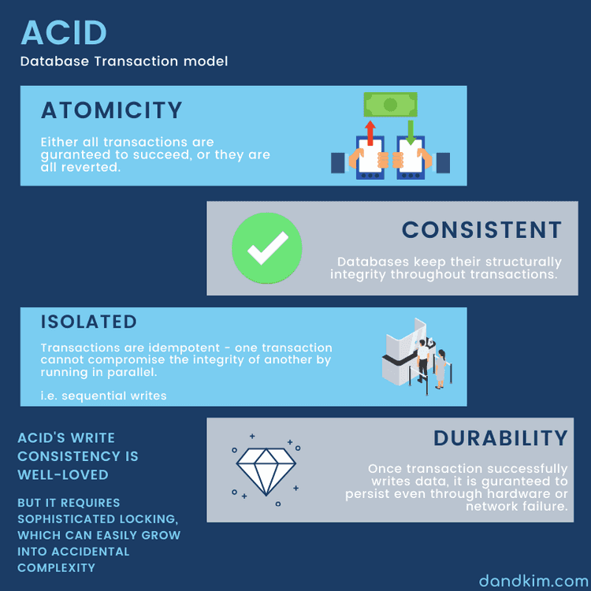
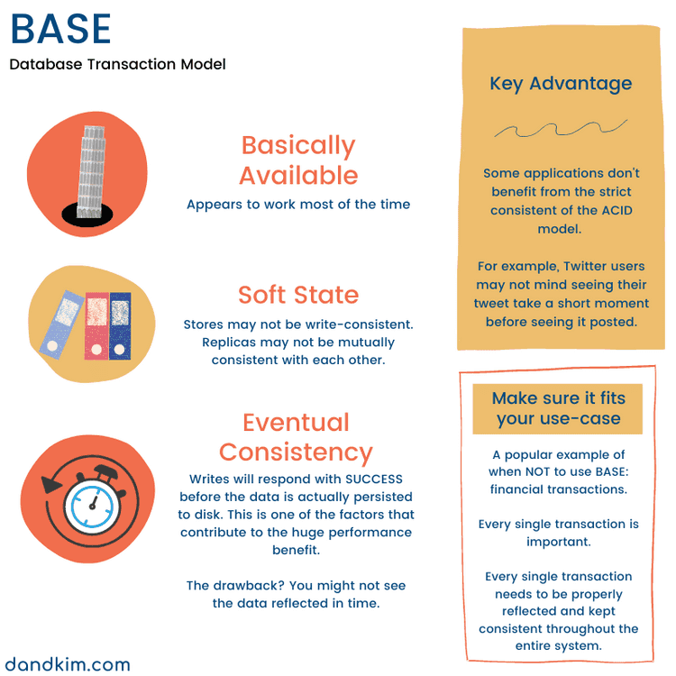
System Design(a.k.a Distributed Systems) Basics
Transactions –

Slide 96
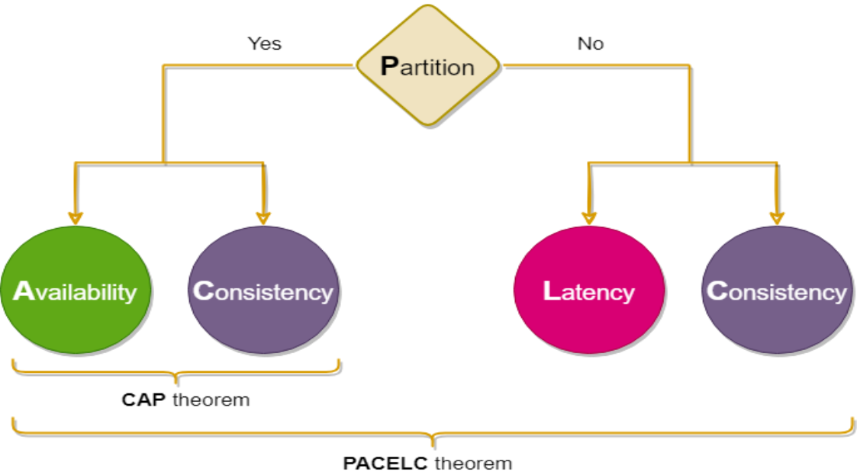
System Design(a.k.a Distributed Systems) Basics
Transactions –
PACELC Theorem(extension of CAP Theorem) –

Slide 97
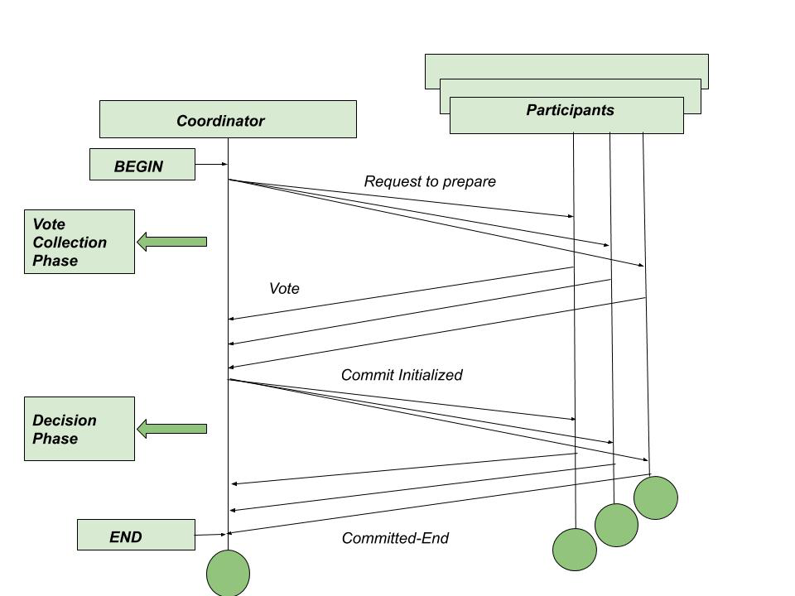
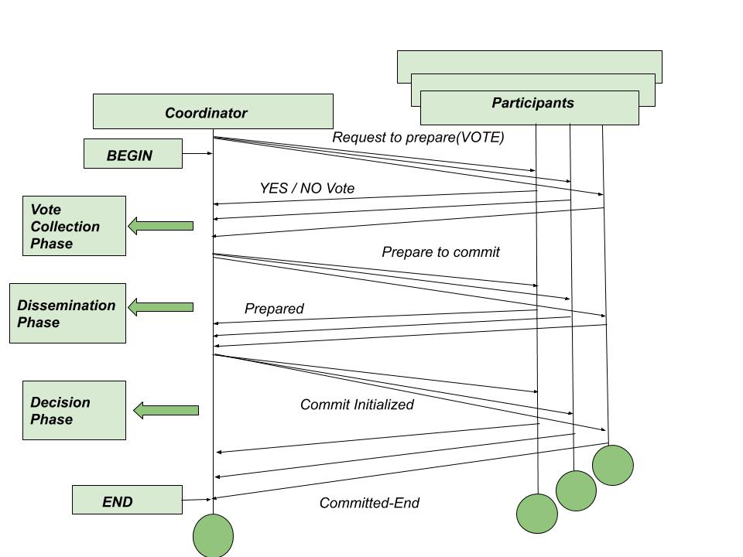
System Design(a.k.a Distributed Systems) Basics
Transactions –
Synchronous Transaction using 2PC(/3PC) -
An example here can be Same Bank Account Transfer.

Slide 98
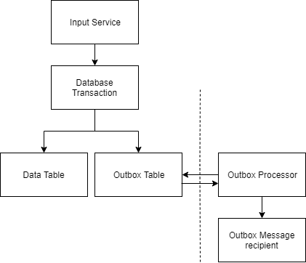
System Design(a.k.a Distributed Systems) Basics
Transactions –
Asynchronous Transactions (Outbox[/Inbox] Pattern - Keep an audit of all egress[/ingress] transactional data in DB)-

Slide 99
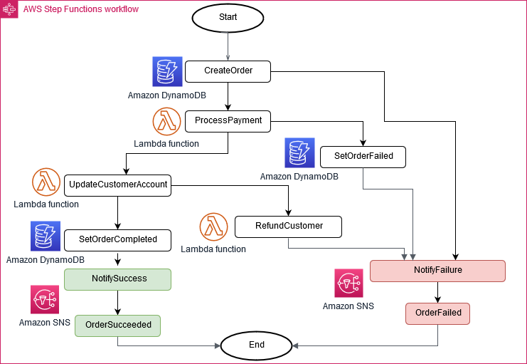
System Design(a.k.a Distributed Systems) Basics
Transactions –
Asynchronous Transactions (Saga Pattern – Handling Cancelation or Failures using Compensating Transactions) -
An example where Saga Pattern can/should be used is Cross Bank Account Transfer

Slide 100
System Design(a.k.a Distributed Systems) Basics
Transactions –
For Further Exploration -
ACID vs BASE –
What are the differences and similarities between ACID and BASE properties of database transactions?
ACID vs BASE: Database transactions – System Design
PACELC Theorem(extension of CAP Theorem) –
PACELC theorem – Wikipedia
2PC/3PC Transactions –
Dealing Distributed Transactions with 2PC, 3PC, Local Transaction Table with MQs
Flat & Nested Distributed Transactions - GeeksforGeeks

Slide 101
System Design(a.k.a Distributed Systems) Basics
Transactions –
For Further Exploration(contd … ) –
An Example of Synchronous Transaction using 2PC/3PC(MS-DTC needs to be enabled for this in windows based machines) –
DDD-Based-Enterprise-Application-Framework/Infrastructure/UnitOfWork/UnitOfWork.cs at master · sandipray63in/DDD-Based-Enterprise-Application-Framework · GitHub (check the commit and commitAsync methods).
N.B. - Always wrap Synchronous Transactions using UnitOfWork Pattern.
Asynchronous Transactions using Outbox and Saga Pattern –
Outbox(& Inbox) Pattern –
Pattern: Transactional outbox
Saga Pattern
Pattern: Saga
Microservices Data Consistency - transaction-manager-for-microservices.pdf

Slide 102
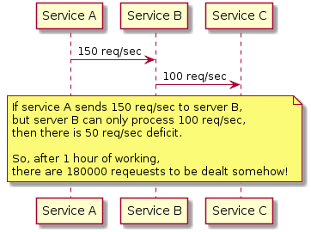
System Design(a.k.a Distributed Systems) Basics
Back Pressure –
For Further Exploration-
Back-pressure patterns in practice

Slide 103
System Design(a.k.a Distributed Systems) Basics
Management vs Control vs Data Plane –
Management Plane – mainly used for high level controlling & monitoring the Control plane below but in most systems Management Plane is merged into Control Plane & called as Control Plane.
Control Plane - mainly used for Admin(/Write[/Read]) tasks
Data Plane - mainly used for app users Transactional(/Read[/Write]) tasks
For Further Exploration-
Control Plane and Data Plane Architecture – Daniel Donbavand
Data, Control, Management: Three Planes, Different Altitudes - The New Stack

Slide 104
System Design(a.k.a Distributed Systems) Basics
For Further Exploration –
Fundamentals of Distributed Systems | Baeldung on Computer Science
A Thorough Introduction to Distributed Systems
What Are Distributed Systems? | Splunk
A Crash Course on Distributed Systems
Building-Modern-Distributed-Systems-with-Java
Designing Data-Intensive Applications (DDIA)
Distributed Systems for practitioners - Behind the scenes – A curious mind
Distributed Systems Labs and Framework
Raspberry Pi Super Cluster | IoT & Hardware | Print
Hints for Distributed Systems Design
System-Design-Master-Plan
System Design Blueprint: The Ultimate Guide
System Design PDFs - by Alex Xu - ByteByteGo Newsletter
Understanding Distributed Systems
Think Distributed Systems - Dominik Tornow
Amazon.com: Alex Xu: books, biography, latest update
System Design Interview by Alex Xu | Duri Chitayat
System Design at Google
System Design Roadmap
System Design Resources | LinkedIn
Awesome-System-Design

Slide 105
System Design(a.k.a Distributed Systems) Basics
For Further Exploration(contd…) –
System-Design: System Design for Web-Apps
System-Design-Architecture
System Design on AWS[Book]
Comprehensive List of System Design Problems | LinkedIn
Global State in Distributed Systems.pdf
How to do distributed locking — Martin Kleppmann’s blog
Consistency Model in Distributed System - GeeksforGeeks
Distributed Mutual Exclusion Algorithms
Distributed Recovery.pdf
Design a Distributed Job Scheduler for Millions of Tasks in Daily Operations
Thread (online communication) – Wikipedia
Message Threading
Warming up dedicated IP addresses (standard) - Amazon Simple Email Service
UUID and timeuuid functions | CQL for Cassandra 3.0
Writing: Differential Synchronization
Distributed File System (DFS) Architecture Components Explained
ARCHITECTING EXTREMELY LARGE SCALE WEB APPLICATIONS
Software Architecture, Cloud Computing, Multithreading, & Advanced Java Courses
Think Distributed Systems

Slide 106
NFR Matrix
Category Example Goals
Performance Response time, throughput, latency
Scalability Ability to handle increasing load
Availability System uptime, redundancy
Reliability Error tolerance, failover recovery
Security Encryption, authentication, authorization
Usability Ease of use, accessibility
Maintainability Ease of updates, code quality
Compliance Regulatory (GDPR, HIPAA, etc.)
Portability Works across OS/cloud environments
Observability Monitoring, logging, tracing.

Slide 107
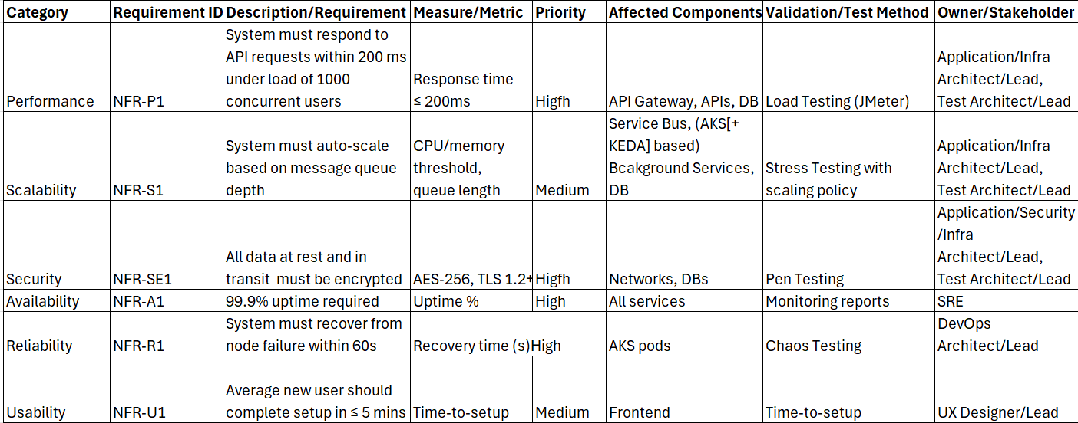
NFR Matrix
Common Structure of an NFR Matrix(Representative Example only and not any actual value from some actual prod App)
Correction: In the above slide, for row “Usability” and column “Validation/Test Method”, the value should be User Testing instead of Tme-to-setup. That’s a copy-paste error.

Slide 108
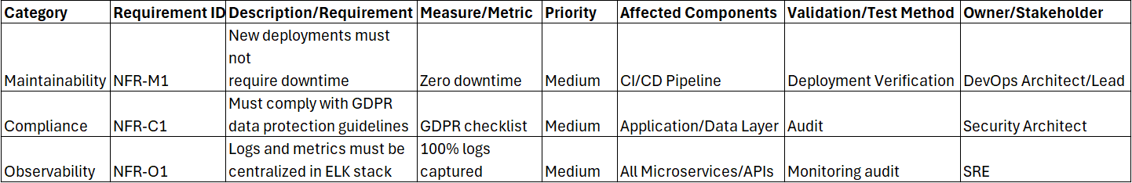
NFR Matrix
Common Structure of an NFR Matrix(Representative Example only and not any actual value from some actual prod App)
For Further Exploration -
Non-functional requirement – Wikipedia
REST API Development: Gentle checklist of NFRs
Non Functional Requirement | My Love with SQL Server
Mastering Non-Functional Requirements | Programming | eBook

Slide 109
Well Architected Framework & Runtime NFRs
Performance –
Logs & Profiling Tools –
1) Logs - Always 1st check logs to find the root cause of the performance issue. Also, to increase the overall performance of the application, may-be you can opt for asynchronous logging.
2) Profiling Tools – If via step 1 above, not able to find the root cause, run some profiling tools (e.g. ANTS Profiler[$$$]) & find where is the issue & what’s the cause of the issue. SQL Server has inbuilt profiler. Similar profilers(or profiling add-ons) are available in other DBs(including NoSQL DBs).

Slide 110
Well Architected Framework & Runtime NFRs
Performance contd … –
Resource Utilization & ways to improve it – Ckecking if some resource(RAM, HardDisk, CPU or Network) is getting overutilized w.r.t. some metric beyond the threshold limit.
RAM Optimization -
1) Garbage Collection Optimization – Refer Garbage Collection slide(s) of Programming Paradigms Training(mainly for memory leaks issues)
2) Use Chunking & Streaming Techniques if needed(e.g. you face OOM[Out of Memory] Exception)[discussed in next slide]

Slide 111
Well Architected Framework & Runtime NFRs
Performance contd … –
Resource Utilization & ways to improve it contd … –
RAM Optimization contd … -
Chunking and Streaming - Let’s say you are given below requirements –
Server “A” needing a 1TB file to be processed but having only 1GB RAM
Another server “B” is there with > 1TB HardDisk size
How do you split the 1TB file in Server A into 1K 1GB files & put them in server B using server A as the processing server?
Hint - c# - How to load large files with StreamReader in chunks? - Stack Overflow
For Further Exploration –
What is http multipart request? - Stack Overflow
c# - How do I download a large file (via HTTP) in .NET? - Stack Overflow

Slide 112
Well Architected Framework & Runtime NFRs
Performance contd … –
Resource Utilization contd … –
CPU Optimization -
May get StackOverFlow Exception(sometime some irrelevant exception also shows up) if the CPU gets utilized too much. Mainly happens(in continuously running schedulers) due to tight loop issue wherein the CPU continuously runs the loop & at some point reaches 100% utilization. To fix the issue, introduce a Thread.Sleep(1) within the loop at the end, to make the CPU relax for sometime.
And ofcourse Multi-Core Parallelism can be used to make computations fasters. Also, Multi-Threading techniques can be used to boost CPU Performance.
EP112: Top CPU Usage Reasons? - ByteByteGo Newsletter

Slide 113
Well Architected Framework & Runtime NFRs
Performance contd … –
Resource Utilization contd … –
Network & HardDisk (& DB) IO Optimization-
Use async/await(refer Async/Await slides of Programming Paradigms training)
Use Bulk Operations/Batch Processing wherever possible
If possible, use Parallel Async IO
Other Network & HardDisk(& DB) Optimization –
Other Network & HardDisk performance issues(e.g. fragmentation etc) needs to be checked separately. Most of these other issues are concerns of Infra, DBA etc. teams though.

Slide 114
Well Architected Framework & Runtime NFRs
Performance contd … –
Response Time – Time required to get the response from server since the request has been sent from the client
Ways to improve Response Time –
1) SQL Tuning
Always return specific columns in Select rather than using *
Try to get all relevant results in single shot using proper where clause(if needed use paging)
Check that proper indexes are applied in where clause and join clause columns.
Other Sql Tuning Techniques - SQL Performance Tuning - GeeksforGeeks

Slide 115
Well Architected Framework & Runtime NFRs
Performance contd … –
Response Time contd … –
Ways to improve Response Time contd … –
2) Server Side Tuning -
a) ORMs(Dapper & EF) Tuning –
Dapper being a micro-orm & uses mainly raw sql, nothing much is there to tune within Dapper itself & most of the Sql Tuning techniques should do the trick.
For EF Tuning, refer -
15+ Steps to improve EF Core Performance | LinkedIn
For ADO.NET refer –
.net - C# - What are Some High Performance Best Practices/Tips for ADO.NET - Stack Overflow

Slide 116
Well Architected Framework & Runtime NFRs
Performance contd … –
Response Time contd … –
Ways to improve Response Time contd … –
2) Server Side Tuning contd … -
b) Caching –
Small one time write & multiple read based application data can be cached in-memory but validate that it doesn’t throw OOM Exception.
Large Application data, Session data & rarely-changing data can be cached using some Distributed Cache (Refer - Redis OSS vs. Memcached - Difference Between In-Memory Data Stores – AWS, Choosing your node size - Amazon ElastiCache & Why redis cluster only have 16384 slots? - Stack Overflow for further exploration)

Slide 117
Well Architected Framework & Runtime NFRs
Performance contd … –
Response Time contd … –
Ways to improve Response Time contd … –
2) Server Side Tuning contd … -
b) Caching contd … –
Caching Types –
Types of Cache – GeeksforGeeks
Caching Strategies –
Top caching strategies - by Alex Xu - ByteByteGo Newsletter
Cache Strategies | Medium
Caching Eviction Strategies –
Cache replacement policies – Wikipedia
For Further Exploration-
Optimizing Distributed Cache for Read-Heavy vs. Write-Heavy Workloads with Docker
HybridCache in ASP.NET Core - New Caching Library

Slide 118
Well Architected Framework & Runtime NFRs
Performance contd … –
Response Time contd … –
Ways to improve Response Time contd … –
2) Server Side Tuning contd … -
c) Concurrency Handling–
If multiple requests do (read +) write(update/insert) the same record in some table in the DB, then concurrency issues as mentioned in 6 ways of doing locking in .NET (Pessimistic and optimistic)- CodeProject can happen. In general, solution to such problems is to use Optimistic or Pessimistic Concurrency handling techniques as per requirements(which are discussed in next 2 slides).Another technique can be to put the requests into some queue/buffer & then process them sequentially(if possible in bulk to improve performance).

Slide 119
Well Architected Framework & Runtime NFRs
Performance contd … –
Response Time contd … –
Ways to improve Response Time contd … –
2) Server Side Tuning contd … -
c) Concurrency Handling(contd…) –
Optimistic Locking – a strategy where you read a record, take note of a version number (other methods to do this involve dates, timestamps or checksums/hashes) and check that the version hasn't changed before you write the record back. When you write the record back you filter the update on the version to make sure it's atomic. (i.e. hasn't been updated between when you check the version and write the record to the disk) and update the version in one hit.If the record is dirty (i.e. different version to yours) you abort the transaction and the user can re-start it.
In general, we use the number of records fetched(as part of the [read +] write query e.g. checking max(VersionNumber) = current Version Number) or we check some exception raised or not(e.g. applying Retry + unique key constraint on [read +] write query)
Versioning is the best approach since timestamp based approaches can have Server clock synchronization issues.

Slide 120
Well Architected Framework & Runtime NFRs
Performance contd … –
Response Time contd … –
Ways to improve Response Time contd … –
2) Server Side Tuning contd … -
c) Concurrency Handling(contd …) –
Pessimistic Locking – when you lock the record for your exclusive use until you have finished with it. It has much better integrity than optimistic locking but requires you to be careful with your application design to avoid DeadLocks. To use pessimistic locking you need either a direct connection to the database (as would typically be the case in a two tier client server application) or an externally available transaction ID that can be used independently of the connection. In the latter case, you open the transaction with the TxID and then reconnect using that ID. The DBMS maintains the locks and allows you to pick the session back up through the TxID.
For more details refer - What's the difference between optimistic and pessimistic locking?

Slide 121
Well Architected Framework & Runtime NFRs
Performance contd … –
Response Time contd … –
Ways to improve Response Time contd … –
2) Server Side TunTransactioning contd … -
c) Concurrency Handling(contd …) –
For Further Exploration-
ADO.NET Entity Framework Interview Questions- CodeProject
Handling Concurrency Conflicts - EF Core | Microsoft Learn
Different Types of DB Locks | LinkedIn
Concurrency Control Mechanisms in Distributed Systems | by Roopa Kushtagi | Medium

Slide 122
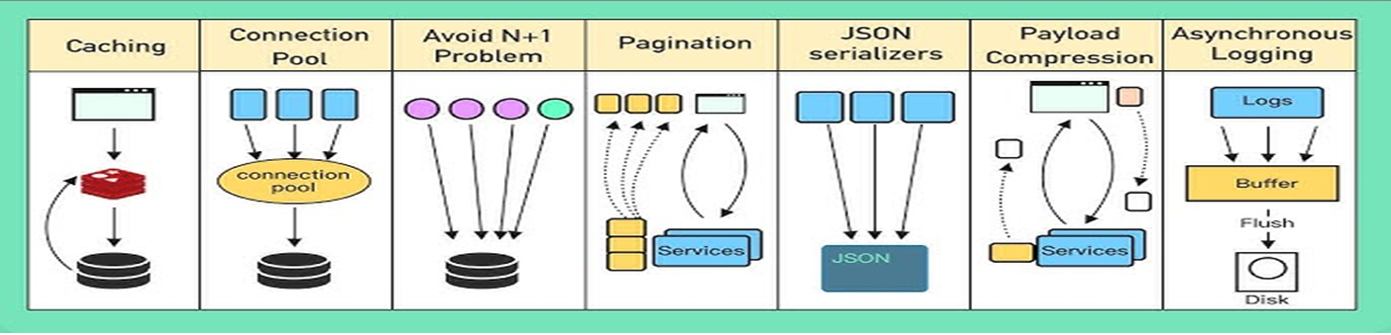
Well Architected Framework & Runtime NFRs
Performance contd … –
Response Time contd … –
Ways to improve Response Time contd … –
2) Server Side Tuning contd … -
API Performance Improvement Techniques in General -

Slide 123
Well Architected Framework & Runtime NFRs
Performance contd … –
Response Time contd … –
Ways to improve Response Time contd … –
2) Web UI Tuning –
Bundling & Minification
Compression
Pre-Fetching
CDN
Http/Web Caching
Cache Control & Expires
Etag/Last Modified
Which one to use : Expire Header, Last Modified Header or ETags - Stack Overflow
For Further Exploration -
Frontend Optimization - 9 Tips to Improve Web Performance – KeyCDN
Data Fetching Patterns in Single-Page Applications
API Pagination | Feed | LinkedIn
Others saying slow but it’s fast for me| LinkedIn
ASP.NET-Core-1.0-High-Performance: ASP.NET Core 1.0 High Performance by Packt Publishing
Best practices for improving performance using Azure Service Bus - Azure Service Bus | Microsoft Learn

Slide 124
Well Architected Framework & Runtime NFRs
Performance –
Some Important Statistics –
Current & Target loads –
Avg transactions/day
Typical hours transactions
Peak hours transactions
Avg Response time
90 percentile response time
Inbound & Outbound Batch Jobs
Volume
Duration
Transactions/sec
For Further Exploration
Benchmarking Message Queue Latency – Brave New Geek

Slide 125
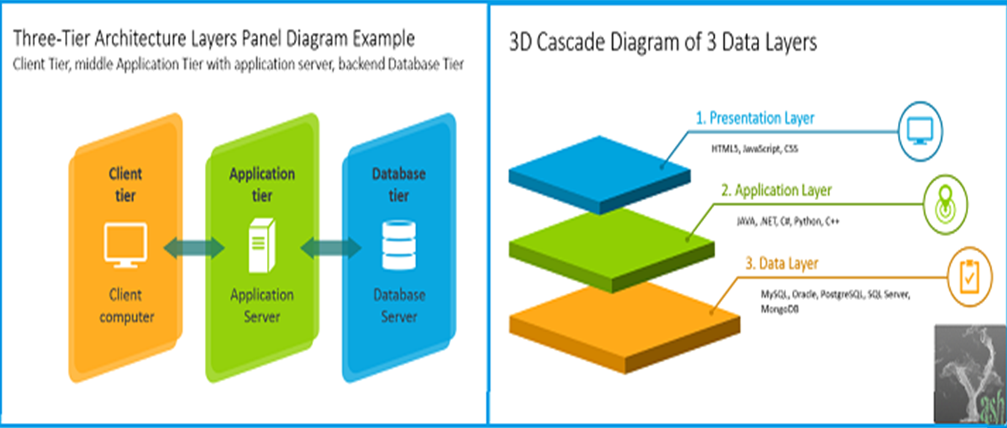
Well Architected Framework & Runtime NFRs
Scalability –
Layer vs Tier –

Slide 126
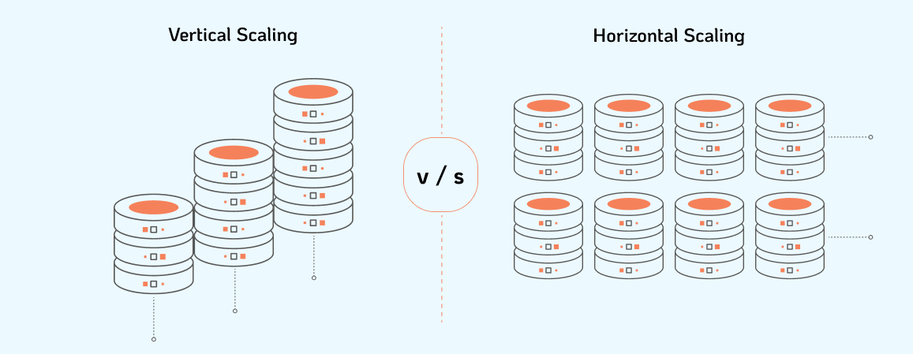
Well Architected Framework & Runtime NFRs
Scalability –
Vertical vs Horizontal Scaling –

Slide 127
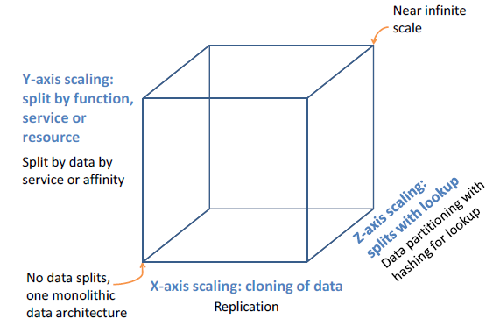
Well Architected Framework & Runtime NFRs
Scalability –
Scale Cube –

Slide 128
Well Architected Framework & Runtime NFRs
Scalability –
Layer vs Tier –
What's the difference between a cake tier and a layer of cake? – My Baker
Horizontal vs Vertical Scaling –
Horizontal vs. Vertical Scaling: HPA, VPA & Beyond | nOps
Scale Cube –
The Scale Cube

Slide 129

Well Architected Framework & Runtime NFRs
Scalability –
Replication –

Slide 130

Well Architected Framework & Runtime NFRs
Scalability –
Web Stateful Replication –

Slide 131

Well Architected Framework & Runtime NFRs
Scalability –
Web/Service Stateless Replication –

Slide 132

Well Architected Framework & Runtime NFRs
Scalability –
DB Replication –

Slide 133

Well Architected Framework & Runtime NFRs
Scalability –
DB Replication contd … –

Slide 134

Well Architected Framework & Runtime NFRs
Scalability –
Partitioning(needed for Distributed Stateful components
[DBs/MQs/Caches etc]) –
For Further Exploration –
Consistent Hashing Explained
The Ultimate Guide to Consistent Hashing | Toptal®
How data is distributed across a cluster (using virtual nodes)

Slide 135
Well Architected Framework & Runtime NFRs
Scalability –
For Further Exploration(Replication [& Partitioning]) –
Distributed Events Ordering(Physical vs Logical vs Vector Clock)
Distributed Systems: Physical, Logical, and Vector Clocks
Distributed Systems Clocks | LinkedIn
Leader Election –
Leader Election pattern - Azure Architecture Center | Microsoft Learn
How does the leader election in Raft work?
tate Machine Replication(PAXOS vs RAFT vs ZAB) -
Paxos vs. Raft vs. ZAB
Chain Replication - Chain replication : how to build an effective KV-storage (part 1/2)
CRDTs(Conflict Free Replicated Data Types) - A Look at CRDT
Broadcast Protocols in Distributed Systems –
Broadcast protocols in distributed computer control systems – ScienceDirect
Dynamo Style Stores - System Design Concepts: Dynamo
Co-Ordination Avoidance & CALM Theorem - Avoiding Coordination Cost
DB Sharding vs Partitioning - Sharding vs Partitioning: Understanding Database Distribution Methods | DataCamp

Slide 136
Well Architected Framework & Runtime NFRs
Scalability –
Throughput – Number of requests(/transactions) served by a (Web/App/DB) server.
Ways to Improve Throughput –
1) Load Balancers & Horizontal Scaling
2) Asynchronous Processing (mainly to increase write throughput)
3) Use Partitioning to increase Write Throughput while use Replication to increase Read Throughput
Auto-Elastic Scalability Techniques(Reactive Techniques are Rule Based & State of the Art Proactive Techniques are ML based) –
autoscaling_survey.pdf
For Further Exploration –
8 Must Strategies for System Scaling | Feed | LinkedIn
7 Must Strategies for DB Scaling | LinkedIn
Art of Scalability
The Art of Capacity Planning, 2nd Edition [Book]
Scalability Rules: 50 Principles for Scaling Web Sites eBook
Web Operations: Keeping the Data On Time eBook
Scaling Pods and Nodes in K8s | Build Intelligent Apps On Azure
Scale applications in Azure Kubernetes Services (AKS) - Azure Kubernetes Service | Microsoft Learn
Performance and scaling best practices for small to medium workloads in Azure Kubernetes Service (AKS)
Azure Service Bus - Automatically update messaging units - Azure Service Bus | Microsoft Learn
Microsoft Azure Service Bus quotas and limits - Azure Service Bus | Microsoft Learn(an Azure SB topic/queue/subscription doesn’t allow more than 5K concurrent requests and so topics/queues/subscriptions might have to be [auto]scaled if > 5K concurrent requests needed to be supported or some sort of chunking/batching needs to be there from the publisher end[Sending Large Batches to Azure Service Bus | Mikhail Shilkov – seems even a batch request is considered as a single request but need to test this]).Sometimes Batching can solve timeout issues as well.
Kubernetes Event-driven Autoscaling (KEDA) - Azure Kubernetes Service | Microsoft Learn
KEDA_Related_Query_Answered_By_ChatGPT · GitHub

Slide 137
Well Architected Framework & Runtime NFRs
Availability/Reliability & Resiliency –
Total System Availability/Reliability – How to measure?
System Reliability and Availability
Calculating Total System Availability
How to Calculate System Availability: Definition and Measurement
Health Checks - /health(/error) endpoints using httpHead(/httpGet) verbs. AP/BackgroundServices Health checks can be strong indicator of API/BackgroundServices Availability since Availability can be calculated as ratio of successful health checks to the total number of health checks performed over a specific period. Although MTTD + MTTR + MTTF can give a much better picture about Availability but its not a trivial task to calculate MTTD, MTTR & MTTF from health checks.(check next 2 slides)
Liveness vs Readiness –
Liveness: Used to check if the app is available and alive.
Readiness: Used to check if the application is ready to be used and serve the traffic.
Normally the readiness check is only performed when an application has just been started, to make sure the load balancer or orchestrator can start directing the traffic. After the Application becomes ready, only then liveness check is performed. Typically, while a Liveness probe would return Healthy or UnHealthy, the Readiness probe could return Degraded if the application is not ready to process requests yet.
For Further Exploration –
Health checks with ASP.NET Core and Kubernetes - David Guida
High availability for multitier AKS applications - Azure Architecture Center | Microsoft Learn
Erasure Coding Demystified – YouTube
Performing a health check in .NET Core Worker Service - Stack Overflow

Slide 138
Well Architected Framework & Runtime NFRs
Availability/Reliability & Resiliency –
Calculating MTTD, MTTR & MTTF from Health checks -
It is possible to calculate MTTD, MTTR, and MTTF using data from health checks. These metrics are all derived from tracking the time between events related to system failures and their resolution. Health checks can provide the necessary data points for these calculations.
Explanation:
MTTD (Mean Time to Detect):
Health checks can be configured to monitor system health and trigger alerts when issues arise. By logging the time of the issue detection (from the health check alert) and the time of the actual incident occurrence (if it can be determined), you can calculate the time it took to detect the issue (MTTD).
MTTR (Mean Time to Repair/Resolution):
Health checks can also be part of the resolution process. They can be used to verify when a system or service has been restored to a healthy state after an issue is resolved. By measuring the time from detection to resolution (including any repair or remediation actions) based on health check data, you can calculate MTTR.
MTTF (Mean Time to Failure):
This metric is typically used for non-repairable systems, but health checks can be used to track the time until a system or component reaches a point where it needs to be replaced. By monitoring the system's health and logging the time of failures, you can determine the average time to failure for that component.

Slide 139
Well Architected Framework & Runtime NFRs
Availability/Reliability & Resiliency –
Calculating MTTD, MTTR & MTTF from Health checks contd… -
How Health Checks Enable the Calculations:
Automated Detection:
Health checks automate the detection of issues, providing a timestamp for when the problem was recognized.
Automated Verification:
Health checks can also automatically verify if a problem has been resolved, providing a timestamp for the resolution.
Data Logging:
By logging all health check data, including timestamps of incidents and resolutions, you have the necessary data points for calculating MTTD, MTTR, and MTTF.
In essence, health checks serve as a reliable source of data for tracking the key metrics of incident management and system reliability.

Slide 140
Well Architected Framework & Runtime NFRs
Availability/Reliability & Resiliency –
Redundancy is introduced in a system to avoid Single Point of
Failure.
Redundancy Types –
Active Redundancy
All nodes do the processing
Ideal for Highest Availability
Passive Redundancy
Only Active nodes do the processing
Ideal for quick Recovery
Cold Redundancy
Spare Nodes are brought up only on failover
Not for High Availability. Good for things like BackUp etc.

Slide 141
Well Architected Framework & Runtime NFRs
Availability/Reliability & Resiliency –
Stateless Components Redundancy(SlCR) –
- APIs/Services are in general stateless components
- Similar to Stateless Replication
- But need to have servers for availability requirements on top of
scalability requirements.
- Kind of Active - Active always
Stateful Components Redundancy(SfCR) –
- DBs, Cache, MQs, Static Content Servers are stateful components.
- Again, similar to Stateful Replication
- In case of DBs, the redundant server is more of a Backup rather
than a replica & Master Slave Architecture is mainly used(mainly
async).
- For other stateful components, mainly Master-Master Architecture
is used(mainly in async mode)

Slide 142
Well Architected Framework & Runtime NFRs
Availability/Reliability & Resiliency –
Correlation(Correlated Redundancy)
If I have 2 machines at the same place & there has been some power failure then both the machines will go down since the failure of both is due to the same reason(i.e. the failure reason is correlated).So we should plan for correlated redundancy situations as well and that’s one of the main reasons why most of the Cloud Providers divide their cloud into Regions, Zones, Data Centers & other levels of granularity.

Slide 143
Well Architected Framework & Runtime NFRs
Availability/Reliability & Resiliency –
Fault Detection using Ping & Heartbeat –
Ping – Ping the nodes continuously(say 1 sec interval) & check that they send the response back within certain time else assume that the node is dead.
Heartbeat – Each node sends some heartbeat about itself to some centralized monitoring component & if some node has not sent heartbeat beyond a threshold limit then consider that as dead.
Fault Isolation Techniques –
Bulkhead Pattern - Bulkhead pattern - Azure Architecture Center | Microsoft Learn
Shuffle Sharding - Shuffle Sharding: Massive and Magical Fault Isolation
Cell Based Architecture – Reducing the Scope of Impact with Cell-Based Architecture - Reducing the Scope of Impact with Cell-Based Architecture

Slide 144

Well Architected Framework & Runtime NFRs
Availability/Reliability & Resiliency –
Stateful Failover –
Mainly done using a registry(similar to how a DNS works) or Floating/Virtual IP(which gets assigned to the Standby on Primary node failure & sync needs to be there between the nodes). Virtual IP way is shown as below -

Slide 145
Well Architected Framework & Runtime NFRs
Availability/Reliability & Resiliency –
Self Healing(3 Levels) –
System Level - The most common system level errors include process failures (often resolved by redeploying or restarting) and throughput issues (often resolved by scaling and descaling). Self-healing systems conduct health checks on different components and automatically attempt fixes (such as redeploying) to recover to their desired states.
Application Level - Self-healing applications incorporate design elements that resolve problems. For example, applications that use Akka, arrange elements in a hierarchy and assign an actor’s problems to its supervisor. Although DapR has an in-built (virtual) actor model but it doesn’t support traditional Hierarchy Actor model like that of Akka.NET(which alongwith supporting local Hierarchies, also supports Cluster model).
How Actors Recover from Failure | Petabridge
Meet the Top Akka.NET Design Patterns | Petabridge
But do we really need App Level Self Healing? Seems K8s (& Service Mesh) based Clustering & System Level Self Healing is sufficient for most real world apps. If real App level healing is needed, then that can be done using something similar to Presence Detection Services approaches used in Chat/IoT Systems.

Slide 146
Well Architected Framework & Runtime NFRs
Availability/Reliability & Resiliency –
Self Healing(3 Levels) contd … –
Hardware Level - True hardware level self-healing (for example, a machine that can heal failed memory or repair a broken hard disk) does not exist. It’s still in the sci-fi realm and is leading to a newfound appreciation for biology, spurring fresh interest in biological computing(check IISc scientists develop brain-inspired analog computing platform).
SPOF(Single Point of Failure) –
Handling SPOF –
1) A worker in a cluster can become a master using Leader Election Algo.
2) If possible, have multiple SPOF resources communicate with each other via P2P Networking.
3) Use vertically scaled SPOF resources
For Further Exploration(mainly Global System Design Considerations) –
What are the biggest challenges of designing a global system architecture?
Localization Checklist: Top Tips and Tools
Availability Regions and Zones for AWS, Azure & GCP – BMC Software | Blogs
AWS Global Cloud Infrastructure: Regions, Zones & More – BMC Software | Blogs
Azure Global Infrastructure Cheat Sheet

Slide 147
Well Architected Framework & Runtime NFRs
Availability/Reliability & Resiliency –
Resiliency Patterns –
Timeout – This is the simplest one. You make request to some external API and wait for it to send the response & if you don’t get the response within some specified threshold limit, handle this as per requirements.
COTS/Cloud Products with inbuilt non-configurable timeouts (maybe beyond certain limit) can create issues[Discussion].
Retry(for transient failures) –
Normal – the number of retries can be configured. But problem with just configuring number of retries is that if N clients are calling some API with retries, the API can get overloaded with requests.

Slide 148
Well Architected Framework & Runtime NFRs
Availability/Reliability & Resiliency –
Resiliency Patterns –
Retry(for transient failures) contd …–
Exponential BackOff – increasing the time between individual retries(e.g. 2secs, 4 secs, 8 secs, 16 secs…).But again this can lead a client sometimes to wait too long.
Capped Exponential Backoff – Set a max Threshhold value on the Exponential backoff value.
Jitter – A random amount of time between each retry to prevent large bursts by spreading out the arrival rate.
For Further Exploration
Timeouts, retries and backoff with jitter
Resilient .NET Application with Polly Resilience Pipelines
Building resilient cloud services with .NET 8 - .NET Blog
Build resilient HTTP apps: Key development patterns - .NET | Microsoft Learn

Slide 149

Well Architected Framework & Runtime NFRs
Availability/Reliability & Resiliency –
Resiliency Patterns –
Circuit Breaker –
For Further Exploration
Circuit Breaker pattern - Azure Architecture Center | Microsoft Learn

Slide 150
Well Architected Framework & Runtime NFRs
Availability/Reliability & Resiliency –
Resiliency Patterns contd … –
A small framework related to all the Resiliency Patterns based on OOP/FP principles-
DDD-Based-Enterprise-Application-Framework/Infrastructure/ExceptionHandling at master · sandipray63in/DDD-Based-Enterprise-Application-Framework · GitHub
A more generic approach to the above framework probably would be to consolidate the (most important) Resiliency Patterns in the following order(using C# Task Continuation)
Timeout
Retry(with Jitter)
Circuit Breaker
For Further Exploration(Dead/Poison Letter queues also provide resiliency ultimately) –
Dead Letter Queue and Poison Queues - Stack Overflow

Slide 151
Well Architected Framework & Runtime NFRs
Availability/Reliability & Resiliency –
Self Healing Techniques
Key Self-Healing Techniques:
Automatic restarts: The simplest form of self-healing, where a service is automatically restarted if it becomes unresponsive or crashes. This is effective for transient issues that a simple reboot can fix. The system executes pre-programmed corrective actions, such as restarting a service, reallocating resources, or patching a bug. Retry Policies: Automatically re-attempt failed API calls, as some issues are transient and can be resolved with a single retry. An effective retry pattern uses exponential backoff, waiting progressively longer before each retry to avoid overwhelming a failing service. Circuit Breakers: Monitor service calls and, upon detecting repeated failures, temporarily halt requests to a failing service, allowing it to recover and preventing cascading failures. Prevents a background service from repeatedly trying to access a failing dependency. After a set number of failures, the circuit "opens" and prevents further calls to that dependency, protecting both services.
Fallback Mechanisms: Implement a system to switch to a backup model or service when the primary service is down, ensuring users remain unaffected.

Slide 152
Well Architected Framework & Runtime NFRs
Availability/Reliability & Resiliency –
Self Healing Techniques
Health Checks: Services expose health endpoints that are periodically checked by a health monitor. If a health check fails, the monitoring tool can trigger a restart or removal of the unhealthy service instance. Continuously monitor the API's performance and stability, providing real-time alerts when issues arise. Automated Error Handling & Transformation: Use AI or rule-based systems to automatically adapt to changes, such as when a data schema mismatches, by applying safe transformations or opening a ticket with a data snapshot. Real-time Monitoring and Alerting: Receive immediate notifications about service issues and automatically fix them, contributing to a more responsive system. Continuous tracking of system metrics (e.g., CPU usage, memory, network latency, error rates) to detect anomalies or potential issues. Adaptive Load Shedding: Use techniques like token buckets to manage load and shed excess traffic during periods of high demand or failure. Auto-Rollback: Automatically roll back a new feature or deployment if it correlates with a spike in errors or negative performance indicators.

Slide 153
Well Architected Framework & Runtime NFRs
Availability/Reliability & Resiliency –
Self Healing Techniques
Queue-based work processing: Instead of direct communication, background services can pull tasks from a queue. If a service instance fails, the task returns to the queue and can be picked up by another, healthy instance, preventing data loss.
Recovery: The API continues to operate, potentially with reduced functionality or by serving stale data from a cache, while the underlying issue is resolved. Anomaly detection: Uses predefined thresholds, baselines, or AI/machine learning to identify performance deviations and potential failures before they
escalate into an outage. Root cause analysis: A diagnostic engine that analyzes monitoring data and logs to pinpoint the underlying cause of a detected problem.
Infrastructure-level techniques: Container orchestration (e.g., Kubernetes): For services deployed in containers, orchestrators like Kubernetes automatically handle self-healing. They monitor container health and automatically restart or replace any that fail to meet their

Slide 154
Well Architected Framework & Runtime NFRs
Availability/Reliability & Resiliency –
Self Healing Techniques
health checks.
Deployment automation: An automated and self-healing deployment pipeline can revert a new release if it fails a set of automated health checks, preventing a bad update from reaching production.
Redundancy and failover: Critical services are duplicated to ensure that if one component fails, another can take over its function immediately. This includes redundant storage, databases, and compute resources. Automated scaling: When a service experiences high load that could cause a performance degradation or failure, auto-scaling mechanisms can automatically provision additional resources to handle the demand. Feedback loop: After a resolution, the system logs and analyzes the event to learn and improve its future responses.
Advanced techniques with AI.
Predictive maintenance: Systems learn from past errors, and AI and machine learning can be used to improve future detection and correction capabilities.
AI and machine learning analyze historical data to predict potential failures

Slide 155
Well Architected Framework & Runtime NFRs
Availability/Reliability & Resiliency –
Self Healing Techniques
before they occur. For example, the system could identify that a particular
service often fails after its memory usage crosses a certain threshold and proactively restart it. Autonomous remediation: With an AI-driven system, the background service can make autonomous decisions about the best course of action rather than relying on predefined rules. This enables more complex problem-solving without human intervention.
How They Work Together: These techniques are often combined in a layered approach to create a resilient system: Detection: Health checks and monitoring systems detect a problem. Isolation: A circuit breaker might be triggered to stop requests to the affected service, preventing further issues. Response: A retry mechanism attempts to re-establish a connection, a fallback mechanism might take over, or a simpler logic is used.

Slide 156
Well Architected Framework & Runtime NFRs
Availability/Reliability & Resiliency –
Self Healing Techniques
Benefits: Increased Reliability: APIs become more robust and less prone to downtime. Reduced Maintenance: Automated recovery reduces the need for manual intervention, saving time and effort. Improved User Experience: Users experience a more seamless and responsive service, even when underlying problems occur. Faster Issue Resolution: Problems are identified and fixed quickly, minimizing their impact on the system.

Slide 157
Well Architected Framework & Runtime NFRs
Network Availability & Scalability -
Network availability is a measure of how well a network can respond to performance and connectivity demands, while network scalability is a network's ability to handle increased amounts of change:
Network availability
Also known as network uptime, this is a measure of how well a network can respond to performance and connectivity demands. A common goal for organizations is to achieve five nines (99.999%) of availability.
Network scalability
A scalable network can efficiently manage increased amounts of users, devices, or data, while maintaining stable and reliable performance.
Here are some strategies for ensuring network availability and reliability:
Design redundancy into the network architecture
Monitor performance
Implement security
Update and patch
Test and backup
Train and document
Load balancing can also improve a network's availability, scalability, security, and performance by directing and controlling internet traffic between application servers and their clients
For Further Exploration-
What Is Network Scalability? How to Optimize for Growth | Nile
What is Network Availability? - IT Glossary | SolarWinds
What Is Network Availability? | F5

Slide 158
Well Architected Framework & Runtime NFRs
Security -
Security vs Privacy –
Security controls “who” can access the data, whereas, Privacy is more about “when’’ and “what” type of data can be accessed. “You can’t have privacy without security, but you can have security without privacy.”
For example, we’re all familiar with the term “Login Authentication and Authorization”. Here, authentication is about who can access the data, so it’s a matter of security. Authorization is all about what, when, and how much of the data is accessible to that specific user, so it’s a matter of privacy.

Slide 159

Well Architected Framework & Runtime NFRs
Security -
Security vs Privacy contd… –
For Further Exploration –
Privacy-nhancing technologies - Wikipedia

Slide 160

Well Architected Framework & Runtime NFRs
Security -
Security Principles –
Secure SDLC –
For Further Exploration –
Secure Software Development Life Cycle Explained | Black Duck Blog
What the Sec is DevSecOps? | Accelera
N.B. – DevSecOps pertains to securing every component in the DevOps pipeline including IaC, CaC, the pipeline itself, configs, Docker, K8s etc and running SAST/DAST/SCA etc tools (& relevant reporting with integration with Jira) from the pipeline itself to identify security loopholes in app code as well.

Slide 161

Well Architected Framework & Runtime NFRs
Security -
Security Principles –
Zero Trust -
Zero Trust doesn’t mean that you should not trust an app at all but it only means that you should trust it only after proper validation/verification of the system.
For Further Exploration
What is Zero Trust Security? Principles of the Zero Trust Model | CrowdStrike
Zero Trust Model - Modern Security Architecture | Microsoft Security
Zero Trust Security - a Cautious move | LinkedIn

Slide 162
Well Architected Framework & Runtime NFRs
Security -
CIA Triad –
Confidentiality – No hacker should be able to understand the data at rest or in transit. Usually Symmetric/Asymmetric Encryption used for the same.
Integrity – No hacker should be able to tamper the (encrypted) data (especially in transit) as well. Done using some Hashing Algo.
Availability – The system/app should be available to whom(Authentication) & how much it should be available(Authorization)

Slide 163

Well Architected Framework & Runtime NFRs
Security -
“C” And “I” of CIA Triad(Example of Handshaking in SSL) –
Erratum – Dataa is a typo mistake above. Should be Data.

Slide 164

Well Architected Framework & Runtime NFRs
Security -
“C” & “I” of “CIA” Triad using mTLS–
For Further Exploration –
What Is mTLS?
SSL vs TLS - Difference Between Communication Protocols – AWS
GrokkingBitcoin-Ch02-Hash-Functions-and-ignatures.adoc
Implementing mTLS Between Two Apps Using ASP.NET - Microsoft Q&A

Slide 165

Well Architected Framework & Runtime NFRs
Security -
“A” of “CIA” Triad using OAuth -
Auth Code Grant Type –

Slide 166

Well Architected Framework & Runtime NFRs
Security -
“A” of “CIA” Triad using OAuth -
Client Credentials Grant Type –

Slide 167

Well Architected Framework & Runtime NFRs
Security -
“A” of “CIA” Triad using OAuth -
Resource Owner Credentials Grant Type –

Slide 168
Well Architected Framework & Runtime NFRs
Security -
“A” of “CIA” Triad using OAuth -
Refresh Token Grant Type –

Slide 169

Well Architected Framework & Runtime NFRs
Security -
“A” of “CIA” Triad using OAuth -
Implicit Grant Type –

Slide 170

Well Architected Framework & Runtime NFRs
Security -
“A” of “CIA” Triad using OAuth -
Device Flow Grant Type –

Slide 171
Well Architected Framework & Runtime NFRs
Security -
OAuth Based Communication
✅ 1. UI → Internal API (User → Frontend → Backend)
Here the user is involved. You need flows that authenticate humans, not machines.
Best OAuth Flows for UI → Internal API
A. Authorization Code Flow (with PKCE) — Recommended
The most secure and modern flow for SPAs, mobile apps, and web apps.
Where used?
React / Angular / Vue SPA
Mobile apps
Server-rendered apps
How it works
UI redirects user to OAuth provider (Azure AD, Auth0, Keycloak, Okta).
User logs in.
OAuth provider returns a Code.
UI exchanges code + PKCE verifier → gets:
ID Token (JWT) → identifies user
Access Token (JWT) → calls internal APIs
Refresh Token (optional)

Slide 172
Well Architected Framework & Runtime NFRs
Security -
OAuth Based Communication
✅ 1. UI → Internal API (User → Frontend → Backend)
A. Authorization Code Flow (with PKCE) — Recommended
How it works
Internal API Responsibilities
Validate signature (RS256)
Check expiration
Enforce scopes (e.g., api.read, profile.email)
Why PKCE?
Prevents code interception
Especially important for SPAs & mobile apps
B. Implicit Flow (Deprecated)
Used by older SPAs but should not be used now because:
No refresh tokens
Tokens delivered via browser URL hash

Slide 173
Well Architected Framework & Runtime NFRs
Security -
OAuth Based Communication
✅ 1. UI → Internal API (User → Frontend → Backend)
A. Authorization Code Flow (with PKCE) — Recommended
C. Session + Cookie Approach (No OAuth Token in Browser)
Modern alternative to avoid token exposure in browser.
Flow:
UI sends login request → backend performs OAuth Authorization Flow.
Backend sets HttpOnly session cookie.
UI calls internal APIs → cookie automatically sent.
Advantage:
Tokens stay server-side; browser never sees them.
🔶 Typical Architecture for UI → Internal API
UI (SPA/Mobile/Web)
|
| Access Token (JWT)
v
Internal API Gateway or BFF
|
-> Internal Microservices
Best Practice: Use a Backend For Frontend (BFF) to prevent exposing access tokens to browser.

Slide 174
Well Architected Framework & Runtime NFRs
Security -
OAuth Based Communication
✅ 2. Internal API → Internal API (Service-to-Service Communication)
This is machine-to-machine communication. No user. You need server-side OAuth flows using client credentials.
Best OAuth Flows for Internal API → Internal API
A. Client Credentials Flow (Most Common)
Each internal microservice has:
Client ID
Client Secret
(or certificate-based authentication)
How it works
Service A sends client credentials to OAuth server.
Gets an Access Token with scopes/roles like:
service.read
service.write
Service A calls Service B using bearer token.

Slide 175
Well Architected Framework & Runtime NFRs
Security -
OAuth Based Communication
✅ 2. Internal API → Internal API (Service-to-Service Communication)
B. Token Exchange (JWT → JWT Mapping)
Used when:
The frontend token (user token) should not be directly forwarded to downstream APIs.
Zero-trust microservice systems (e.g., Istio, Envoy).
Flow:
Frontend calls API Gateway with user access token.
API Gateway exchanges the token for a new internal token:
Removes PII
Adds microservice-specific claims
Gateway calls Service B with internal token.
This protects:
Internal API from over-exposing user claims
Avoids token reuse across systems
C. Mutual TLS (mTLS) + OAuth
Used in highly secure enterprise environments.
Internal API communication uses:

Slide 176
Well Architected Framework & Runtime NFRs
Security -
OAuth Based Communication
✅ 2. Internal API → Internal API (Service-to-Service Communication)
C. Mutual TLS (mTLS) + OAuth
Internal API communication uses:
OAuth access token
mTLS certificate validation
Often used for:
Banking systems
Smart meter / Grid IoT platforms
Healthcare APIs
🔶 Internal API → Internal API Architecture
Service A -- Client Credentials Token --> Service B
|
| (optional token exchange)
v
Identity Provider (Azure AD / Auth0 / Keycloak)

Slide 177
Well Architected Framework & Runtime NFRs
Security -
OAuth Based Communication
✅ 3. Internal API → External API
When your backend calls a third-party external API, the OAuth configuration depends on who is calling and who needs authentication.
A. Backend Calls External API on Behalf of USER
Example:
Internal Home Automation API calling Google Home APIs
CRM calling Salesforce APIs on behalf of a user
Use: OAuth Authorization Code + Refresh Token
Flow:
User logs into external provider (Google, GitHub, Salesforce).
Internal system stores refresh token securely (Key Vault).
Backend gets access token whenever needed.
Calls external API using bearer token.
Backend responsibilities
Maintain a secure token cache
Auto-refresh tokens
Handle token revocation
B. Backend Calls External API as MACHINE (no user)
Example:
Internal service pushing logs to Datadog
Backend calling Stripe API
Internal system calling Mapbox or Twilio
Use: OAuth Client Credentials Flow
or API Key (if provider doesn’t support OAuth)
Flow:
Internal API sends client_secret/client_id to external provider.
Gets machine token.
Calls external API.
C. External API Provides JWT → Your System Validates
Example:
Webhook systems where external system signs JWT
Payment providers sending callbacks
Flow:
External provider signs JWT
Your API validates:
Signature
Issuer
Audience
Claims

Slide 178
Well Architected Framework & Runtime NFRs
Security -
OAuth Based Communication
✅ 3. Internal API → External API
B. Backend Calls External API as MACHINE (no user)
Example:
Internal service pushing logs to Datadog
Backend calling Stripe API
Internal system calling Mapbox or Twilio
Use: OAuth Client Credentials Flow
or API Key (if provider doesn’t support OAuth)
Flow:
Internal API sends client_secret/client_id to external provider.
Gets machine token.
Calls external API.
C. External API Provides JWT → Your System Validates
Example:
Webhook systems where external system signs JWT
Payment providers sending callbacks

Slide 179
Well Architected Framework & Runtime NFRs
Security -
OAuth Based Communication
✅ 3. Internal API → External API
C. External API Provides JWT → Your System Validates
Flow:
External provider signs JWT
Your API validates:
Signature
Issuer
Audience
Claims

Slide 180
Well Architected Framework & Runtime NFRs
Security -
OAuth Based Communication
🧩 Putting Everything Together
UI / Mobile App
|
| (User Token / PKCE)
v
BFF or API Gateway
|
| Token Exchange (optional)
v
──────────────────────────────────────────
Internal Microservice Layer (Zero Trust)
──────────────────────────────────────────
| |
| (Client Cred) | (Client Cred)
v v
Service A →→→→→→→→ Service B →→→→→ External API
(Machine Token / JWT)

Slide 181
Well Architected Framework & Runtime NFRs
Security -
OAuth Based Communication
⭐ Recommended Best Practices
1. Always Prefer Authorization Code + PKCE for UI
Never expose client secrets or tokens in the browser.
2. Use BFF Pattern ( especially for SPAs )
Tokens stay server-side → more secure.
3. Use Client Credentials for Microservices
Do not forward user tokens unless required.
4. Rotate Client Secrets Frequently
Use:
Azure Key Vault
AWS Secrets Manager
HashiCorp Vault
5. Use Token Exchange Strategy
Especially in:
Zero-trust networks
Multi-layer microservice systems
6. Prefer Short-Lived Access Tokens
Example:
5–15 minutes access token
Refresh token stored securely (encrypted)

Slide 182
Well Architected Framework & Runtime NFRs
Security -
“A” of CIA Triad using OIDC -
OpenID Connect is an extension of OAuth2 that adds an identity layer to the authorization framework. It allows a client to verify the identity of the user and obtain basic profile information. The user logs in to an identity provider (such as Google or Facebook) using OpenID Connect, and the identity provider returns an ID token to the client. The ID token is a JSON Web Token (JWT) that contains information about the user, such as their name, email, and picture. The client can also request an access token and a refresh token from the identity provider, which can be used to access other resources.
OAuth2 is only concerned with standard client credentials based authorization, while OpenID Connect is also concerned with authentication(alongwith the OpenID specific AuthZ Roles/permissions). OAuth2 does not provide a standard way to obtain user information, while OpenID Connect does. OAuth2 relies on access tokens, which are opaque strings that can only be validated by the resource server, while OpenID Connect relies on ID tokens, which are self-contained and can be validated by the client. OAuth2 is more flexible and can be used for various types of applications, while OpenID Connect is more specific and can be used for single sign-on (SSO) or social login or any federation service.
How to validate an OpenID Connect ID token · Blog · Connect2id

Slide 183

Well Architected Framework & Runtime NFRs
Security -
Web SSO –
Web SSO can be used for UI based Integration of nested/cross app pages with separate domains within the same organization or with external partners.
For Further Exploration –
Web SSO with external or partner applications - Stack Overflow
How does Single Sign-On (SSO) work? - by Dr Milan Milanović
SSO Explained| LinkedIn

Slide 184
Well Architected Framework & Runtime NFRs
Security -
Advanced Users Management using Okta - Account Linking vs Org2Org -
Account linking & Org2Org are both Okta features that can be used to connect organizations:
(Partner) Account linking Allows users to sign in to an app using multiple identity providers, and Okta links all of those profiles to a single Okta user. For example, if a user signs in to an app using a different identity provider than they used for registration, account linking can establish that the user owns both identities. This allows the user to sign in from either account. Account linking is configured at the identity provider level. Org2Org Connects multiple source organizations to a single target organization, allowing the source organizations to push users to the target organization. It's designed for a hub and spoke configuration, where the source organizations are the spokes and the target organization is the hub. Org2Org supports Okta's IdP-initiated SSO and JIT (Just In Time) Provisioning features. When configuring the SAML IdP in the hub organization, it's recommended to disable account linking if possible.
For Further Exploration –
User Account Linking
Auth0 Organizations
Account Linking and SSO - Auth0 Community (Account Linking is more at data level while SSO is more at application level)

Slide 185
Well Architected Framework & Runtime NFRs
Security -
AuthN and AuthZ Providers
AuthN (Authentication) providers verify a user's identity, while AuthZ (Authorization) providers determine what authenticated users are allowed to do. Popular AuthN providers include Auth0, Microsoft Entra ID, and Keycloak, which handle tasks like password validation or SSO. AuthZ providers often use models like Role-Based Access Control (RBAC) and might include systems like the Open Policy Agent (OPA) or OpenFGA to enforce permissions based on policies. AuthN (Authentication) Providers. These services focus on proving a user's identity. Purpose: To confirm that a user is who they claim to be. Methods: Often involves username and password, multi-factor authentication (MFA), biometrics, or tokens. Common Providers: Auth0: A popular platform offering authentication services and single sign-on (SSO). Microsoft Entra ID (formerly Azure AD): A comprehensive identity and access management service. Keycloak: An open-source identity and access management solution with SSO and user management features. Firebase Auth: Provides authentication services for web and mobile applications.

Slide 186
Well Architected Framework & Runtime NFRs
Security -
AuthN and AuthZ Providers
AuthZ (Authorization) Providers. These services manage what an authenticated user can access and do. Purpose: To define and enforce permissions and access rights for users. Models: Often uses models like Role-Based Access Control (RBAC), Attribute-Based Access Control (ABAC), or relationship-based access control (ReBAC). Common Providers/Systems: Open Policy Agent (OPA): A general-purpose policy engine for enforcing authorization logic using the Rego policy language. OpenFGA: An open-source project based on Google's Zanzibar authorization system, using a relationship-based access model. Topaz: A standalone authorization system supporting both OPA policies and relationship-based access control. How they work together. AuthN and AuthZ work in tandem to secure systems: Authentication (AuthN): A user logs in, providing credentials (e.g., password, token). The AuthN provider verifies their identity. Authorization (AuthZ): Once the user is identified, the AuthZ provider uses policies to determine what resources or functions the authenticated user can access within the system. For instance, after a user logs in, the AuthZ system might grant them access to a specific project board but deny them access to others, based on their assigned role or permissions.

Slide 187
Well Architected Framework & Runtime NFRs
Security -
Why AuthN and AuthZ Should be separated?
AuthN (authentication) and AuthZ (authorization) should be separated from their respective providers to enhance security, simplify development, and promote adaptability. Separation creates a "separation of concerns," reducing the risk that a compromise in one area will impact the other and allowing specialized tools to be used for each distinct function, leading to a more robust and scalable identity and access management (IAM) system. Security Benefits. Reduced Risk of Compromise: By separating AuthN and AuthZ, a security breach in one system is less likely to compromise the other. If a single provider handles both, an attacker who gains access to it could control both identity verification and what the user can do. Improved Posture: A dedicated AuthZ provider or system can implement policies (like the Principle of Least Privilege) that grant only necessary permissions, minimizing the impact of any potential compromise. Development & Maintenance Benefits. Simpler Codebase: Separating authentication logic from authorization logic makes the code cleaner and easier to understand, as each component has a distinct purpose.

Slide 188
Well Architected Framework & Runtime NFRs
Security -
Why AuthN and AuthZ Should be separated?
Increased Agility: Teams can update or replace the AuthN or AuthZ provider without affecting the other, making it easier to adapt to new technologies or security standards. Specialized Tooling: You can select the best tools for each function. For example, a specialized Identity Provider (IdP) can handle AuthN, while a dedicated Authorization as a Service (AaaS) can handle AuthZ. Independent Development: Developers can work on the authentication and authorization services independently, which increases development velocity and productivity. Scalability & Complexity. Better Scalability: As applications grow, having separate services for authentication and authorization allows them to scale independently to meet user and resource demands. Manageable Complexity: Splitting these "cross-cutting concerns" into their own services makes the overall system easier to manage, especially in large and complex applications or microservices architecture.

Slide 189
Well Architected Framework & Runtime NFRs
Security -
AuthZ Providers - OPA vs OpenFGA
OPA is a flexible, policy-driven engine suitable for attribute-based (ABAC) or role-based (RBAC) access control, while OpenFGA is a data-driven, relationship-based authorization engine inspired by Google Zanzibar. OPA provides a universal policy language (Rego) for complex decisions and contextual awareness, whereas OpenFGA excels at modeling complex relationships like inheritance and containment for collaborative applications. OpenFGA offers built-in reverse queries, faster performance for relationship checks, and a simpler model for relationship-based scenarios, while OPA has a more mature ecosystem but can be more complex to configure. Open Policy Agent (OPA). Approach: Policy-driven, supporting Attribute-Based Access Control (ABAC) and Role-Based Access Control (RBAC). Strengths: Policy-as-Code: Uses the Rego policy language for flexible and auditable access control policies. Contextual Awareness: Policies can consider user, resource, and environmental attributes for decisions. Decentralized Management: Teams can manage policies independently. Best For: Scenarios requiring flexible, policy-driven control and rich contextual information for authorization decisions. Considerations: Can be complex to configure and may face scalability challenges in high-demand environments.

Slide 190
Well Architected Framework & Runtime NFRs
Security -
AuthZ Providers - OPA vs OpenFGA
OpenFGA (Google Zanzibar). Approach: Data-driven, focusing on Relationship-Based Access Control (ReBAC). Strengths: Native Relationship Modeling: Built-in support for complex relationships like hierarchies and containment. Reverse Queries: Easily answer questions like "who has access". Intuitive Model: Simpler for relationship-heavy collaborative applications. Best For: Systems that rely heavily on complex relationships between users and resources, such as collaborative platforms. Considerations: Less suitable for use cases focused on attributes (ABAC) or simple RBAC. The ecosystem is younger than OPA's. Key Differences. Focus: OPA is a policy engine for general authorization; OpenFGA is a specialized authorization platform for relationship modeling. Data Model: OPA is flexible, using input data with policies; OpenFGA uses a predefined data model designed for relationships. Use Case Suitability: OPA is better for context-aware, policy-driven decisions. OpenFGA is superior for complex, graph-like relationship data.
For Further Exploration
RBAC, ABAC, and ReBAC - Differences and Scenarios
Policy Language
OPA-Csharp
OpenFGA SDK for .NET
Bring your own OPA server | Solo.io documentation
Dynamic Authorization - Phil Windley

Slide 191
Well Architected Framework & Runtime NFRs
Security -
AuthZ Providers - TOPAZ
Topaz implements a hybrid authorization approach that combines elements of both Open Policy Agent (OPA) and the Google Zanzibar data model, which OpenFGA is also based on.
OPA Integration: Topaz uses the OPA decision engine as an embedded library. This means it leverages OPA's core capabilities for policy evaluation, including full support for the Rego policy language. This allows Topaz to handle Attribute-Based Access Control (ABAC) scenarios and other policy-driven authorization logic defined in Rego. Topaz also benefits from OPA's standard query protocol, policy language, and decision log format.
Zanzibar-Style Data Store (similar to OpenFGA): Topaz includes an embedded database that implements a Zanzibar-style directory. This directory stores subjects, relationships, and objects in a graph-like structure. This enables Topaz to handle Relationship-Based Access Control (ReBAC), where authorization decisions are based on the relationships between users, resources, and other entities. Topaz provides built-in functions, such as check_permission and check_relation, that facilitate graph traversal over this Zanzibar-style store, similar to how OpenFGA operates. In essence, Topaz provides: Policy-as-code capabilities: through its OPA integration and Rego policies. Policy-as-data capabilities: through its Zanzibar-style relationship store, allowing for fine-grained, relationship-based authorization. This combination allows Topaz to address a broad range of authorization use cases, including RBAC, ABAC, and ReBAC, within a single, self-contained solution.
For Further Exploration
Unlocking fine-grained authorization with Topaz authorizer
Topaz: Cloud-native authorization for modern applications and APIs
aserto-dev/aserto-dotnet: Aserto dotnet SDK

Slide 192
Well Architected Framework & Runtime NFRs
Security -
For Further Exploration –
The Nuts and Bolts of OAuth 2.0 | Udemy
Oauth2, scopes and user roles - Stack Overflow (Think in terms of User Roles, User Scopes & API scopes mappings)
EP120: What do version numbers mean?
Creating your own Global Identity Provider — Part I | by Danny García Hernández | Medium
Implement authorization by grant type | Okta Developer
Impersonation Approaches with OAuth and OpenID Connect | Curity
Software Design Challenge: How to implement Impersonation with AUTH0 - Leverture
Complete-List-Oauth-Grants
Free Security EBooks | Syncfusion
Authorization Methods | Ping Identity
Microservices Security in Action
Advanced API Security: OAuth 2.0 and Beyond | SpringerLink
OAuth Patterns and Anti-Patterns - DZone Refcardz
A SAML Whitepaper: How to Study and Learn SAML
Data Masking vs. Data Encryption: How Do They Differ?
Data Masking vs Tokenization | Understand the Difference
Data Masking: 8 Techniques and How to Implement Them Successfully - Satori
Keycloak.ASPNet.Angular: How to: ASP.NET Core with OAuth2 (Keycloak) and Angular
Implementing Multifactor Authentication | Security | Print
Identity Management with Biometrics | Security | Print
Difference between PII, PHI, and PCI – Sprinto
A Guide to Types of Sensitive Information | BigID
What is the difference between JOSE, JWA, JWE, JWK, JWS and JWT? - Stack Overflow
Jose-Jwt
PCI DSS - Azure Compliance | Microsoft Learn
PCI 3D Secure (PCI 3DS) | CompliancePoint
Architecture of an AKS regulated cluster for PCI-DSS 3.2.1 - Azure Architecture Center | Microsoft Learn

Slide 193
Well Architected Framework & Runtime NFRs
Security -
For Further Exploration –
Microsoft identity platform and OAuth 2.0 Resource Owner Password Credentials
Azure AD vs Azure AD B2C vs Azure AD B2B - Stack Overflow
Microsoft identity platform overview - Microsoft identity platform | Microsoft Learn
Microsoft Security Development Lifecycle
New name for Azure Active Directory - Microsoft Entra | Microsoft Learn
Apps & service principals in Microsoft Entra ID - Microsoft identity platform | Microsoft Learn
What's the Difference Between Azure Service Principal vs. Managed Identity? | Atmosera
Creating Azure Service Principals or Managed Identities & Granting them Access | by Cherie | Medium
Service to Service Auth with Azure AD, MSI & OAuth 2.0 (Step by Step) | by Danny Shemesh | Medium
Configure an app's publisher domain - Microsoft identity platform | Microsoft Learn
Password-based authentication with Microsoft Entra ID - Microsoft Entra | Microsoft Learn
Integrated Windows Authentication | Microsoft Learn
Download A Guide to Claims-Based Identity and Access Control, Second Edition
OpenID Connect (OIDC) on the Microsoft identity platform - Microsoft identity platform | Microsoft Learn
Graph Explorer | Try Microsoft Graph APIs - Microsoft Graph
MSGraph-sdk-design
What is Azure Active Directory B2C? | Microsoft Learn
Billing model for Azure Active Directory B2C | Microsoft Learn
Manage resources with Microsoft Graph - Azure AD B2C | Microsoft Learn
Enable custom domains in Azure Active Directory B2C - Azure AD B2C | Microsoft Learn
Developer notes for user flows and custom policies - Azure AD B2C | Microsoft Learn
TrustFrameworkPolicy - Azure Active Directory B2C | Microsoft Learn
User migration approaches - Azure AD B2C | Microsoft Learn
Azure AD B2C custom policy solutions and samples.
Error code reference - Azure AD B2C | Microsoft Learn
External Collaboration with Azure AD B2B Succinctly

Slide 194

Well Architected Framework & Runtime NFRs
Security -
Some Important OWASP Application issues–
CSRF(Cross Site Request Forgery) -
For Further Exploration –
Prevent Cross-Site Request Forgery (XSRF/CSRF) attacks in ASP.NET Core | Microsoft Learn

Slide 195

Well Architected Framework & Runtime NFRs
Security -
Some Important OWASP Application issues–
SSRF(Server-Side Request Forgery) -
For Further Exploration –
Server Side Request Forgery | OWASP Foundation

Slide 196

Well Architected Framework & Runtime NFRs
Security -
Some Important OWASP Application issues–
CORS(Cross Origin Resource Sharing) -
For Further Exploration –
Enable Cross-Origin Requests (CORS) in ASP.NET Core | Microsoft Learn

Slide 197

Well Architected Framework & Runtime NFRs
Security -
Some Important OWASP Application issues–
XSS(Cross Site Scripting) -
For Further Exploration –
Prevent Cross-Site Scripting (XSS) in ASP.NET Core | Microsoft Learn

Slide 198

Well Architected Framework & Runtime NFRs
Security -
Some Important OWASP Application issues–
SQL Injection -
For Further Exploration –
SQL Injection | OWASP Foundation

Slide 199

Well Architected Framework & Runtime NFRs
Security -
Some Important OWASP Application issues–
DDoS(Distributed Denial of Service) -
For Further Exploration –
What is a distributed denial-of-service (DDoS) attack? | Cloudflare

Slide 200

Well Architected Framework & Runtime NFRs
Security -
Some Important OWASP Application issues–
DDoS Types -
For Further Exploration –
What is a State-Exhaustion DDoS Attack? | NETSCOUT

Slide 201
Well Architected Framework & Runtime NFRs
Security -
Some Important OWASP Application issues–
Further Exploration –
Unearthing Vulnerabilities in C# Source Code: A Pragmatic Approach
Security topics | Microsoft Learn
Attacks | OWASP Foundation
24 Deadly Sins of Software Security: Programming Flaws and How to Fix Them[Book]
CVE List | Application Security Cheat Sheet
Vulnerabilities detected by Burp Scanner – PortSwigger
All learning materials - detailed | Web Security Academy

Slide 202
Well Architected Framework & Runtime NFRs
Governance –
Accesses – Mainly from Dev perspective, who has what access.
Processes – Again mainly from Dev perspective, the processes that needs to be followed.
Regulatory Compliance – Mainly from App perspective. Compliance that needs to be followed as part of some Regulatory Authority(e.g. consents[EULA, Allow Cookies PopUps etc] )
Auditing - Can be from both App & Dev perspective. Who did what and When.
Archival & Purging - Mainly from App perspective. How much data & how often & for how long the data should be archived. How frequently & how much amount of data should be purged.
For Further Exploration –
Data Governance in a Digitally Intelligent World - a PoV | LinkedIn
Cross Industry RegTech Platform - a PoV | LinkedIn
Cloud Compliance - Amazon Web Services (AWS)
Security best practices and patterns - Microsoft Azure | Microsoft Learn

Slide 203
Well Architected Framework & Runtime NFRs
Manageability –
Mostly write-once through some control panel(can be some DevSecOps script as well) & read many times via the data plane.
Vaults – Mainly used for storing secrets(e.g. API keys, Symmetric/Asymmetric keys)
Configs – Mainly used for storing configuration settings. Can be used to store some desired state as well.
Feature Toggling – Although can be done via configs as well but special tools like below have been developed for the same –
LaunchDarkly: Feature Flags, Feature Management, and Experimentation
Feature Flags in .NET, from simple to more advanced
Test-Driven or Feature Flag-Driven Development: What’s Best for Your Team?
But in some sense, the Feature Flag tools are some sort of config only. Also, it might seem that such feature flag tools should not be needed in any Enterprise but when you have lots of (micro)services and you want complex centralized management of feature toggling then such tools turn out to be very useful.

Slide 204
Well Architected Framework & Runtime NFRs
DR(Disaster Recovery) –
Difference between Business Continuity & DR is that Business Continuity is continuing the business on some parts of the system failure but DR is more of accommodating to situations after total system failure.
DR should be done not only for data but also for code & Infra.
Code – DR can be done using Distributed Version Control Systems.
Infra – Quick Recovery can be done using IaC.
RTO & RPO –
RTO(Recovery Time Objective) – How much time does it take to recover from a failure? DR techniques for code & infra(alongwith Data) improves this.
RPO(Recovery Point Objective) – How much & how frequently data/code/infra should be backed up so that on failure we can atleast use the Backup?

Slide 205


Well Architected Framework & Runtime NFRs
DR(Disaster Recovery) –
Age-Old On-Premise DR Techniques –

Slide 206

Well Architected Framework & Runtime NFRs
DR(Disaster Recovery) –
Cloud DR Techniques –
DR(Disaster Recovery) –
Cloud DR Techniques –
For Further Exploration –
Disaster recovery options in the cloud
Enterprise-scale disaster recovery
The ultimate guide to achieving RPO/RTO

Slide 207
Well Architected Framework & Runtime NFRs
Cost Optimisation (Techniques)
Cloud cost optimization involves techniques like rightsizing instances, shutting down idle resources, and using commitment-based savings plans or reserved instances for predictable workloads. Other strategies include implementing auto-scaling, leveraging spot instances for fault-tolerant tasks, and optimizing storage and data transfer costs.
Optimize resources and usage
Rightsize instances:
Match the size of your virtual machines and services to your actual workload requirements to avoid overspending on oversized instances.
Eliminate idle resources:
Identify and shut down unused or idle resources, such as virtual machines, storage, and other services.
Use autoscaling:
Automatically adjust the number of resources based on demand, scaling up during peak times and down during off-peak hours.
Use reserved instances and savings plans:
Commit to a one- or three-year term for stable workloads to get significant discounts compared to pay-as-you-go pricing.

Slide 208
Well Architected Framework & Runtime NFRs
Cost Optimisation (Techniques)
Leverage spot instances:
Use these deeply discounted instances for non-critical, fault-tolerant workloads like big data processing or development and test environments, as they can be terminated by the provider.
Optimize data and storage
Choose the right storage:
Select the most appropriate storage options for your data based on its access frequency and performance needs.
Limit data transfer fees:
Minimize unnecessary data transfers between cloud services or regions to reduce costs.
Delete unused snapshots:
Regularly clean up old or unnecessary snapshots to avoid incurring storage costs.
Release unused IP addresses:
Release idle or unused Elastic IP addresses, as they can incur costs when not attached to an instance.

Slide 209
Well Architected Framework & Runtime NFRs
Cost Optimisation (Techniques)
Implement better cost management practices
Monitor and tag resources:
Use tagging and cost allocation tools to tag resources and gain visibility into spending by department or project.
Set budgets and alerts:
Establish budgets and set up alerts to be notified when spending approaches or exceeds predefined limits.
Automate cost optimization:
Integrate cost optimization into your CI/CD pipelines and use automated tools to identify and remediate cost anomalies.
Conduct regular audits:
Perform periodic audits to review spending patterns, identify new optimization opportunities, and ensure policies are being followed.
Build a cost-aware culture:
Foster a culture where everyone on the team understands and is accountable for managing cloud costs.
For Further Exploration –
Awesome-Finops: Awesome FinOps Resources
Efficient Cloud FinOps | Cloud & Networking | Print
Cloud FinOps[Book]
Azure-Finops-Guide
FinOps-Handbook-for-Microsoft-Azure

Slide 210
Well Architected Framework & Runtime NFRs
Operational Excellence (Techniques)
Cloud operational excellence techniques include automation through infrastructure as code (IaC), continuous improvement of processes, and proactive monitoring and logging. Other key strategies are making frequent, small, and reversible changes to systems, anticipating failure, and learning from all operational failures.
Automation and standardization
Automate everything:
Use tools and processes to automate deployments, maintenance, and workflows, including using IaC for infrastructure and standardizing build and release processes.
Standardize processes:
Create standardized approaches for deployments, code management, and monitoring to ensure consistency and reduce errors.
Develop a "operations as code" mindset:
Apply coding principles to operations by treating operational tasks and procedures like code, making them repeatable and version-controlled.
Continuous improvement and learning
Make frequent, small changes:
Deploy updates in small, manageable batches to minimize the impact of any issues and make them easier to reverse if necessary.
Anticipate and plan for failure:
Identify potential points of failure and proactively test your ability to handle them through simulations or "game days".

Slide 211
Well Architected Framework & Runtime NFRs
Operational Excellence (Techniques)
Learn from failures:
Establish a process to document all operational failures and share the lessons learned across the organization to prevent future occurrences.
Refine processes:
Continuously review and improve operational procedures, seeking out opportunities to make them more efficient.
Monitoring and management
Implement comprehensive monitoring:
Set up detailed monitoring, alerting, and logging for both the platform and workloads to maintain visibility into system health.
Manage capacity:
Actively manage service quotas and perform capacity planning to ensure your cloud environment can handle current and future demand.
Establish roles and responsibilities:
Clearly define who is responsible for different operational tasks and decision-making to create accountability.
For Further Exploration
Continuous Delivery
Release It!

Slide 212
Well Architected Framework & Runtime NFRs
Sustainable Development (Techniques)
Sustainable cloud development combines green cloud practices with energy-efficient programming to minimize the environmental impact of technology. These techniques are crucial for reducing the energy consumption and carbon emissions generated by data centers, which are projected to double by 2030 due to increased demand for AI and other digital services.
Green cloud development techniques
These practices focus on optimizing the infrastructure side of cloud computing to reduce resource and energy use.
Choose a green cloud provider: Select a cloud service provider (CSP) that prioritizes sustainability. Leading providers like Amazon Web Services, Google Cloud Platform, and Microsoft Azure have made public commitments to power their data centers with renewable energy sources.
Optimize resource allocation: Use tools provided by your CSP to "right-size" your virtual machines, containers, and databases to match your workload needs. This prevents over-provisioning and reduces energy waste from idle resources.

Slide 213
Well Architected Framework & Runtime NFRs
Sustainable Development (Techniques)
Leverage serverless architectures: Serverless computing, such as AWS Lambda or Azure Functions, automatically allocates resources only when your code is running. This minimizes idle server time and can significantly reduce your carbon footprint.
Implement virtualization and containerization: Both virtualization and containerization allow multiple workloads to run on a single physical server, maximizing resource utilization and minimizing the number of servers required. Containers, like Docker, are especially lightweight and efficient.
Adopt edge computing: Process data closer to the user to reduce the energy consumed by transferring data over long distances.
Use sustainable data storage strategies: Efficient data management can reduce the need for excessive storage. Employ tiered storage to move infrequently accessed data to less energy-intensive archive tiers, and use compression and deduplication to reduce the volume of stored data.
Optimize data center location: When possible, strategically place workloads in regions with lower carbon intensity, where data centers are more likely to be powered by renewable energy sources.

Slide 214
Well Architected Framework & Runtime NFRs
Sustainable Development (Techniques)
Energy-efficient programming techniques
Also known as "green coding," these techniques focus on writing and optimizing software to consume less energy during execution.
Select energy-efficient algorithms and data structures: Choose algorithms that require fewer computational steps to complete a task. For example, a binary search is more efficient than a linear search for sorted data.
Refactor for efficiency: Regularly review and optimize code to eliminate unnecessary operations, redundant loops, and inefficient queries. This reduces the processing power needed to run the application.
Manage data transfer efficiently: Minimize the amount of data sent over networks by compressing files, reducing the size of media assets, and using efficient data serialization formats.
Use effective caching: Store frequently accessed data in a temporary, high-speed cache to reduce the need for repeated, resource-intensive server and database calls.
Optimize for different contexts: Adapt your application's behavior based on its operating conditions. For example, enable a "dark mode" for users with OLED

Slide 215
Well Architected Framework & Runtime NFRs
Sustainable Development (Techniques)
screens, which can reduce battery consumption on their devices.
Automate tasks wisely: Use automation to schedule resource-intensive tasks, such as batch processing or software updates, for off-peak hours when demand on the energy grid is lower.
Monitor and measure: Use tools from your CSP (e.g., Google Cloud's Carbon Footprint tool) or third-party solutions (e.g., Cloud Carbon Footprint) to track and analyze your application's energy consumption. Use this data to inform and prioritize optimization efforts.
Architectural principles for sustainability
For comprehensive sustainability, integrate these techniques into your overall development lifecycle.
Start with design: Incorporate sustainability goals into your software architecture and design patterns from the beginning. Consider resource efficiency, scalability, and modularity to build applications that are inherently greener.
Embrace sustainable DevOps: Optimize your Continuous Integration/Continuous Deployment (CI/CD) pipelines to reduce resource

Slide 216
Well Architected Framework & Runtime NFRs
Sustainable Development (Techniques)
screens, which can reduce battery consumption on their devices.
waste from unnecessary builds and inefficient testing. Use Infrastructure as Code (IaC) to automatically provision and decommission resources.
Manage the full lifecycle: Ensure responsible e-waste management and consider hardware longevity. For hardware you manage, follow clear policies for maintenance, recycling, and disposal.
Focus on continuous improvement: Track your metrics, educate your team, and continuously refactor to keep reducing your environmental footprint over time. A sustainable mindset should be a key part of your organization's culture.
For Further Exploration
Sustainable software architecture
Sustainable Cloud Development | Cloud & Networking | eBook

Slide 217
Well Architected Framework & Runtime NFRs
For Further Exploration
For Further Exploration
Announcing updates to the AWS Well-Architected Framework guidance | AWS Architecture Blog
How to use the Azure Well-Architected Framework documentation - Microsoft Azure Well-Architected Framework
Optimizing Azure Kubernetes Service (AKS) with the Well-Architected Framework | Microsoft Community Hub
Business criticality in cloud management - Cloud Adoption Framework | Microsoft Learn
Design-Practice-Repository

Slide 218

Polyglot Persistance
Selecting DBs(for Polyglot Persistence) based on DB Relationships[Discussion] –
One-to-One & One-to-Many(& Data Locality)
Many-to-Many
SQL vs NoSql vs NewSql(a new RDBMS type)
Key Value – Mainly used for Application Cache or Session data
Document DB –In DDD terms, it seems if the relation is between some entity & value object(s) & it’s 1-to-1 or 1-to-many, then we can go for using such DB but else better to go with RDBMS(else the docs may have repetitive/redundant data).Also mind it, each doc has size limitations & the docs collection as well has size limitations.

Slide 219
Polyglot Persistance contd…
NoSql Types –
Columnar DBs –
DWs using Facts & Dimensions[usually denormalized] [Discussion]
Relational & Modern DWs based on Row and Column Oriented DBs[Discussion]
Spatio- Temporal DBs – For this, PostGresSQL/PostGIS is a good general purpose option while GeoMesa & other specialized options(e.g. SpaceTime) offer advantages for very large datasets or specific analytical requirements.
Graph DB – Can be mainly used for Semantic Data Modelling i.e. modelling data not only to show the data but also its meaning via relationship between data e.g. sequential data(e.g. DNA sequences or to store the relationship between words/sentences etc in text[this technique is heavily used in Natural Language Processing]), hierarchical data or some other complex relational data as well
(Multi-Modal) Search DB – Mainly used for (multi-modal[text/images/videos]) search. State-Of-The-Art technique is to use Embeddings based Vector DBs.
N.B.-> For Many-to-Many DB relationships better to opt for an RDBMS(preferably NewSql based) since in this case no much point of having cross data locality using Document DB(in-fact that ultimately leads to worse performance & worse maintainability).
For Further Exploration –
Which DB to use ?
In Memory Data Structures Representations In DB
Time Series Databases - everything you need to know
Time Series Database - Amazon Timestream – AWS
MetricsDB: TimeSeries Database for storing metrics at Twitter
CRUD Database - Amazon Quantum Ledger Database (QLDB) - AWS

Slide 220
Database[or Related] Design Checklist
If the app is write heavy(i.e. having more inserts/updates compared to selects w.r.t DB) then go for Normalized DB design else if its read heavy then go for Denormalized DB design. Also, via CQRS pattern,, data can be written in normalized DB while can be read from denormalized DB.
Use Audit Columns like CreatedBy, CreatedOn, LastUpdatedBy & LastUpdatedOn if auditability is required.
Use Outbox(& Inbox) patterns for any integration(to external/internal APIs, MQs or DBs or File Servers)
Check if Sync(Synchronous) Transactions needed to be handled & Sync Transactions are in general needed for -
a) Bulk(multiple) items of same record/row type[i.e. within same table] needs to be
inserted/updated/deleted in an atomic way in “all or none” mode.
b) An object/record which needs to be splitted in parts & each part needs to be inserted in different
DB tables
c) Multiple operations(e.g. insert & some conditional update) needs to be done on the same record of
a table in an “all or none” mode.
d) A combination or all of a, b & c above.
N.B. - Always wrap Synchronous Transactions using UnitOfWork Pattern.
5) Check upfront if there is any usecase where the same record/row of a DB table can be (read +)
written(updated/inserted) by multiple concurrent users/requests as depicted in Concurrency Control in DBMS –
GeeksforGeeks, then various concurrency issues can occur & should be handled using Optimistic or Pessimistic
Concurrency checks. 2 common use-cases/scenarios related to this are –
a) Using integer IDs as PKs – say you read a max PK & then do new to-be inserted PK = max PK + 1 & then insert
the data with new PK. For multiple concurrent requests, concurrency issue(s) can happen here & rather than
explicitly using some optimistic or pessimistic concurrency control mechanism to handle the concurrency issue(s),
it’s better to change the DB design to use GUID based PKs instead of integer based PKs.

Slide 221
Database[or Related] Design Checklist
b) Any booking of something e.g. you want to book a hotel room A from today till next 3 days while there is
another user who wants to book the same hotel room A for tomorrow only & both the requests have come at the
same time & so concurrency is happening & that needs to be controlled/handled. Distributed Locking(How to do
distributed locking — Martin Kleppmann’s blog) on impacted rows only using some attribute/column say
LockedByUserID seems to be the best way to handle such scenario(s). But then again in this case other client
requests may have to implement Retry + Circuit Breaker Resiliency patterns or there needs to be MQ based async
layer to process requests one by one before the distributed locking comes into picture.
Have proper index being applied to fetch queries for join & where clause columns. Also check volumetrics upfront
and see if partitioning is needed for some transactional tables/collections(e.g. Cosmos Mongo has a constraint
that single default partition size cannot be > 20GB) which can grow (hugely) with time. If yes, then have the
partition key in where clause of each update and select query for such transactional tables else performance can
degrade heavily with growth of data. Purging & Archiving data based on some retention policy also can be a
solution but sometimes both Partitioning and Retention policy based implementation might be needed.
In any Data pipeline, decide upfront the data processing framework(s)/tool(s) & kind of storage to be used i.e. use
the right tool for the right job(in the right way) e.g. there can be need to use persistent storage or in-memory
storage & retention policy can be applied to both & retention period can be as low as deleting the records just
after processing or it can be very long periods of say 50 years or even more(atleast for persistent storage) as well
due to some compliance.

Slide 222
OLAP & Dimensional Modeling
OLAP(Online Analytical Processing) is different from OLTP(Online Transaction Processing) in the sense that OLAP deals with large amount of data rows/records of table(s) within some DB(mainly reading thousands/millions or even billions/trillions, mainly in the form of some aggregate[s]) while OLTP deals with very few reads/writes(most of the times effecting only a single record in the DB) via normal sql selects/inserts/updates(or some equivalents e.g. in NoSql). Being read heavy, OLAP DBs are in general denormalized. To transfer the data from OLTP to OLAP, various (Real Time) ETL(Extract Transform Load)/ELT(Extract Load Transform) techniques & strategies can be used e.g. doing nightly bulk/batch ETL to transfer data from a OLTP DB to a OLAP DB. This process is a type of Data Migration only ultimately.
Dimensional data modeling organizes data into a star schema or snowflake schema for analytical purposes, using fact tables to store business process metrics and dimension tables for business context (who, what, when, where). Developed by Ralph Kimball, this technique is optimized for fast data retrieval in data warehouses and business intelligence systems, making complex data understandable and usable for generating insights.
Key Concepts
Fact Table:
Contains quantitative measurements (facts) from a business process, such as sales, and connects to one or more dimension tables.
Dimension Table:
Stores descriptive attributes (dimensions) that provide context to the facts, like details about products, customers, or time.
Star Schema:
A common structure where a central fact table is surrounded by multiple dimension tables, resembling a star's points.
Denormalization:
Dimensional models intentionally include redundancy to improve query performance and simplify data retrieval for analysis.

Slide 223
OLAP & Dimensional Modeling
How It Works
Identify the Business Process:
Focus on a specific area of business, like sales or customer orders.
Declare the Grain:
Define the lowest level of detail for the business process (e.g., one row per sales order line).
Identify Dimensions:
Determine the descriptive context for the facts (e.g., product, store, date).
Identify Facts:
Pinpoint the measurable data points from the business process (e.g., quantity, price, sales amount).
Build the Model:
Create fact and dimension tables, linking them with primary and foreign keys to create a structured, analytical database.
Benefits
Performance:
Optimized for fast querying and data retrieval, especially for reporting and analytics.
User-Friendly:
The structure is intuitive and easy for business users to understand and query.
Scalability:
Provides a framework for handling large datasets and complex business processes.
Business Insights:
Enables deeper analysis of trends, patterns, and performance across various business dimensions.

Slide 224
OLAP & Dimensional Modeling
OLAP cubes are used to store large amounts of data in the form of facts and dimensions tables & make them searchable in a easy & fast manner. They allow quick retrieval of data by using nested arrays to store information across multiple dimensions
For Further Exploration –
Why shift from ETL to ELT? - Hexanika (Think Beyond Data)
Data Warehouse Tutorial for Beginners: Learn Basic Concepts
Schemas used in data warehouses: Star, Galaxy, and Snowflake
Concepts for Data Engineers: Dimensional Data Modelling | by Cássio Bolba | Medium
Concept Hierarchy in Data Mining – GeeksforGeeks
Measures Their Categorization and Computation in Data Mining – GeeksforGeeks
Data Warehouse vs. OLAP Cube? - Stack Overflow
What is OLAP? - Online Analytical Processing Explained – AWS
Data Cube or OLAP approach in Data Mining - GeeksforGeeks
Types of OLAP Models for Databases & Data Warehouses Simplified 101 - Learn | Hevo
OLAP Functions
OLAP Operations - Scaler Topics
Understanding SSAS Multidimensional vs. Tabular Models - Saransh Inc.
Books - SQLBI

Slide 225
Semantic Data Modelling
Semantic data modeling creates a business-focused, structured model of data that captures its meaning, relationships, and context, acting as a layer between raw data and users for analysis. It abstracts complex underlying data structures into easy-to-understand subject areas, enabling technical and non-technical users to analyze data intuitively, integrate disparate systems, and support advanced analytics without needing to understand the technical complexity.
How it works
Capturing Meaning and Context: Semantic models focus on the "meaning" of data and its relationships within a specific domain.
Abstraction: They abstract physical database objects into logical dimensions, presenting data in a way that aligns with business understanding.
User-Friendly Layer: This model serves as a "translation layer" between the underlying data and business users.
Subject Areas and Hierarchies: Data is organized into intuitive subject areas, tables, columns, and hierarchies that reflect business structures.
Formal Knowledge Representation: Techniques like ontologies and formal knowledge representation are used to define concepts, relationships, and rules precisely.
Benefits
Improved Understanding: Makes data understandable for both technical and non-technical stakeholders.
Enhanced Analytics: Supports advanced analytical applications by exposing a metrics-oriented data layer.
Data Integration: Facilitates data integration and interoperability across different systems.
Reduced Redundancy: Helps identify and eliminate data redundancies before physical implementation.
Informed Decision-Making: Allows users to query data in an intuitive way to answer business questions and make better decisions.
Common Use Cases
Business Intelligence and Reporting: Powers dashboards, analyses, and reports by providing a structured, understandable data source.
Data Integration and Data Warehousing: Helps integrate data from various sources and supports data resource planning.
Data Science: Provides structured business logic that can be leveraged in data science applications.
Knowledge Management: Organizes knowledge explicitly and makes it queryable for multiple decision-making tasks

Slide 226
Spatio Temporal Data
Spatio-temporal data integrates both location (spatial) and time (temporal) information for objects or phenomena, allowing us to track their evolution and patterns over time and space. Common examples include GPS trajectories of moving vehicles, weather patterns, or the spread of diseases, and analyzing this data requires specialized methods to account for its unique properties like self-correlation and heterogeneity.
Key Characteristics
Dual Properties: The data explicitly captures both a geographic location (e.g., coordinates, grid cell) and a time stamp.
Dynamic Nature: Spatio-temporal objects can dynamically change their location or extent over time, like a moving car or a shifting weather front.
Autocorrelation: Nearby locations and nearby times often exhibit similar characteristics (e.g., a cluster of high temperatures in adjacent regions, according to ScienceDirect), which deviates from the independent samples assumption of traditional data mining.
Heterogeneity: The data can be diverse, with different types of spatial and temporal granularity, reflecting patterns at various levels of detail.
Types of Spatio-Temporal Data
Trajectory Data: Captures the path of a moving object, such as the route of a flight or a person's movement tracked by a mobile device.
Event Data: Records specific events that occur at a particular time and place, like a traffic accident or the outbreak of a disease.
Raster Data: Represents data as a grid, where each cell (pixel) has a value that changes over time (e.g., satellite imagery showing evolving weather conditions).
Applications
Traffic and Transportation: Analyzing traffic congestion and optimizing delivery routes.
Environmental Monitoring: Tracking climate variables and changes in natural disasters.
Public Health: Studying the spread of epidemics and their spatial correlation.
Urban Planning: Understanding population density changes and resource distribution.
Analysis Challenges
Traditional statistical and machine learning methods may not perform well on spatiotemporal data due to its complex, dynamic, and spatially dependent nature.
Analyzing these datasets requires specialized models and techniques, often involving chronological networks or deep learning and physics-guided AI, to effectively identify trends and make predictions.

Slide 227
Spatio Temporal Data Modeling
1. Data Representation Techniques
A. Grid-Based (Raster) Models[Continuous]
The space is divided into cells (regular grids), and each cell stores attribute values over time.
Common in remote sensing, climate modeling, and environmental monitoring.
Temporal modeling: Time can be handled as discrete snapshots (time series per cell) or as continuous functions.
Pros: Simple, easy to visualize and compute.
Cons: Can be memory-intensive for high-resolution grids; loses geometric detail.
B. Vector-Based Models[Discrete]
Space is represented as points, lines, or polygons, each with temporal attributes.
Example: A moving vehicle can be represented as a point with (x, y, t).
Temporal dimension can be discrete timestamps or intervals.
Pros: High geometric accuracy; good for tracking moving objects.
Cons: Complex for large datasets; harder to query efficiently.
C. Object-Oriented / Moving Object Models
Treat moving entities as first-class objects with attributes: position, velocity, and state.
Examples:
Trajectories: trajectory = { (x1, y1, t1), (x2, y2, t2), ... }
Event-based updates: Changes in object state at discrete times.
Good for tracking vehicles, animals, people, satellites.
D. Graph-Based Models
Nodes represent spatial locations, edges represent connections, and attributes evolve over time.
Useful in transport networks, social networks, disease spread.
Spatio-temporal graphs: G(t) = (V(t), E(t)) where both nodes and edges can change over time.
Enables graph analytics and path prediction.
E. Hybrid Models
Combine raster/vector, grid/graph, or object-based approaches for complex applications.
Example:
Urban mobility:
Roads → graph

Slide 228
Spatio Temporal Data Modeling
2. Temporal Modeling Techniques
Discrete time steps: Data is captured at fixed intervals (hourly traffic, daily temperature).
Event-based / asynchronous: Only record when changes occur (sensor triggers, transactions).
Continuous functions: Represent time as continuous variable; often used in physics simulations or interpolation.
Common temporal representations:
Time-stamped snapshots: Multiple static states over time.
Intervals: Start and end times for events.
Trajectories / time series: Continuous tracking of attributes over time.
3. Data Storage and Query Techniques
A. Relational + Spatio-Temporal Extensions
Spatial databases: PostGIS, Oracle Spatial.
Temporal tables: Store validity periods with spatial objects.
Query example: Find regions where temperature > 30°C during the last week.
B. NoSQL / Graph Databases
Neo4j, ArangoDB, TigerGraph for spatio-temporal graphs.
MongoDB or Cassandra for storing trajectories or time-series linked with geospatial info.
C. Specialized Spatio-Temporal Indexing
R-Trees / Quadtrees: Index spatial objects.
3D R-Trees / Time-Parameterized R-Trees (TPR-Trees): Index moving objects over time.
Space-filling curves (Z-order, Hilbert): Efficient storage and retrieval of spatio-temporal points.
4. Modeling Approaches for Analysis
A. Statistical / Probabilistic Models
Spatio-temporal autoregressive models (STAR): Predict value at location based on neighboring locations and previous time steps.
Gaussian Processes for spatio-temporal data: Continuous modeling for environmental monitoring.
B. Machine Learning / Deep Learning
RNNs / LSTMs / Transformers for time series of spatial points.
Graph Neural Networks (GNNs): On spatio-temporal graphs (e.g., traffic flow prediction).
ConvLSTM / ST-ConvNet: Convolutional + temporal modeling for grids or images over time.

Slide 229
Spatio Temporal Data Modeling
C. Simulation / Agent-Based Modeling
Useful for urban mobility, crowd movement, epidemics.
Each agent has spatio-temporal rules governing motion or interaction.
5. Visualization and Analysis
Animation over time on maps.
Heatmaps / density maps for changing spatial distributions.
Trajectory plots for moving objects.
Interactive dashboards with time sliders.
Summary Table
Technique | Spatial Type | Temporal Type | Use Case
Raster grids | Continuous | Snapshots | Climate, land use
Vector object | Points/lines/polygon | Timestamps / intervals | GIS, vehicles
Moving object | Entities | Trajectories | Transportation, logistics
Graphs Nodes/Edges | Dynamic | Edges/Nodes | Road networks, social networks
Hybrid | Mixed | Mixed | Complex urban modelling

Slide 230
Unstructured Data Modelling
Unstructured data modeling refers to the processes and techniques used to analyze and convert raw, undefined data (like text, images, and videos) into a usable format for extracting meaningful insights, often by leveraging Machine Learning (ML) and Natural Language Processing (NLP) to transform it into a structured representation that can be analyzed. This involves preprocessing the data, applying algorithms to identify patterns, and storing the transformed data in systems like NoSQL databases or data lakes to support applications like sentiment analysis, image recognition, and knowledge discovery.
Key Aspects of Unstructured Data Modeling
Data Types:
Unstructured data includes text documents, emails, social media posts, images, audio files, videos, and sensor data.
Lack of Schema:
Unlike structured data (like that in traditional relational databases), unstructured data does not adhere to a predefined data model or fixed schema.
Sophisticated Tools:
Extracting insights from unstructured data requires advanced technologies, including ML and NLP, to process the raw data.
Data Storage:
Unstructured data is often stored in file systems, NoSQL databases, or data lakes, which are designed to handle massive amounts of raw, varied data.

Slide 231
Unstructured Data Modelling
Common Use Cases
Text Analysis:
Using NLP to analyze text data from customer reviews, social media, and documents to understand sentiment and categorize information.
Image and Video Analysis:
Applying computer vision techniques for tasks like facial recognition, object detection, and content classification.
Speech and Audio Processing:
Analyzing audio data for speech recognition and to gauge voice sentiment.
Knowledge Discovery:
Uncovering patterns and relationships in unstructured data, such as common issues in customer support tickets.
Process of Unstructured Data Modeling(check the “AI, ML, DL and Related Topics” deck slides for more info)
Data Collection:
Gather large volumes of raw, unstructured data from various sources.
Preprocessing:
Clean and prepare the data, which might involve steps like tokenization for text or feature extraction for images.
Feature Extraction/Representation:
Convert the unstructured data into a structured format suitable for ML models, such as using techniques like Bag of Words (BoW) or TF-IDF for text data.
Modeling and Analysis:
Apply ML algorithms to the structured representation to perform tasks like classification, clustering, and sentiment analysis.
Insight Generation:
Leverage the results from the modeling process to gain actionable business insights.

Slide 232
Some Data Modelling Resources
Master Data vs Reference Data: Data Type Comparison – Reltio
Data Modeling Explained: Conceptual, Logical, & Physical
Introduction to relationships - EF Core | Microsoft Learn
Books, an immutable double-entry accounting database service
Database Model – jBilling
Microsoft SQL samples - SQL Server | Microsoft Learn
AdventureWorks - ER Diagram at dbdiagrams.com | HTML report
Adventureworks Database - Exercises, Practice, Solution
AdventureWorksDW
Uber-Database-Design-System
Yelp-Dataset/06_report/report.pdf at master · Tiankai-Jiang/Yelp-Dataset · GitHub
Airbnb Database Schema [classic] | Creately
Analytics Server Database Structure – Verizon Connect Enterprise Help
Dropbox DB Schema | System Design Primer
Netflix DB Schema | System Design Primer
Common data model – Wikipedia
Common Data Model - Common Data Model | Microsoft Learn
Common Data Model - Cloud Adoption Framework | Microsoft Learn
CDM
Database schema templates by DrawSQL
Vertabelo Database Modeler
What is NoSQL Data Modeling? Definition & FAQs | ScyllaDB
How To Design Schema For NoSQL Data Models | MongoDB
NoSQL Data Modeling Techniques – Highly Scalable Blog
Schema design for time series data | Bigtable Documentation | Google Cloud
The DynamoDB Book -- The most comprehensive book on data modeling with Amazon DynamoDB
Data Modeling with NoSQL Database: 3rd Edition
Steve Hobberman Books | Amazon.com
Temporal and Spatio-temporal Graphs in Neo4j

Slide 233
Sql, Data Analytics, Data Visualization[/Reporting] Resources
Difference between Relational Algebra and Relational Calculus - GeeksforGeeks
Practical-sql-2
SQL-for-Data-Analytics
SQL for Data Analysis
SQL Cookbook, 2nd Edition[Book]
SQL-Query-Design-Best-Practices: SQL Query Design Best Practices
Order of Execution in SQL - Shiksha Online
What every developer should know about Sql Performance
Mastering Tricky SQL Interview Questions: Part 3
Data Engineer SQL Questions
Free SQL questions – LeetCode
Joe Celko: books, biography, latest update
SQL Roadmap - roadmap.sh
Data-Analytics-Made-Easy
Fundamentals of Data Visualization
Guide to Data Chart Mastery | Atlassian
80 types of charts & graphs for data visualization (with examples)
The Data Visualisation Catalogue
Graph Analysis and Visualization | Wiley Online Books
Truthful Art, The: Data, Charts, and Maps for Communication
Visualizing Graph Data
Geospatial Analysis - spatial and GIS analysis techniques and GIS software.
Geospatial-Analysis-with-SQL
Learning-Geospatial-Analysis-with-Python
12 Methods for Visualizing Geospatial Data on a Map | SafeGraph
SQL-Data-Analysis-and-Visualization-Projects
Data Analyst Roadmap
Spatio-Temporal Graph Data Analytics
N.B – For the various Chart and Graph types in above Data Visualization resources, one can google/chatgpt for sample sql queries and understand the chart/graph.

Slide 234
(Modern) Data Architectures
A Data Warehouse stores structured, curated data for BI and reporting, while a Data Lake holds vast amounts of raw, unstructured, semi-structured, and structured data. A Data Lakehouse combines the best of both by bringing data warehousing capabilities (like ACID transactions) to data lakes. A Data Vault is a specific modeling technique for data warehouses, while a Data Fabric is an architectural approach that provides seamless data access and management across a distributed data environment. Finally, a Data Mesh is a decentralized organizational and architectural model where data is treated as a product, owned by various domain teams.
1. Data Warehouse
Purpose: Optimized for BI, reporting, and analytical queries on structured, historical data.
Data Type: Highly structured and curated data.
Schema: Schema-on-write, meaning the structure is defined before data is loaded.
Pros: Fast query performance and high data quality for specific business use cases.
2. Data Lake
Purpose:
Stores all types of data in its raw format for exploration, data science, and future, undefined uses.
Data Type:
Raw, unprocessed data, including structured, semi-structured, and unstructured data.
Schema:
Schema-on-read, allowing for flexible data analysis later.
Pros:
High storage volume at a lower cost, ideal for big data and AI/ML workloads.

Slide 235
(Modern) Data Architectures
3. Data Lakehouse
Purpose:
Unifies data warehousing and data lake capabilities into a single platform.
Data Type:
Supports both structured and unstructured data.
Schema:
Combines schema-on-write (for structured data) and schema-on-read (for raw data).
Pros:
Offers the flexibility of a data lake with the structure and advanced analytics of a data warehouse.
4. Data Vault
Purpose: A modeling technique to build a scalable and flexible data warehouse that captures historical data.
Data Type: Primarily for structured data within a data warehousing context.
Schema: Relational, but designed to handle historical changes efficiently.
Pros: Provides a robust and audit-ready solution for historical data in a data warehouse.
5. Data Fabric
Purpose: A distributed architectural approach that provides seamless data access and management across various applications, platforms, and locations.

Slide 236
(Modern) Data Architectures
Data Type: Manages data regardless of its type or storage location.
Schema: Operates across diverse data environments, enabling unified governance.
Pros: Facilitates data discovery, access, and sharing in a heterogeneous data ecosystem.
6. Data Mesh
Purpose:
A decentralized organizational and architectural paradigm where data is treated as a product, managed by domain-specific teams.
Data Type:
Supports various data types within its decentralized data products.
Schema:
Each data product team is responsible for its data's quality and governance.
Pros:
Addresses the limitations of centralized architectures by distributing data ownership, improving accountability, and fostering agility.
For Further Exploration –
Data Warehouse,Data Lake,Lake House, Data Vault,Data Fabric,Data Mesh – YouTube
Data Lakehouse, Data Mesh, and Data Fabric - James Serra - Data Toboggan - March 2023 – YouTube
Medallion Architecture

Slide 237
Data Migration
Basically, for any type of (huge) Data Migration, should use E(T)L/EL(T) tools(custom-built or OSS/Free or COTS) with capabilities like -
a) Good Observability
b) Good Resiliency
c) Good Performance
d) Good (Horizontal) Scalability
e) Validating correctness of source & destination data(after migration), maybe using counts, hashes etc
Although other NFRs(e.g. Security, Config driven etc) can also be important based on contextual requirements, but the above 5 NFRs are kind of bare minimum needed to be addressed in most Data Migration projects(especially, if the Data volume is huge).For Autoscaling, can take a API based approach alongwith some Background Service in the front.
If you want to address all the 5 NFRs above efficiently, use ADF(Azure Data Factory)[or Apache Airflow or something similar] as a start even if you start with just 10 records because in reality that turns to 10 million records sometimes. And use ADF even for data validation as well. And anyways, ADF is serverless & so you need to pay only for the time you use that & the data volume getting processed. Bulk Inserts(in batches if needed) approach also can be used since they are really fast but only problem is granular record level failure handling with Bulk Inserts is not possible since Bulk Inserts work in “all or none” mode. Also, sometimes you may need to use concepts like stream programming, multi-threaded/concurrent programming, multi-core/parallel programming, distributed computing/programming(mainly via [multiple] Master- Slave Architecture), alongwith Batching in some specific use cases. For Concurrency scenarios, wherein you need to execute read & write operations together in an atomic way[say multiple threads read some max value & then increment that value & then save in DB], you can use Sequential Batch Processing(which is the simplest) or use Optimistic Concurreny[but that needs DB to be designed to have a version number or something similar] or use Pessimistic Concurrency[but that turns out to be the least performant in general].

Slide 238
Data Migration contd…
By the way, there are high chances that the source & destination primary key doesn’t have any direct mapping & so you may need to use some Business Functionality Specifying Column(s) of the tables based uniqueness (logic) to identify a record to migrate(insert/update) from source to destination. Schema versioning also can become important for certain Data Migrations.
Also, if you have a CreatedBy Audit column in the destination table then that can turn out to be very useful w.r.t data migration since say for normal process you can set CreatedBy to “system” & for data migration tasks can be set to “data migration system”(or something else that identifies the data migration task) & that can ultimately help in testing.
Also, deletion of source data might be needed after migration(if applicable) & as part of prod release rollback plan, if something goes wrong then the whole migrated data may need deletion & for that its better to check upfront that how much time atleast a small sample of the actual data size takes & then extrapolate if needed.
For Further Exploration –
The Secret Sauce of the Document Migration Process - OpenText Blogs
Fluent migrations framework for .NET | FluentMigrator documentation
How to Build ETL Processes Using Azure Data Factory
Azure-Data-Factory-Cookbook-Second-Edition: Azure Data Factory Cookbook_Second Edition, published by Packt
Azure-Data-Factory-by-Example: Source Code for 'Azure Data Factory' by Example by Richard Swinbank
Understanding-Azure-Data-Factory
Map-Data-Flows-in-Azure-Data-Factory
Azure Data Factory Documentation - Azure Data Factory | Microsoft Learn (mainly check Copy, Web Activity & Triggers)
Copy activity performance and scalability guide - Azure Data Factory & Azure Synapse | Microsoft Learn
Azure data transfer options for large datasets, moderate to high network bandwidth | Microsoft Learn
Azure Storage migration guide | Microsoft Learn
Secure File Transfer Service - AWS Transfer Family – AWS
The Essential Guide to Database Backup: Tips & Strategies | Metis
Back Up and Restore of SQL Server Databases - SQL Server | Microsoft Learn
Practical Data Migration

Slide 239
Data Consolidation
Data consolidation is the process of gathering data from multiple sources and combining it into a single(or less number of DBs/Tables/Schemas etc compared to earlier state), unified location, such as a data warehouse or data lake. This unified view helps break down data silos, improves data consistency, and provides a single source of truth for reporting, analytics, and decision-making.
Key aspects of data consolidation
Combines disparate sources: It integrates data from various systems like applications, databases, and online platforms into one central repository.
Creates a unified view: By combining and standardizing the data, it provides a comprehensive overview of information, such as a retailer combining sales data from physical stores and its online platform.
Supports analytics and reporting: Consolidated data is easier to analyze, enabling better business intelligence, forecasting, and strategic decision-making.
Uses various techniques: Common methods include ETL (Extract, Transform, Load) or ELT processes to ingest, clean, and store the data.
Improves data governance: By centralizing data, organizations can better manage its security, integrity, and consistency.
Benefits of data consolidation
Better decision-making: A single source of truth leads to more informed and strategic choices.
Increased operational efficiency: Streamlines data management and reduces the time spent on reconciling inconsistent data from different sources.
Enhanced data accuracy and consistency: Centralizing data helps minimize redundancy and ensures information is standardized.
Improved data accessibility: Provides a single point of access for users across different departments.
Techniques
You can consolidate data by position or category, especially using spreadsheet tools like Microsoft Excel. Other methods include using ETL tools for complex processes or hand-coding for highly customized solutions.

Slide 240
Data Consolidation
Spreadsheet software consolidation (like Excel)
By position: Combine data from multiple worksheets that have the same layout and labels in the same order.
By category: Combine data from worksheets that may have different layouts but share the same labels (e.g., "Sales" or "Revenue"). This is similar to a PivotTable, as shown in this Microsoft Support article.
Data warehousing and business intelligence
ETL (Extract, Transform, Load) tools: Use specialized tools to extract data from various sources, transform it into a standardized format, and then load it into a central repository like a data warehouse for analysis. This is best for batch processing and historical data.
Custom solutions
Hand-coding: Write custom scripts to extract, transform, and load data. This method offers high customization but requires technical expertise.
For Further Exploration
What Is Data Consolidation? Process, Techniques & Types | Rivery
Data Consolidation Techniques | LinkedIn

Slide 241
Some Vs of Big Data
a) Value - Doing all the below 5 Vs of Big Data(& all the relevant processes of Big Data), what value does that contribute to the Organisation? Why we are doing all these & why now?
b) Volume - Based on existing(& YoY growth) volume, may need to decide the storage, compute infra e.g. to use single-machine/(Multi) Cluster of CPU or GPU or some Quantum Compute machine or some device(s).
c) Velocity - how fast do you need to process the data at each step? What if multiple streaming sources are there? How do you handle delivery time mis-match between multiple sources? Need to implement some Backfilling strategy? Do you need a CEP(Complex Events Processing) solution?
d) Variety - what various types of data(row or column oriented data formats) needs to be supported? e.g Json, CSV, Parquet, ORC or Aveo or Thrift etc.Consider both input & output data types.
e) Variability- How often does the schema of each Data Type change? What’s the plan of action if the schema changes?
f) Veracity - That’s the data quality aspect. If the data doesn’t meet all the data quality standards, discard(or somehow correct) the data.
For Further Exploration –
Fifty-Six Big Data V’s Characteristics and Proposed Strategies to Overcome Security and Privacy

Slide 242
Big Data Processing Frameworks
Although once upon a time Hadoop ruled the Big Data Landscape(atleast for Batch Processing & Stream processing also could be done via some laborious workarounds) but now enterprises are mainly using Apache Spark for Batch Processing while Apache Flink for Stream Processing. Hadoop used to store the data in distributed file system (e.g. HDFS[Hadoop Distributed File System]) hard disk but Spark & Flink stores data across servers in-memory(RAM) & since accessing data from in-memory is way faster than doing the same from hard disks, Spark & Flink are way more faster than Hadoop.
Apache Flink vs Apache Spark
Data processing model: Flink is designed for real-time data processing, while Spark was originally designed for batch processing
Processing approach: Flink handles data as a continuous flow, while Spark uses a micro-batch approach to process streaming data
Performance: Flink is generally considered faster than Spark, particularly for real-time stream processing applications, because of its native support for continuous streaming, which eliminates the need for micro-batching, leading to significantly lower latency and higher throughput compared to Spark's micro-batching approach; this makes Flink ideal for scenarios requiring immediate data processing with minimal delay.
Operator Chaining: Flink efficiently chains operations together, optimizing data flow and reducing processing overhead
State management: Flink prioritizes state and offers flexible state management. Spark only supports HDFS-based state management

Slide 243
Big Data Processing Frameworks contd…
Apache Flink vs Apache Spark
Watermark generation: Flink allows custom watermark generation, while Spark calculates the watermark based on the latest event seen per stream
Ecosystem: Spark has a larger and more mature ecosystem than Flink. Ease of use: Flink's APIs are often considered to be more intuitive and easier to use
Also in general for (Real Time) ETL/ELT, Batch Processing suffices but for ML(Machine Learning) jobs, iterative processing is needed in general since most ML algos are iterative & both Flink & Spark supports both batch & iterative processing.
Why Kafka is used before and after a Apache Spark or Apache Flink pipeline
Kafka is used before a Spark/Flink pipeline as a high-throughput, real-time data ingestion layer and after as a durable storage/message delivery system for processed data. This pattern decouples data producers from consumers, allowing Spark or Flink to process data in micro-batches or streams without being directly tied to the data sources, while ensuring data is not lost.

Slide 244
Big Data Processing Frameworks contd…
Why Kafka is used before Spark or Flink
Data ingestion:
Kafka acts as a central hub to collect data from various sources in real time.
Decoupling:
It decouples data producers from the processing pipeline, so sources don't need to wait for the processing job to be ready.
Buffering:
It acts as a buffer, absorbing sudden spikes in data volume and smoothing out the flow of data to the processing engines like Spark or Flink.
Reliability:
It provides a durable and fault-tolerant system for message delivery, ensuring data isn't lost if the processing pipeline temporarily fails.
Why Kafka is used after Spark or Flink
Data storage:
Kafka stores the processed data, making it available for multiple downstream applications to consume.
Decoupling:
It decouples the processing pipeline from the consuming applications. The processing job can finish its work, and consumers can read the data at their own pace, from the Kafka topic.
Replayability:
It provides a log of processed events that can be replayed for debugging or for different consumers who might need to process the data again.
Message delivery:
It ensures the final results are reliably delivered to any number of downstream systems, such as dashboards, alerting systems, or other microservices.

Slide 245
Big Data Processing Frameworks contd…
Complex Events Processing
What CEP is — short definition
Complex Event Processing (CEP) is the real-time detection, correlation and processing of patterns of events (often high-volume streams) to produce higher-level events, alerts, or materialized state. CEP systems continuously evaluate incoming events against temporal, logical and statistical patterns to detect meaningful situations (e.g., fraud, SLA violations, anomalies, business opportunities).
Core concepts & vocabulary
Event: an immutable record of something that happened. Contains at least a timestamp, type, id, and payload.
Event stream: ordered sequence of events (possibly partitioned by key).
Atomic event vs Complex event: atomic = single raw event; complex = composed outcome representing pattern or aggregation.
Event model / schema: fields, types, optional metadata (producer id, ingestion time).
Time semantics:
Event time — timestamp assigned when the event occurred (preferred for correctness).
Processing time — system clock when event is processed (fast, but can be incorrect for late events).
Ingestion time — when event entered the ingest layer.
Windowing: grouping events across a time range or event count for aggregation/pattern detection.
State: retained information about past events (per-key) used for correlation and alerting.
Pattern language: query language to express sequences/conditions (e.g., EPL, Flink SQL, Siddhi).
Watermarks: mechanism to advance event-time progress and handle out-of-order arrivals.

Slide 246
Big Data Processing Frameworks contd…
Complex Events Processing
Lateness: how much extra time you allow for late events before finalizing results.
Exactly-once / at-least-once semantics: delivery guarantees.
Event types and modeling
Simple event: single occurrence (e.g., click, payment).
Enriched event: simple event plus lookups (user profile, geo).
Composite/Complex event: derived from multiple events (e.g., potentialFraud).
Event taxonomy: classify events by domain (telecom, finance, ops).
Schema versioning: plan for backward/forward compatibility (additive fields, schema registry).
Time & ordering — fundamentals
Use event time for correctness in analytics and CEP.
Out-of-order events: support by buffering (watermarks + allowed lateness).
Watermarks represent a time such that you assume no earlier events will arrive. Choose watermarking strategy based on observed delays (fixed delay, periodic, adaptive).
Session windows: group based on inactivity gaps; good for user sessions.
Tumbling/hopping/sliding windows: for periodic aggregation.
Event punctuations: explicit signals that allow state flushes.
Window types & behaviors
Tumbling (fixed): non-overlapping fixed duration windows.
Hopping (sliding with fixed step): overlapping windows (useful for moving averages).
Sliding windows by count: last N events.

Slide 247
Big Data Processing Frameworks contd…
Complex Events Processing
Session windows: close when no events for a key for a gap duration.
Keyed windows: window per partition key (e.g., userID).
Eviction policies: how to purge old state (time-based or count-based).
Pattern detection & languages
Sequence detection — detect ordered patterns (A then B then C) with optional gaps.
Kleene / repetition — detect one-or-more, zero-or-more patterns.
Negation/absent events — detect when an expected event doesn’t happen (harder — usually done with timers).
Temporal constraints — e.g., A then B within 5 minutes.
Correlation — join events by key or by matching attributes.
Common CEP languages / styles:
EPL (Esper): event pattern language (classic CEP).
SQL-like streaming (Flink SQL, KSQL/ksqlDB): windows and MATCH_RECOGNIZE for sequences.
DSLs: Kafka Streams DSL, Flink DataStream API (Java/Scala/Python).
Siddhi: streaming SQL/CEP engine.
Example (conceptual EPL):
SELECT * FROM PATTERN [
every a=LoginEvent -> b=FailedPaymentEvent(a.userId = b.userId)
WHERE timer:within(10 minutes)
]

Slide 248
Big Data Processing Frameworks contd…
Complex Events Processing
Example (conceptual Flink SQL MATCH_RECOGNIZE):
SELECT *
FROM orders
MATCH_RECOGNIZE (
PARTITION BY userId
ORDER BY event_time
MEASURES A.event_time AS first_time, B.event_time AS second_time
PATTERN (A B)
DEFINE
A AS event_type = 'login',
B AS event_type = 'purchase' AND B.amount > 100
) AS T
Important CEP techniques & algorithms
Stateful streaming: keep keyed state (counts, last event, window aggregates). Use RocksDB or in-memory state backends.
Event correlation: join streams (stream-stream join; stream-table join) with time windows.
Temporal joins: join an event with a reference dataset as of event time (requires versioned reference or changelog stream).
Complex pattern matching: deterministic finite automata (DFA) or non-deterministic with backtracking to match regex-like patterns.
Sliding-window aggregation: incremental aggregation to avoid recomputing entire windows.

Slide 249
Big Data Processing Frameworks contd…
Complex Events Processing
Approximate algorithms: HyperLogLog (distinct counts), Count-Min Sketch (heavy hitters), Bloom filters (membership).
Anomaly detection: statistical (z-score), EWMA, or ML models (isolation forest, online learning).
Decay / time-weighted aggregates: Exponential moving averages for recency bias.
Patterns & anti-patterns (practical)
Useful patterns:
Event enrichment: join raw events with reference data to add context before detection.
Temporal correlation: match events across streams using join or pattern language.
Stateful alerting: keep rolling aggregates and emit alerts when thresholds crossed.
Materialized views: keep computed tables (KTables, Flink state snapshots) for fast queries.
Event sourcing + CEP: use event store as history plus CEP stream for real-time detection.
Saga / compensating action: execute workflows driven by detected complex events.
Anti-patterns:
Storing large blobs in events — makes state heavy.
Using processing time for correctness-sensitive detection.
Not keying streams properly and causing hot partitions.
Long-running per-key state without TTL — memory exhaustion.
Architecture & components
Typical stack:
Producers — sensors, apps, logs -> push events.
Ingestion / Message Bus — Kafka, Pulsar, Kinesis — durable ordering & replay.

Slide 250
Big Data Processing Frameworks contd…
Complex Events Processing
Architecture & components
Typical stack:
Stream processing / CEP engine — Flink, Kafka Streams/ksqlDB, Apache Beam, Esper, Siddhi.
State store — embedded RocksDB, external KV (Redis/Cassandra) for lookups if needed.
Sinks — OLAP DB, key-value, alerting (PagerDuty), dashboards, downstream events.
Monitoring & Tracing — metrics, logs, distributed traces.
Schema registry & governance — Avro/Protobuf/JSON Schema.
Design decisions:
Use partition key to limit state per operator and enable parallelism.
Use durable queue with partitioning to allow replay.
Choose engine by need: low latency + complex SQL -> Flink; lightweight -> Kafka Streams; pattern-specific -> Esper/Siddhi.
Consistency, semantics & fault tolerance
At-least-once: may produce duplicates; need idempotency or dedup logic.
Exactly-once: snapshot/checkpoint + transactional sinks (two-phase commit). Implementations: Flink checkpoints + Kafka transactions.
Checkpointing: periodically persist state for recovery.
Backpressure: streaming systems must handle slow downstreams; operator chaining and buffer sizing matter.

Slide 251
Big Data Processing Frameworks contd…
Complex Events Processing
Deduplication strategies:
Event ids with TTL stored in state to detect duplicates.
Idempotent sinks: coalesce writes by key/version.
Handling out-of-order & late data
Watermarks combined with allowed lateness: buffer until watermark passes, then finalize results.
Late-arrival handling strategies:
Late events are dropped (fast but lossy).
Late events update previously emitted results and emit correction events.
Keep longer windows and re-compute (cost vs correctness tradeoff).
Scaling & performance
Partitioning key selection: choose key to distribute load evenly. Avoid single “global” key.
Parallelism: operator parallelism matches ingest partitions. Scale the message bus + processors together.
State sharding: per-key state reduces contention.
Operator chaining minimizes serialization overhead.
RocksDB tuning: compaction, memory, bloom filters.
Hot key mitigation: sampling, pre-aggregation, or explicit throttling.
Throughput vs latency trade-offs: batching increases throughput, hurts latency.
Storage & state management
Keyed state: per-key stored in state backend (fast read/write).
Window state: aggregates keyed by window and key.

Slide 252
Big Data Processing Frameworks contd…
Complex Events Processing
State TTL: evict old state to control storage.
Snapshots & backups: persistent checkpoints for recovery.
Integration with ML & analytics
Feature extraction pipeline: CEP extracts features (counts, patterns) which are fed into a real-time model.
Online learning: incremental model updates or streaming model scoring via model-serving endpoints.
Feedback loops: use labels from downstream systems to retrain and improve detection.
Testing & validation
Unit tests: feed synthetic events and assert expected outputs for each operator.
Integration tests: end-to-end with message bus and state backend.
Property-based testing: random inputs, verify invariants (e.g., monotonicity).
Replay testing: replay production partitions to test behavior and performance.
Chaos testing: node failures, partition rebalances, checkpoint failures.
Backtest historical data to compare CEP outputs with ground truth.
Observability & operations
Metrics: event throughput, processing latency, watermark lag, checkpoint duration, state size, backpressure.
Logging: correlated logs with event ids and trace ids.
Tracing: distributed traces to follow event flows.
Alerting: set SLO-based alerts (e.g., watermark delay > threshold).
Runbooks: procedures for recovery from stuck watermarks, checkpoint failures, hot keys.

Slide 253
Big Data Processing Frameworks contd…
Complex Events Processing
Security & governance
Encryption in transit & at rest for events and state.
Authentication & RBAC on brokers and processors.
PII handling: redact or tokenize sensitive event fields.
Audit trails: immutable logs for compliance.
Schema registry & governance: enforce compatibility rules.
Common CEP use cases
Fraud detection (sequence of suspicious transactions)
Real-time monitoring and alerting (SRE/ops: SLA breaches)
Clickstream analytics and personalization
Trading & market surveillance (pattern detection, arbitrage)
IoT anomaly detection (sensor fusion, predictive maintenance)
Telecom (call patterns, churn prediction)
Workflow orchestration and complex business event correlation
Design patterns (practical recipes)
Enrichment + Correlate: enrich stream with user profile via stream-table join -> correlate events for user.
Detect-and-Replay: detect suspicious events -> write to separate topic -> replay with enriched context for investigation.
Sliding-window top-k: maintain approximate heavy hitters per window using Count-Min Sketch + periodic materialized view.
Sessionization: detect user session boundaries using inactivity gap and aggregate engagement.

Slide 254
Big Data Processing Frameworks contd…
Complex Events Processing
Absence detection: after event A, set timer; if event B doesn’t come by timer, emit absent alert.
Escalation pipeline: pattern detected -> create ticket -> if not resolved within X -> escalate (CEP tracks state).
Stateful throttling: track counts per key and drop or queue events above rate limits.
Example CEP queries & snippets
Esper EPL (conceptual):
SELECT userId, count(*) as cnt
FROM LoginEvent.win:time_batch(1 min)
WHERE success = false
GROUP BY userId
HAVING cnt > 5
Kafka Streams (Java DSL) — detect 3 fails in 5 mins:
KStream<String, Event> stream = builder.stream("events");
stream.filter(e -> e.type.equals("loginFail"))
.groupByKey()
.windowedBy(TimeWindows.of(Duration.ofMinutes(5)))
.count()
.toStream()
.filter((k, v) -> v >= 3)
.to("alerts");
Flink DataStream (Java) — simple sequence detection using ProcessFunction and timers
(keep last login time, set timer for window, etc.)

Slide 255
Big Data Processing Frameworks contd…
Complex Events Processing
Choosing a CEP engine — quick guide
Esper / Siddhi: specialized CEP with powerful pattern languages; embedded use-cases.
Apache Flink: strong for large-scale stateful stream processing, robust windowing, event-time semantics, exactly-once, and SQL support.
Kafka Streams / ksqlDB: good for Kafka-native topology, easier ops for Kafka-centric architectures.
Apache Beam: portable model across runners; good if you need pluggable execution.
Commercial platforms: offer GUI-driven pattern builders, integrated alerting and management.
Choose based on:
Throughput & latency needs
State size and complexity of patterns
Operational familiarity and ecosystem (Kafka, Kubernetes)
Language preference and integration (Java, Python, SQL)
Performance tuning checklist
Use keyed operations to parallelize state.
Tune checkpoint interval vs impact on throughput.
Optimize RocksDB options and memtables.
Apply operator chaining when possible.
Increase task slots / parallelism in the engine to meet throughput.
Avoid frequent small timers per key (coalesce timers).
Pre-aggregate where possible to reduce state churn.

Slide 256
Big Data Processing Frameworks contd…
Complex Events Processing
Real-world caveats & tradeoffs
Correctness vs latency: waiting longer for late events improves correctness but increases detection latency.
State explosion: long retention windows or many keys can exhaust storage — plan TTLs.
Complex negation: patterns that require "absence" of events are complex and can be tricky to implement under reorders.
Human-in-the-loop: sometimes you must allow analysts to review and adjust detection thresholds.

Slide 257
Big Data Processing Frameworks contd…
For Further Exploration –
Resilient Distributed Dataset (RDD) - The Internals of Spark Core (Resiliency & better read throughput is achieved via in-memory Replication across servers while better write throughput is achieved via partitioning – refer earlier scalability slides)
Feature Deep Dive: Watermarking in Apache Spark Structured Streaming | Databricks Blog
At most once, at least once, exactly once - by Alex Xu (mathematically, exactly-once = atleast-once + atmost-once & atleast once at high level can be implemented using client side “retries” while atmost-once can be implemented at high level using server side idempotency handling)
What's the difference between Processing Time and Event Time in Apache Beam
Is there a difference between on-line learning, incremental learning and sequential learning
Big Data File Formats
Data Processing Architecture On Microsoft Azure | by Karunakar Kotha | Medium
Some aspects of parallel and distributed iterative algorithms—A survey – ScienceDirect
Bigdata-on-Kubernetes
Challenges (BD2)
The Hadoop Ecosystem Table
Hadoop – Apache Hadoop 3.4.1

Slide 258
Big Data Processing Frameworks contd…
For Further Exploration –
Hadoop Internals
Data-Algorithms-with-Spark
Why PySpark| LinkedIn
Overview - Spark 3.5.3 Documentation
Spark Core - The Internals of Spark Core
SparkInternals
Free E-Book - The ultimate data streaming guide - Kai Waehner
Apache Flink Documentation | Apache Flink
Apache flink - Internal architecture of pyflink - Stack Overflow
Kafka for Architects - Katya Gorshkova
Resources for Apache Kafka, Data Streaming, Apache Flink, and More
Awesome-Flink
Streamdb-Readings
Exploring Flow Architectures | Microsoft Learn
Flow Architectures[Book]
Streaming Systems[Book]
Grokking Streaming Systems
Messages vs Stream
Azure Stream Analytics documentation - Azure Stream Analytics | Microsoft Learn

Slide 259
Big Data Processing Frameworks contd…
How to use Apache Airflow with Apache Kafka, Apache Spark and Apache Flink
Apache Airflow serves as an orchestration tool that can manage and schedule workflows involving Apache Kafka, Spark, and Flink. It is particularly useful for building complex data pipelines that integrate these different technologies.
1. Integrating with Apache Kafka:
Kafka Operators:
Airflow provides the Apache Kafka provider package, which includes operators for interacting with Kafka.KafkaOperator: For producing messages to a Kafka topic.
KafkaSensor: For detecting the presence of new messages in a Kafka topic, allowing for event-driven DAGs.
Connection Management:
Airflow's connection management system can store Kafka connection details, including bootstrap servers and consumer group IDs, for easy access by operators.
Use Cases:
Triggering data processing tasks when new data arrives in a Kafka topic.
Publishing processed results from Spark or Flink jobs back to Kafka for downstream consumption.
Monitoring Kafka topics for specific events or message counts.
2. Integrating with Apache Spark:
Spark Operators:
Airflow's Apache Spark provider offers operators to submit and manage Spark jobs.
SparkSubmitOperator: For submitting Spark applications (e.g., PySpark scripts, Spark JARs) to a Spark cluster.
DatabricksSubmitRunOperator: For interacting with Databricks-managed Spark clusters.
Operators for specific cloud-managed Spark services like Amazon EMR.

Slide 260
Big Data Processing Frameworks contd…
How to use Apache Airflow with Apache Kafka, Apache Spark and Apache Flink
Workflow Orchestration:
Airflow can orchestrate multi-step ETL pipelines where Spark performs data transformations, aggregations, or machine learning tasks.
Use Cases:
Scheduling daily or hourly batch Spark jobs for data processing.
Triggering Spark Structured Streaming jobs to process data from Kafka.
Managing dependencies between Spark jobs and other tasks in the data pipeline.
3. Integrating with Apache Flink:
Custom Operators:
While a dedicated Flink provider might not be as extensive as Spark or Kafka, custom Airflow operators can be created to interact with Flink. These operators can use Flink's REST API or command-line tools to submit, monitor, or cancel Flink jobs.
Orchestrating Streaming Workflows:
Airflow can be used to manage the lifecycle of Flink streaming applications.
Use Cases:
Triggering Flink streaming jobs to start or stop based on external events or schedules.
Deploying Flink applications to a cluster.
Monitoring the health and status of running Flink jobs and triggering alerts if issues arise.
Overall Synergy:
Airflow provides the overarching orchestration layer, allowing you to define complex data pipelines as Directed Acyclic Graphs (DAGs). Within these DAGs, Kafka acts as a message bus for data ingestion and real-time communication, Spark handles batch or micro-batch data processing and analytics, and Flink excels at continuous, low-latency stream processing. Airflow ensures that these components work together seamlessly, handling scheduling, dependencies, error handling, and monitoring across the entire data flow.

Slide 261
Big Data Processing Frameworks contd…
How to use Apache Airflow with Apache Kafka, Apache Spark and Apache Flink
N.B. - For simple Use Cases, which doesn’t need large scale processing, tasks calling executors which will execute APIs/Microservices should suffice.
For Further Exploration -
Exploring Airflow: First Impression from a Seasoned SSIS & ODI User
Apache Spark vs. Apache Airflow
Airflow vs Apache Flink
Data Orchestration Tools: A Comprehensive Look at Apache Airflow, AWS Glue, and ADF
Apache Airflow Resource I
Apache Airflow Resource II
Executors in Apache-Airflow
The Complete Hands-On Introduction to Apache Airflow 3 | Udemy
Apache Airflow | A Real-Time & Hands-On Course on Airflow | Udemy
Apache Airflow: The Operators Guide | Udemy
Data Pipelines with Apache Airflow®
Mastering Workflow Management with Apache Airflow
Apache Airflow Demystified: Build, Schedule, and Monitor Data Pipelines
Apache-Airflow-Best-Practices

Slide 262
(Automated) Data Reconciliation Techniques
Automated data reconciliation uses a combination of software, algorithms, and AI to systematically compare data from different sources, identify discrepancies, and enable quick resolution. Comparison can be based on counts, actual values or both and should consider “as of date” ideally.
Key techniques include:
Core Techniques
Automated Data Extraction & Normalization:
Data is automatically pulled from various sources (databases, APIs, spreadsheets) and converted into a standardized format for reliable comparison.
Automated Matching Algorithms: Software uses predefined criteria to match transactions or records across systems.
This includes:
Deterministic Matching: Requires exact matches on key fields (e.g., a specific transaction ID and amount).
Fuzzy Matching: Identifies similar, but not identical, entries (e.g., "Robert Smith" and "Bob Smith," or "McDonald's" and "McDonalds") by allowing for minor variations, typos, or different aliases.
Probabilistic Matching: Uses statistical methods to calculate the likelihood that records represent the same entity based on multiple factors, assigning a confidence score to potential matches.
One-to-many and Many-to-many Matching: Handles complex scenarios where a single transaction in one system corresponds to multiple entries in another.
Exception Management Workflows: Discrepancies or low-confidence matches are automatically flagged, categorized, and routed to the appropriate human teams for review and resolution.
Continuous Monitoring: Instead of period-end batch processes, modern techniques involve real-time or near-real-time monitoring to detect issues as they occur, preventing them from cascading into larger problems.

Slide 263
(Automated) Data Reconciliation Techniques
Advanced Techniques with AI/ML
AI-Powered Anomaly Detection: Machine learning models learn from historical patterns to identify unusual transactions or data entries that deviate from expected behavior, which might indicate errors or fraud.
Intelligent Rule Suggestions: AI analyzes past reconciliation outcomes and user input to suggest new or refined matching rules, continuously improving the automation rate over time.
Natural Language Processing (NLP): LLMs can interpret unstructured data from free-text descriptions or email attachments (like invoice details in a memo field) to extract relevant information and facilitate matching.
Implementation Best Practices
Standardize Data: Ensure consistent data formats and definitions across all source systems to minimize errors during comparison.
Implement Data Quality Checks: Validate data completeness, accuracy, and format before reconciliation to prevent bad data from entering the process.
Maintain Detailed Audit Trails: The system should log every action, discrepancy, and resolution step for transparency, compliance (e.g., SOX, GDPR), and auditing purposes.
Integrate Systems: Seamlessly connect the reconciliation platform with existing ERP, accounting, and banking systems to ensure real-time data flow and consistency across platforms.
Define Clear Governance: Establish clear policies and assign roles and responsibilities for data quality, review, and approval of exceptions.
N.B. After Reconciliation, various cleanups of various resources(DBs, DLQs etc) may be needed and after cleanup , replay also might be needed.
For Further Exploration –
A Deep Dive into Agoda's Generic Reconciliation Platform
Real Time Event Stream Reconciliation Pattern | by Rajesh Ojha | Medium
Pinecone: Data Reconciliation framework
Reconcile data with the Financial Reconciliation agent (preview) | Microsoft Learn
NLP-Powered Ledger Reconciliation With LangChain

Slide 264
(Automated) Data Reconciliation Techniques
For Further Exploration –
A Deep Dive into Agoda's Generic Reconciliation Platform
Real Time Event Stream Reconciliation Pattern | by Rajesh Ojha | Medium
Pinecone: Data Reconciliation framework
Reconcile data with the Financial Reconciliation agent (preview) | Microsoft Learn
NLP-Powered Ledger Reconciliation With LangChain

Slide 265
Some Data Engineering Resources
Data Engineer Roadmap
Comprehensive Data Engineering Diagram| LinkedIn
Mastering Data Layers in data platform | Medium
Awesome Data Engineering Learning Path - Best resources, books, courses
Data-Engineer-Handbook
Lakehouse vs Data Warehouse vs Real-Time Analytics/KQL Database
Azure Data Lake Storage Introduction - Azure Storage | Microsoft Learn
Architecting Data-Intensive Applications
Data Engineering Design Patterns (DEDP)
Data Engineering Design Patterns[Book]
Data Pipeline Design Patterns - #1. Data flow patterns · Start Data Engineering
Azure - Data Factory, Synapse Analytics and DataBricks Comparison - Stack Overflow
Difference between synapse and databricks - Microsoft Q&A
Azure Data Engineer MasterClass | DP-203 | DP-600 | DP-700 | Udemy
Azure-Data-Engineering-Cookbook
Azure-Data-Engineering-Cookbook-2nd-edition
Azure Data Factory +Synapse Analytics End to End ETL project | Udemy
Azure Data Engineer Masterclass - The Complete Guide | Udemy
Azure Synapse Analytics E-book | Microsoft Azure
Limitless-Analytics-with-Azure-Synapse
Ultimate-Azure-Synapse-Analytics

Slide 266
Some Data Engineering Resources contd..
Databricks - Master Azure Databricks for Data Engineers | Udemy
Databricks Certified Data Engineer Associate - Preparation | Udemy
Azure-Databricks-Cookbook
Azure-Databricks-Cookbook-Second-EdOld
Distributed Data Systems with Azure Databricks | Data | eBook
Delta Lake: The Definitive Guide by O’Reilly | Databricks
Master Microsoft Fabric: A Complete End-to-End Project- CICD | Udemy
Azure Data Factory | Data Engineering on Azure and Fabric | Udemy
[2025] Mastering Azure Data Factory :From Basics to Advanced | Udemy
LearningJournal (Prashant Kumar Pandey)
Ramesh Retnasamy . 200,000+ Learners | Best Selling Data & AI Engineering Instructor | Udemy
Batch integration with Azure Data Factory for Azure Digital Twins - Azure Example Scenarios
Big Book of Data Warehousing and BI | Databricks
Preferred file format and why? (CSV, JSON, Parquet, ORC, AVRO) : r/dataengineering
FAIR data – Wikipedia (another you can add here is [Data] Lineage)
Data Quality Fundamentals[Book]
Data Governance Handbook | Data | Print
Data Contracts[Book]
The data contracts book
Apache Hudi vs Delta Lake vs Apache Iceberg - Data Lakehouse Feature Comparison
Druid vs Pinot: Choosing the best database for Real-Time Analytics – Imply
Featured | Isha Rani | LinkedIn
Learn Data Engineering From These GitHub Repositories – Kdnuggets
Awesome-Stream-Processing
Awesome-Streaming

Slide 267
Some Data Engineering Resources contd…
Some Probabilistic Data & Niche Scenarios Resources –
Introduction to the Probabilistic Data Structure – GeeksforGeeks
Probabilistic Data Structures Decoded: Enhancing Performance in Modern Computing
What are probabilistic data structures? - Stack Overflow
Probabilistic Data Structures Simplified | by Anik | Medium
Advance Data Structures for Data Engineering — Part II
Probabilistic | Docs
Algorithms and Data Structures for Massive Datasets eBook
Probabilistic Data Structures and Algorithms for Big Data Applications eBook
Probabilistic Data Structures for Blockchain-Based Internet of Things Applications
Category:Probabilistic data structures – Wikipedia
IO_Efficient_Computation
CPS 296 Advanced Topics in CS
External memory algorithm – Wikipedia
External_Memory_Algos.pdf
External.pdf
Vit.IO_survey.pdf

Slide 268

BPM & BRE
Some Terminologies –
STP(Straight Through Processing) & Non-STP
Hydration, De-Hydration & Re-Hydration
(Re-)Hosting
State Machine & FlowCharts

Slide 269
BPM & BRE
Microservices Orchestration – Building Blocks
WORKFLOWS
consist of
TASKS
SYSTEM TASKS
FORK
SIMPLE TASKS
JOIN
deployed on
registered with
DECISION
implement
start
WAIT
ORCHESTRATION SERVER
poll and update
WORKERS
HTTP
registered
with
complete or terminate
EVENT
EVENT HANDRS
listens to
MESSAGING INFRASTRUCTURE
publishes to
Typically use an FSM(Finite State Machine) based approach to implement orchestration. FSM can be implemented using various techniques including “DSL(Domain Specific Language) + Template Method Design Pattern(for workflows/operations/actions) + Chain Of Responsibility Design Pattern(for tasks/jobs/steps)”.Refer What is Netflix Conductor?, Conductor OSS Foundation and Conductor Documentation for further exploration

Slide 270

BPM & BRE
For Further Exploration –
8 Best Open Source Rule Engines in 2024 | Nected Blogs
RulesEngine | A Json based Rules Engine with extensive Dynamic expression support
Getting Started with Drools.NET- CodeProject
Check For Distributed BPM & Rules Engines as well for better Scalability & Availability

Slide 271
BPM & BRE
For Further Exploration
Workflow Patterns Home Page
Awesome-Workflow-Engines:
GeneratingRestAPIsWithProcessAndDataModel.pdf
Bernd Ruecker Books
Windows Workflow Foundation for .net Core - Stack Overflow
Rehosted-Workflow-Designe
.NET & .NET Core Workflow Engine, Workflow Server & Elsa-workflows
Orchestration vs Choreography
ASP.NETMVC - Using Workflow Foundation in MVC3 to handle Page Flow (as in a Wizard) - Stack Overflow
Orchestration Graphs
Orchestrating ELT in Airflow: Scheduling vs. Orchestrating
Workflow Engines Comparisons - Whats the best workflow Orchestration

Slide 272

RPA(Robotic Process Automation)
RPA vs BPM/Workflows

Slide 273

RPA(Robotic Process Automation)
RPA vs BPM/Workflows

Slide 274

RPA(Robotic Process Automation)
RPA vs BPM/Workflows
🧠 In Simple Terms
RPA = Digital hands → Emulates what a human does on a computer screen.
Workflow = Digital brain → Controls the sequence of tasks and decisions between systems and people.
🧩 Example
Let’s take an Invoice Processing scenario:

Slide 275
RPA(Robotic Process Automation)
RPA vs BPM/Workflows
👉 In practice, RPA bots can perform the repetitive, UI-based steps inside a larger workflow orchestration.
🧩 When to Use What
Scenario Best Choice
No API access, legacy applications, repetitive UI tasks -> RPA
Modern systems with APIs, business rules, human approvals- > Workflow Automation
Need full process automation across both types of systems -> Combine RPA + Workflow Orchestration
🧠 Architectural Integration
In an Intelligent Automation architecture:
Workflow Orchestrator calls RPA bots when a task involves UI-based interaction.
RPA Bots return results to the orchestrator, which continues the business flow.
Example:
Workflow Engine (Camunda / Logic App) → triggers → RPA Bot (UiPath) → completes UI task → returns → workflow continues to next step.

Slide 276
RPA(Robotic Process Automation)
For Further Exploration –
Robotic Process Automation (RPA) Architecture
IBM RPA architecture - IBM Documentation
RPA Architecture | Complete Guide on RPA Architecture
RPA Architecture | A Complete Guide to How RPA Works
RPA_Developer_Roadmap
RPA Solution Architect's Handbook

Slide 277
Master Slave Architecture
Master Slave Architecture in general have –
1) Atleast 1 Master & multiple slaves. More than 1 master is there in some architectures to avoid single point of failure of the master.
2) Metadata/Naming DB – This DB is used mainly for names, topology etc. Mainly one time write & multiple read operations are done here.
3) Config DB – This DB is mainly for threshold values(min/max), desired/target state values etc. Mainly one time write & multiple read operations are done here.
4) (Transactional) State DB – This DB is for lifecycle of the domain/system related transaction states & related data. Mainly a transactional table, action/event table & action/event status table suffices. Both read & write can happen concurrently here & so such DB should support synchronization by default(including transactions, Optimistic/Pessimistic Concurrency etc).
5) (Optional) FSM DB – Which function(s) to execute after completion or before start of which other function(s)? Such questions are related to orchestration/choreography/co-ordination & FSM can model such concepts very well. FSM stands for Finite State Machine & although simple FSMs can be modelled using LinkedList or Tree but Complex FSM(having both sequential & parallel task dependencies or dynamic tasks) are best modelled using DAG(Directed Acyclic Graph). A simple FSM implementation example using DSL(Domain Specific Language) approach is available at Domain-Specific Languages: An Introductory Example | 1.1 Gothic Security | InformIT

Slide 278
Master Slave Architecture
Along-with the stuffs mentioned in the earlier slide, Distributed Patterns(Patterns of Distributed Systems) & Distributed Algorithms(Distributed Algorithms: An Intuitive Approach) are used for master(s) & slaves management by default & the (lifecycle) data/state related to the master(s) & slaves are stored in various DBs mentioned in earlier slide.
K8s & Kafka are 2 such examples of Master Slave Architecture which uses etcd & Zookeeper as the DBs respectively. Consul is another DB which is used in some other popular architectures.
For Further Exploration
Cluster Architecture | Kubernetes
Apache Kafka Architecture
How etcd works with and without Kubernetes
Is there any documentation about kubernetes data structure on etcd? - Stack Overflow
ZooKeeper
Consul Architecture | Consul | HashiCorp Developer

Slide 279

P2P Networking And Architecture

Slide 280

P2P Networking And Architecture
🚦 1. What is P2P Networking?
In a Peer-to-Peer network, each node (peer) is both a client and a server.
No central server controls the system.
Every peer can:
Request resources
Provide resources
Route messages
Store/replicate data
Compared to Client-Server Model:

Slide 281
P2P Networking And Architecture
🧱 2. Types of P2P Architectures
A. Unstructured P2P
No predefined organization. Nodes join randomly.
Examples: Early Gnutella, KaZaA, Napster hybrid parts.
Search: Flood queries → e.g., “Ask your neighbors, then they ask theirs.”
Pros: Simple, easy node joining/leaving
Cons: Search is inefficient → O(n) or flooding
B. Structured P2P
Uses Distributed Hash Tables (DHTs)
Data is placed at specific nodes based on hashes.
Examples: Chord, Kademlia (BitTorrent), Pastry, CAN
Search Complexity: O(log n)
Pros: Fast lookup, scalable
Cons: More complex maintenance when nodes join/leave
C. Hybrid P2P
Mostly P2P but has some centralized components
Examples: BitTorrent trackers, Skype supernodes
Pros: Easier peer discovery
Cons: Partial centralization → risk of censorship / chokepoint

Slide 282
P2P Networking And Architecture
🎛️ 3. Key Building Blocks of P2P Networks
1. Overlay Network
This is a logical network built on top of the internet.
Nodes maintain neighbor lists → e.g., Kademlia keeps k closest nodes.
2. Peer Discovery
How peers find each other:
DNS bootstrap nodes
Distributed Hash Table lookup
Trackers
Multicast / LAN discovery
WebRTC signaling servers
3. Routing & Lookup
Core to structured P2P:
DHT maps Key → Node
A search for a key routes via responsible peers
Example (Kademlia approach): XR = XOR(NodeID, Key)
Pick the node with minimum XR

Slide 283
P2P Networking And Architecture
4. Replication
To prevent data loss when peers go offline:
Replicate to neighbors
Replicate to k-closest nodes
Use erasure coding
5. NAT Traversal
Nodes behind NAT can’t accept inbound connections.
Solutions:
STUN (discover your public IP:port)
TURN (relay data via server if needed)
ICE Framework (try all paths until one succeeds)
Used heavily in WebRTC and P2P voice apps like Skype.
🔑 4. Distributed Hash Tables (DHTs)
DHTs allow scalable, structured lookup.
DHT Routing base Max hops Architectures used in
Chord Ring O(log n) Academic / historical
Kademlia XOR distance O(log n) BitTorrent, IPFS, Ethereum
Pastry Prefix routing O(log n) PAST storage system
CAN Multi-dimensional O(n^(1/d)) Academic
Kademlia is the most widely used today.

Slide 284

P2P Networking And Architecture
🎡 5. Real-World P2P Systems
🧬 6. Data Persistence & Consistency Approaches
P2P must tolerate churn (peers joining/leaving frequently).
Strategy Use Case Example
Replication to k nodes General resilience Kademlia
Merkle DAGs Immutable chains IPFS, Git
Gossip / epidemic protocols Blockchain propagation Bitcoin, Ethereum
CRDTs Conflict-free shared data Collaborative editors

Slide 285
P2P Networking And Architecture
🔒 7. Security Challenges & Mechanisms
Problem Solution
Sybil attacks (fake peers) Proof-of-Work / Stake / Identity attestations
Man-in-the-middle End-to-end encryption
Data poisoning Hash-based verification (Merkle trees)
Eclipse attacks Limit peer influence, rotate peer tables
Public key cryptography is core to all P2P identity systems.
🌍 8. Performance Characteristics
Metric P2P Impact
Scalability Very high; more peers = more resources
Latency Variable, often higher than client-server
Reliability High with replication, low without
Bandwidth usage Can be high (neighbor communication)
✅ 9. When to Use P2P
✅ You should use P2P when:
Resources are widely distributed
Central authority is undesirable/expensive
The system must scale massively
Failover / decentralization is needed

Slide 286
P2P Networking And Architecture
❌ Not ideal when:
Strong consistency is required
Very low latency is required
Regulatory compliance requires central auditability
🎯 Summary (In One Sentence)
P2P networks distribute storage, compute, and control across many nodes using overlay networks, distributed hash tables, gossip, and cryptography to achieve scalability, decentralization, and resilience — without relying on a central server.
Overlay Networks
🧭 1. What is an Overlay Network?
An Overlay Network is a logical network built on top of an existing physical network (usually the Internet).
Nodes are connected by virtual links that correspond to paths on the underlying Internet.
Think of it as a "network on top of a network".
Application Layer
↑
Overlay Network (logical links between peers)
↑
Physical Network (actual IP/TCP/UDP routes)

Slide 287

P2P Networking And Architecture
Overlay Networks
Why do we need overlays?
Native internet routing doesn’t support:
Efficient peer discovery
Content-based addressing
Distributed file lookup
Routing based on node IDs, not IPs
So, Overlay Networks add custom control logic above IP.
🧱 2. Fundamental Components of Overlay Networks
Overlay networks define how nodes see each other, not how the Internet actually wires them.

Slide 288
P2P Networking And Architecture
Overlay Networks
🧱 3. Overlay vs Underlay (Physical Network)
Feature Underlay (IP Network) Overlay
Purpose Deliver packets physically Add routing/search/application logic
Routing Key IP addresses Node IDs, hashes, metadata
Maintained By ISPs / Network layer Application layer
Structure Fixed Dynamic and adaptive
Failure Handling IP rerouting Overlay-specific algorithms
Overlay networks provide flexibility without changing the internet.
🧭 4. Types of Overlay Networks
1. Unstructured Overlays
Nodes connect arbitrarily.
Examples: Gnutella, KaZaA early networks
Search = Flooding
Fast join/leave
Poor search scalability
Node—Node—Node—Node
Links form random mesh

Slide 289
P2P Networking And Architecture
Overlay Networks
🧭 4. Types of Overlay Networks
2. Structured Overlays (Use DHTs)
Nodes maintain structured topology → ensures predictable search.
Examples: Chord, Kademlia, Pastry, CAN, Tapestry
Data stored based on hash(key) → mapped to specific node ID
Search = O(log n) hops
3. Hybrid Overlays
Combination of central coordination + decentralization.
Examples: BitTorrent Trackers, Skype Supernodes
Faster peer discovery
But introduces partial central dependency
🧩 5. Overlay Topology Designs
Topology Used In Key Idea
Ring Chord Nodes arranged in modulo ID space
XOR Metric Graph Kademlia, IPFS “Distance” = XOR of node IDs
Tree / Prefix Routing Pastry / Tapestry Route based on shared prefix
d-Dimensional Torus CAN Map ID space to multi-d grid

Slide 290
P2P Networking And Architecture
Overlay Networks
🔀 6. Routing in Overlay Networks
Greedy Routing
Forward to neighbor closer to destination (using overlay distance metric).
Used in: Kademlia XOR routing
Consistent Hashing
Maps keys + nodes into the same ID space.
Used in: Chord
Example:
NodeID = Hash(IP + Port)
KeyID = Hash(Content)
Store Key at Node with closest NodeID ≥ KeyID
Routing Table Maintenance
Nodes periodically:
Refresh buckets / finger tables
Remove dead peers
Add new peers discovered

Slide 291
P2P Networking And Architecture
Overlay Networks
🗂️ 7. Distributed Hash Table (DHT) as Overlay Networks
DHT Core Idea Routing Cost Used In
Chord Ring with finger table O(log n) Academic, early P2P
Kademlia XOR metric space O(log n) BitTorrent, Ethereum, IPFS
Pastry Prefix-based routing O(log n) PAST storage
CAN Coordinates in d-d space O(n^(1/d)) Research
🔍 8. Overlay Lookup Example (Kademlia)
Want to find node responsible for key K.
Compute XOR(NodeID, K) for neighbors.
Forward query to node with smallest XOR value.
Repeat until convergence.
This makes lookups extremely scalable.
🌐 9. Real-World Overlay Networks
System Overlay Role
BitTorrent DHT Peer discovery for torrents
Ethereum / Bitcoin Gossip & block propagation
IPFS / libp2p Content addressing using Kademlia overlay
WebRTC Mesh Overlay routing media between peers
Tor Onion-routing overlay for anonymity
CDN Peer Caches (P2P CDN) Mesh overlays for offloading traffic

Slide 292
P2P Networking And Architecture
Overlay Networks
🔒 10. Security & Attack Resilience
Threat Overlay Countermeasure
Sybil Attack (fake nodes) Identity proofs, staking
Eclipse Attack (control routing table) Multiple routing paths, node rotation
Routing Poisoning Message signing, hash verification
Traffic Analysis Onion routing (Tor)
Overlay networks rely heavily on public key cryptography + message signatures.
⚖️ 11. Performance Considerations
Factor Effect
Topology choice Impacts routing efficiency
Node churn rate Requires robust maintenance
NAT Traversal needs Affects link formation
Data replication Required for reliability
Gossip frequency Affects bandwidth usage
🧠 12. Summary (Key Understanding)
Overlay Networks create logical peer-to-peer topologies above the physical Internet to enable scalable routing, lookup, storage, and communication behaviors that native IP networks do not provide.They define who talks to whom logically — not physically.

Slide 293
P2P Networking And Architecture
DHT(Distributed Hash Table)
What is a Distributed Hash Table?
A Distributed Hash Table (DHT) is a decentralized data lookup system that maps keys → values across a network of nodes without any central server.
Think of it as:
A decentralized version of a hash table spread across many machines.
Core Goal:
Given a key, find the node that is responsible for storing its value — efficiently (in O(log n) hops), even if nodes join/leave continuously.
🎯 2. Why Do We Need DHTs?
Traditional client-server lookup has:
Single failure point
Scalability limits
Central control
DHTs solve this by:
Feature Benefit
Distributed storage No single server bottleneck
Deterministic placement Anyone can find where data should be
Efficient lookup O(log n) hops even in huge networks
Fault tolerance Replicate data across nodes

Slide 294
P2P Networking And Architecture
DHT(Distributed Hash Table)
🔢 3. Key Idea: Consistent Hashing
Both node IDs and key IDs are assigned using a hash function (e.g., SHA-1).
NodeID = Hash(IP + Port)
KeyID = Hash(KeyName or Content)
Nodes form a structured overlay network where each key is stored at the peer "closest" to it (how closeness is measured depends on the DHT algorithm).
This avoids reassigning many keys when nodes join/leave.
🧱 4. Essential Concepts in Every DHT
Concept Meaning
Node ID Unique identifier for each peer in ID space
Key ID Identifier for stored data
Routing Table Stores selected neighbor nodes to forward queries
Lookup Algorithm Finds the node responsible for a given Key ID
Replication Store copies to survive node failures
Churn Handling Mechanisms to handle nodes joining/leaving frequently

Slide 295

P2P Networking And Architecture
DHT(Distributed Hash Table)
🧩 5. The DHT Lookup Problem
Problem:
Given a KeyID, find which node’s ID is closest to it.
Solution Strategy:
At each step:
Compute distance between target KeyID and known peers.
Forward request to peer that is closer than current.
Continue until no closer peer exists.
This guarantees convergence in O(log n) steps.
🌀 6. Major DHT Algorithms (With Routing Style)

Slide 296
P2P Networking And Architecture
DHT(Distributed Hash Table)
⭐ The Most Important One: Kademlia
Why Kademlia dominates:
Robust under churn
Easy NAT traversal (UDP messages)
Symmetric routing → simpler logic
Used in BitTorrent, Ethereum, IPFS, libp2p Mainline DHT
Key Concept:
distance(A, B) = XOR(A, B)
Smaller XOR = closer in overlay space
Kademlia Routing Table:
Organized into k-buckets
Each bucket holds nodes by XOR distance range
Ensures redundancy and diversity
🔄 7. Lookup Walkthrough (Kademlia)
Goal: Find KeyID = K
1. Choose α closest nodes we know → send lookup request.
2. Each node returns peers closer to K.
3. Update candidate list and repeat.
4. Stop when no closer nodes are found.

Slide 297

P2P Networking And Architecture
DHT(Distributed Hash Table)
This is called iterative lookup or progressive refinement.
Runs in: O(log n) hop rounds, typically ~4–7 in public networks.
🗄 8. Data Storage & Replication
To survive node failures (churn), DHTs store each key at:
The k closest nodes to KeyID, not just one.
And periodically (every T seconds):
Nodes refresh routing tables
Re-replicate lost keys
Drop unreachable peers
This allows DHTs to remain stable even if 30–60% of peers churn hourly.
🛡 9. Security Challenges

Slide 298
P2P Networking And Architecture
DHT(Distributed Hash Table)
🌍 10. Real-World DHT Systems
System What DHT Enables
BitTorrent Mainline DHT Find peers sharing a torrent (no tracker needed)
IPFS Content lookup via CID → Kademlia
Ethereum Node discovery and block propagation
libp2p General purpose distributed networking layer
✅ 11. Summary (In One Sentence)
DHTs provide a scalable, fault-tolerant, deterministic mechanism for locating data in a decentralized network using structured overlay topology, consistent hashing, and efficient O(log n) lookup routing.

Slide 299
P2P Networking And Architecture
For Further Exploration –
Peer-to-Peer – Wikipedia
What is P2P (Peer-to-Peer Process)? – GeeksforGeeks
Peer-to-Peer (P2P) Architecture – GeeksforGeeks
MIT 6.824: Distributed Systems
Peer To Peer Networks – NPTEL Course
Cloud and Distributed Computing: Algorithms and Systems
Gossip Protocol Explained - High Scalability
The Kademlia Protocol Succinctly
Graph-theoretic analysis of structured peer-to-peer systems
Wolf Garbe's answer to What are good books on P2P technology

Slide 300
Blockchain
1. What is Blockchain?
A blockchain is a distributed, decentralized digital ledger that records transactions in a secure, transparent, and immutable way.
Key characteristics:
Decentralization: No single authority controls it. Every participant (node) maintains a copy of the ledger.
Immutability: Once data is written into a block and added to the chain, it cannot be altered without network consensus.
Transparency: Transactions are visible to all participants (in public blockchains).
Security: Cryptography ensures authenticity, integrity, and non-repudiation.
Analogy: Think of it as a Google Sheet shared among thousands of people worldwide. Everyone sees the same data, and no one can secretly change it.
2. Core Components of Blockchain
2.1 Block
A block is a unit of storage containing:
Data/Transactions: Details of financial or non-financial transactions.
Previous Hash: A cryptographic hash of the previous block (links blocks together).
Current Hash: Unique identifier generated by hashing the block content.
Timestamp: When the block was created.

Slide 301
Blockchain
Nonce: A number used for mining (proof of work).
2.2 Chain
Blocks are linked in chronological order to form a chain. Tampering with one block breaks the chain, ensuring integrity.
2.3 Node
A node is any computer connected to the blockchain network. Types of nodes:
Full Node: Stores the entire blockchain.
Lightweight Node (SPV): Stores only block headers.
Validator Node: Verifies transactions and creates blocks.
2.4 Ledger
The ledger is the complete record of all transactions. It can be:
Public Ledger: Accessible to anyone (e.g., Bitcoin, Ethereum).
Private Ledger: Restricted access (used in enterprises).
Consortium Ledger: Shared among a group of organizations.

Slide 302
Blockchain
3. Blockchain Architecture
3.1 Layers
Application Layer: Interfaces and apps for users (wallets, DeFi apps, dApps).
Contract Layer: Smart contracts (Ethereum) automate agreements.
Consensus Layer: Ensures all nodes agree on the ledger state.
Network Layer: Peer-to-peer network for communication.
Data Layer: Stores the chain of blocks.
3.2 Types of Blockchain
Public Blockchain: Open to anyone (Bitcoin, Ethereum).
Private Blockchain: Restricted to certain participants (Hyperledger Fabric).
Consortium Blockchain: Governed by a group (e.g., banks consortium).
Hybrid Blockchain: Mix of public and private features.
4. Consensus Mechanisms
Consensus ensures all nodes agree on the blockchain state.
Main mechanisms:

Slide 303
Blockchain
4.1 Proof of Work (PoW)
Used by Bitcoin.
Miners solve cryptographic puzzles.
Energy-intensive but highly secure.
4.2 Proof of Stake (PoS)
Validators stake cryptocurrency to validate blocks.
Energy-efficient, rewards proportional to stake.
4.3 Delegated Proof of Stake (DPoS)
Stakeholders elect delegates to validate transactions.
Faster and scalable.
4.4 Practical Byzantine Fault Tolerance (PBFT)
Used in private blockchains.
Tolerates faulty or malicious nodes.
4.5 Other Mechanisms
Proof of Authority (PoA), Proof of Elapsed Time (PoET), Hybrid models.

Slide 304
Blockchain
5. Smart Contracts
Definition: Self-executing contracts with rules coded in software.
Features:
Autonomous execution
Immutable once deployed
Transparent to participants
Use Cases: Token issuance, decentralized finance (DeFi), supply chain automation.
6. Tokens and Cryptocurrency
Cryptocurrency: Digital currency built on blockchain (Bitcoin, Ether).
Tokens: Represent assets, rights, or utility within an ecosystem.
Utility Token: Grants access to a service.
Security Token: Represents ownership in assets.
NFTs (Non-Fungible Tokens): Unique digital assets.
7. Security in Blockchain
Cryptography: Hashing (SHA-256, Keccak-256) and digital signatures (ECDSA).
Immutability: Changing a block requires altering all subsequent blocks.
51% Attack: If a malicious actor controls 51% of network computing power, they can manipulate the chain.

Slide 305
Blockchain
8. Blockchain Use Cases
8.1 Finance
Cryptocurrency payments
Cross-border transfers
Decentralized exchanges (DEXs)
8.2 Supply Chain
Track product origin
Ensure authenticity
Reduce fraud
8.3 Healthcare
Secure patient records
Medical data sharing
Drug traceability
8.4 Governance
Digital voting systems
Transparent government records
8.5 Other Emerging Uses
Identity management
Real estate
Intellectual property protection

Slide 306
Blockchain
9. Challenges of Blockchain
Scalability: Handling millions of transactions per second.
Energy Consumption: Especially in PoW networks.
Regulatory Issues: Laws are evolving.
Interoperability: Connecting different blockchains.
Privacy: Public blockchains expose transaction history.
10. Advanced Concepts
Layer 2 Solutions: Lightning Network, rollups to improve scalability.
Sharding: Splitting the blockchain into parts to process parallel transactions.
Decentralized Autonomous Organizations (DAO): Blockchain-based governance.
Cross-chain protocols: Enable communication between different blockchains.

Slide 307

Blockchain
Blockchain based Orchestration and Choreography for Highly Secured and Transparent Transactions between multiple parties

Slide 308

Blockchain
Blockchain based Orchestration and Choreography for Highly Secured and Transparent Transactions between multiple parties
How blockchain enables orchestration and choreography
Blockchain leverages smart contracts to automate and secure multi-party workflows, whether centrally orchestrated or peer-to-peer.
Workflow automation: Smart contracts automate predefined actions when certain conditions are met, such as releasing payment upon delivery of goods or executing an insurance claim when specific criteria are verified.

Slide 309
Blockchain
Blockchain based Orchestration and Choreography for Highly Secured and Transparent Transactions between multiple parties
Trust and transparency: An immutable audit trail of all actions and message exchanges is created on the distributed ledger. All parties can view and verify the process status, increasing trust and accountability.
Automated compliance: Rules can be coded directly into smart contracts, guaranteeing that all participants adhere to the agreed-upon business logic. This automatic enforcement ensures compliance without manual intervention.
Confidentiality: While transparency is a core feature, techniques like zero-knowledge proofs (ZKPs) can be used to prove that a participant's action was valid without revealing sensitive underlying data to the entire network.
Reduced intermediation: By automating and verifying interactions, blockchain reduces the reliance on costly and time-consuming third-party intermediaries.
Use cases in practice
Blockchain-enabled orchestration and choreography are already being applied across various industries to manage complex, multi-party processes.
Supply chain management: A supply chain consortium can use a choreographed process to track goods from origin to destination. Smart contracts record product authenticity, transfer of ownership, and trigger payments automatically at each checkpoint, enhancing transparency and reducing fraud.

Slide 310
Blockchain
Blockchain based Orchestration and Choreography for Highly Secured and Transparent Transactions between multiple parties
Construction industry: A complex project involving architects, engineers, and suppliers can use a blockchain-orchestrated workflow. An orchestrator smart contract controls the project's progress, triggers payments, and manages permissions for accessing design documents represented as non-fungible tokens (NFTs), all while preserving confidentiality.
Decentralized finance (DeFi): Complex DeFi products are assembled using choreographed smart contracts that interact with each other in a decentralized manner, without a central coordinator. This allows for a global peer-to-peer financial system.
DevSecOps: Smart contracts can orchestrate a decentralized software deployment pipeline. The contract can enforce that each step—from code build to testing to deployment—is executed in the correct order and authorized by the right cryptographic signatures, creating a tamper-proof log for security audits.
Digital twins: In manufacturing, blockchain can orchestrate multiple digital twins (virtual replicas of physical systems) to ensure data integrity and track machine actions. This supports predictive maintenance and process optimization in an automated and trustworthy way.

Slide 311
Blockchain
Advanced Concepts
1. Layer 2 Solutions (Off-chain Scaling)
Layer 2 solutions are protocols built on top of a blockchain to increase scalability and reduce transaction costs while leveraging the security of the underlying blockchain.
1.1 Lightning Network (Bitcoin)
Off-chain network for instant micropayments.
Users open payment channels and transact off-chain.
Only the final net settlement goes on-chain, reducing congestion.
1.2 Rollups (Ethereum)
Transactions are executed off-chain, but data is posted on-chain.
Types:
Optimistic Rollups: Assume transactions are valid; challenges can be raised.
ZK Rollups (Zero-Knowledge): Use cryptographic proofs to verify correctness.
1.3 Plasma
Framework for child chains connected to Ethereum.
Offloads computation to child chains while relying on Ethereum for security.
1.4 State Channels
Participants exchange multiple transactions off-chain.
Only the final state is committed to the blockchain.
Reduces gas costs and increases throughput.

Slide 312
Blockchain
Advanced Concepts
2. Sharding
Sharding splits the blockchain into smaller partitions called shards to improve scalability.
Each shard processes its own subset of transactions in parallel.
Ethereum 2.0 is moving toward sharded chains.
Sharding Types:
Network Sharding: Splits network nodes into shards.
Transaction Sharding: Transactions are processed in separate shards.
State Sharding: Each shard maintains part of the blockchain state.
3. Interoperability and Cross-chain Protocols
Blockchains are often isolated, so interoperability is essential for exchanging assets and data.
3.1 Atomic Swaps
Peer-to-peer exchange of cryptocurrencies without intermediaries.
Uses hashed timelock contracts (HTLC) to ensure atomicity.
3.2 Cross-chain Bridges
Allow transfer of assets between blockchains.
Example: WBTC (Wrapped Bitcoin) on Ethereum.
3.3 Interledger Protocol (ILP)
Connects different ledgers for cross-border payments.
Supports both crypto and traditional financial networks.

Slide 313
Blockchain
Advanced Concepts
4. Decentralized Governance
4.1 DAOs (Decentralized Autonomous Organizations)
Organizations governed by smart contracts and token holders.
Decisions like fund allocation or protocol upgrades are voted on-chain.
Example: MakerDAO, Uniswap governance.
4.2 On-chain vs Off-chain Governance
On-chain: Voting and execution happens on the blockchain.
Off-chain: Voting off-chain; blockchain only enforces final decision.
5. Privacy and Confidentiality
Public blockchains are transparent, which is not ideal for sensitive data. Advanced blockchain projects implement privacy layers:
5.1 Zero-Knowledge Proofs (ZKP)
Cryptographic method to prove knowledge of data without revealing it.
Example: Zcash uses zk-SNARKs for private transactions.
5.2 Confidential Transactions
Hide transaction amounts but allow verification.
Often used in enterprise blockchain networks.

Slide 314
Blockchain
Advanced Concepts
5.3 Mixers and Privacy Coins
Mix transactions to obscure sender/receiver information.
Example: Monero, Tornado Cash.
6. Consensus Enhancements
Advanced consensus mechanisms improve scalability, energy efficiency, and fault tolerance.
6.1 Proof of Authority (PoA)
Validators are pre-approved authorities.
Suitable for private blockchains with faster finality.
6.2 Hybrid Consensus
Combines PoW + PoS or other mechanisms.
Example: Decred uses PoW + PoS for governance and security.
6.3 DAG (Directed Acyclic Graph)
Instead of a chain, transactions form a graph structure.
Enables parallel validation (IOTA, Hedera Hashgraph).
7. Tokenization of Assets
Physical and digital assets can be represented as blockchain tokens.
Example: Real estate, art, and commodities.

Slide 315
Blockchain
Advanced Concepts
7.1 Security Tokens
Represent ownership in an asset.
Regulated and compliant with securities laws.
7.2 Non-Fungible Tokens (NFTs)
Unique tokens representing digital collectibles or intellectual property.
7.3 Programmable Money
Smart contracts allow conditional payment flows (DeFi, staking rewards).
8. Oracles
Bridge off-chain data to on-chain smart contracts.
Example: Chainlink provides verified external data feeds.
Types:
Inbound Oracles: Bring external data (stock price, weather).
Outbound Oracles: Send blockchain data to external systems.
9. Advanced Blockchain Architectures
9.1 Multi-chain Ecosystems
Example: Polkadot (relay chain + parachains) and Cosmos (hub + zones).
Enable scalable, interoperable ecosystems.
9.2 Sidechains
Separate blockchain attached to the main chain.
Can handle specialized workloads or experimentation.
9.3 Hybrid Blockchains
Combine public transparency and private control.
Example: Enterprises using private chains but settling assets on public chains.
10. Emerging Trends
Self-sovereign identity (SSI): Users control their identity data on blockchain.
Decentralized Finance (DeFi) 2.0: Advanced lending, liquidity pools, and insurance protocols.
Blockchain for AI & IoT: Secure, decentralized data sharing.
Tokenized governance & social impact: Blockchain-based voting, carbon credits, and ESG tracking.

Slide 316
Blockchain
Advanced Concepts
9.2 Sidechains
Separate blockchain attached to the main chain.
Can handle specialized workloads or experimentation.
9.3 Hybrid Blockchains
Combine public transparency and private control.
Example: Enterprises using private chains but settling assets on public chains.
10. Emerging Trends
Self-sovereign identity (SSI): Users control their identity data on blockchain.
Decentralized Finance (DeFi) 2.0: Advanced lending, liquidity pools, and insurance protocols.
Blockchain for AI & IoT: Secure, decentralized data sharing.
Tokenized governance & social impact: Blockchain-based voting, carbon credits, and ESG tracking.

Slide 317
Blockchain
For Further Exploration –
Types of Blockchain - GeeksforGeeks
What is a Blockchain consensus algorithm?
Evolution of blockchain consensus algorithms
Types of Digital Assets Explained with Examples and Use Cases
Blockchain Developer Roadmap
Grokking Bitcoin
Blockchain Applications: A Hands-On Approach
Mastering-Blockchain

Slide 318
Impedance Mismatch
Impedance mismatch means some form of mismatch between source(s) and destination(s) happening like -
Transformations – T in ETL tries to match the source data format to the destination using some form of transformation. Similarly ORM tries to match the object world with the relational world.
Client(s) & Server(s) Interactions – Both clients and servers(DBs or APIs or SB Topics/Queues) in general needs scaling at thread or core or machine level so that both matches as much as possible without any impedance. Similar requirements are there for Availability. Also Connection pools, Timeouts at clients & RateLimits(Throughput/Latency/Batch Sizes/Quotas) at servers can create such impedance mismatches w.r.t time, volume etc. Infact, most “Vs of Big Data” needs rectification of some sort w.r.t Impedance Mismatch.
Sometimes an explicit intermediary component needs to be introduced in between client(s) & server(s) to mitigate impedance mismatch like e.g. Queue-Based Load Leveling pattern

Slide 319

Real Time Web
Recommendations -
SSE – To be used if only Real Time Writes(to UI) required e.g. Trades Monitoring.
Web-Socket – To be used if both Real Time Writes(to UI) & Real Time Reads(from UI) required e.g. Chat System.
An application may need to use both SSE & Web-Socket individually for various modules of an app. Also, if neither Web-Socket nor SSE supported by browser, go for Long Polling.
For Further Exploration -
What is the difference between Forever-frame and server sent events? - Stack Overflow

Slide 320

Real Time Web
SignalR Architecture –
Entry point is Hub[or Persistent Connection]
May need to keep connection id specific metadata in DB for better Auditability
For Further Exploration -
How to use SignalR in ASP.Net Core | InfoWorld
SignalR: Why choose Hub vs. Persistent Connection? - Stack Overflow
Real Time Notifications using SignalR and SQL Dependency- CodeProject
ASP.NET Core SignalR configuration | Microsoft Learn
Development With A Dot - Video Streaming with ASP.NET SignalR and HTML5
WebRTC vs WebSocket: If WebRTC can do Video, Audio, and Data, why do I need WebSocket? - Stack Overflow

Slide 321

Real Time Web
SignalR Scalability – To save cost, can omit Backplane but then need to have http(s)[/TCP] based inter-server communication & corresponding SignalR per Server communication to Per Server Browsers.
For Further Exploration –
ASP.NET Core SignalR production hosting and scaling | Microsoft Learn

Slide 322
Location Apps
The Big Picture
Earth (Reality)
|
v
[Remote Sensing Sensors]
Satellites, Drones, LiDAR
|
v
Raw Imagery / Point Clouds
|
v
[Photogrammetry Engine]
Orthomosaic Maps / 3D Models / DEM
|
v
[GIS]
Data Storage | Layering | Analysis
|
v
Spatial Insights / Layers
|
v

Slide 323
Location Apps
The Big Picture
|
v
[Cartography Design]
Symbology | Colors | Labels | Legibility
|
v
Ready-to-use Maps
|
v
[Location Services Engine]
GPS + Wi-Fi + Network Positioning
|
v
User Position + Routes
|
v
[Location-Based Apps UI]
Navigation | Delivery | Asset Tracking | AR

Slide 324
Location Apps
The Big Picture
🌏 Core Idea
Remote Sensing + Photogrammetry create the raw spatial data.
GIS organizes + analyzes this data.
Cartography turns it into understandable maps.
Location Services & Location Apps deliver these maps & insights to users in real-time.
Remote Sensing (Seeing the Earth from Above)
Source: satellites, drones, aircraft, radar, LiDAR.
Output: raw imagery or point clouds.
This is like opening your eyes to the world, capturing what is there.→ Provides pixels, spectral data, height, reflected signals.
2) Photogrammetry (Building 3D from 2D Images)
Takes overlapping images from drones/satellites and reconstructs 3D models, Terrain surfaces, Orthomosaics, Dense point clouds
This is geometry magic: turning flat pictures into measurable 3D Earth.
N.B. – Some E2E workflows / pipelines may skip this layer.

Slide 325
Location Apps
The Big Picture
3) GIS (Geographic Information System)
GIS stores, organizes, queries and analyzes spatial data, Layers (roads, elevation, land use, rainfall, addresses, etc.)
Spatial queries (What is near what? How far? What changed over time?)
This is the brain that converts all that data into answers.
4) Cartography (Making Maps Understandable)
Here we apply design, symbology, color theory, labeling.
This is the storyteller:
Turning GIS data into maps that humans can read without headaches.
5) Location Services (Mathematical Positioning)
Uses GPS + cell towers + Wi-Fi + inertial sensors to find:
Where you are.
Where places are.
How to get from A → B.
This is the compass inside your phone.

Slide 326
Location Apps
The Big Picture
6) Location Apps (User Experience Layer)
These are apps people actually use:
Google Maps
UberSwiggy/Zomato delivery routing
MapMyIndia
Pokémon GO map logic
Transport systems dashboards
N.B.-> Worthy to check the Mathematical concepts, techniques & their implementation algorithms used in each layer of the Big Picture by googling or “ChatGPT”ing or some other way.
🎯 One Real-world Example (Uber / Swiggy / Zomato)
Remote Sensing/Photogrammetry -> Drone/Mapping Data → City Map Layers (GIS)
GIS -> Roads + Traffic Data → Travel Cost Model
Cartography → User-friendly map UI
Location Services –> GPS → Your position
Intermediate Operation(s) -> Routing Algorithm → Shortest path to restaurant/customer
Location App → Shows live driver movement, ETA, directions

Slide 327
Location Apps
Remote Sensing
🌍 What Remote Sensing Is
Remote sensing is the art and science of extracting information about Earth without physically touching it, usually by measuring electromagnetic radiation (EMR) reflected or emitted from surfaces.Think of sensors as cosmic ears, tuned to listen to the whispers of surfaces.
✨ Core Workflow (The Grand Map)
[ Sun / Source ]
↓ (Radiation)
[ Atmosphere Interaction ]
↓
[ Energy Reaches Surface ]
↓
[ Surface Reflects/Emits Back ]
↓
[ Sensor (Satellite / UAV / Aircraft) ]
↓
[ Raw Digital Radiance Data ]
↓
[ Radiometric + Atmospheric Correction ]
↓
[ Geometric Correction & Geo-referencing ]

Slide 328
Location Apps
Remote Sensing
✨ Core Workflow (The Grand Map)
↓
[ Image Enhancement & Filtering ]
↓
[ Feature Extraction / Object Detection ]
↓
[ Thematic Classification / Index Computation ]
↓
[ Analysis & Decision ]
1) Energy & Sensor Physics
This is the heartbeat.
Electromagnetic Spectrum 🟣🔵🟢🟡🔴
Remote sensors typically use:
Visible (0.4–0.7 μm)
Near Infrared (0.7–1.3 μm)
Shortwave IR (1.3–3 μm)
Thermal IR (3–14 μm)
Microwave (1 mm–1 m)

Slide 329


Location Apps
Remote Sensing
Key Concepts
2) Sensors & Platforms
Radar and LiDAR Core Maths
LiDAR Distance:
d = (c * Δt) / 2
Radar Backscatter: depends on surface roughness, incidence angle, and dielectric constant.
3) Radiometric Processing
Turning raw brightness into scientifically comparable data.
Step Purpose Key Math
DN → Radiance Convert sensor digital numbers L = gain × DN + bias
Radiance → Reflectance Normalize illumination ρ = (π × L × d²) / (ESUN × cos θ)
Atmospheric Correction Remove haze/scattering Radiative Transfer Equation (RTE) models
4) Geometric Correction
Aligning pixels to real Earth locations.
Uses camera geometry, orbital parameters, GCPs, DEM
Fundamental transformation:
x' = ax + by + c
y' = dx + ey + f
Or full photogrammetric perspective projection:
x = (f * X / Z), y = (f * Y / Z)
This is where maps become maps.
5) Image Enhancement
Not science, but clarity.
Contrast Stretching
Histogram Equalization
Band Ratios (e.g., NDVI)
NDVI Mathematics
NDVI = (NIR - Red) / (NIR + Red)
It’s a vegetation vigor whisperer.
6) Filtering & Texture
Spatial kernels emphasize patterns.
Filter What it does Math Form
Mean Filter Smooths Convolution Σ(I * K)
Sobel/Prewitt Edge detection Gradient magnitude √(Gx² + Gy²)
GLCM Texture Measures surface texture Co-occurrence matrices
7) Classification & Machine Learning
Now the image becomes meaning.
Supervised
Maximum Likelihood Classification (Assumes Gaussian distributions)
Support Vector Machines
Random Forest
Deep CNNs (for land-cover / objects)
Unsupervised
K-means
ISODATA
Maximum Likelihood Math (Core Idea)
P(class|pixel) ∝ exp[ -½ (x-μ)ᵀ Σ⁻¹ (x-μ) ]
8) Change Detection
Compare multitemporal rasters using:
Difference images
Post-classification comparison
Spectral change vectors
9) Active Remote Sensing Maths: SAR & Polarimetry
Radar interacts with structure and moisture.
Backscatter Coefficient (σ°): Measures signal returned
Polarization (HH, HV, VH, VV) decomposes scattering into:
Surface scattering
Double-bounce
Volume scattering
Advanced math: Eigen decomposition of scattering matrix.
10) LiDAR Point Clouds
Every laser pulse gives:
3D point (x, y, z)
Intensity
Return number (single / multiple echoes)
Surface models:
DSM: Visible surfaces
DTM: Ground only (after classification)
nDSM: Height of objects (DSM - DTM)
🎓 Final Summary (The Essence)
Remote sensing is:
Physics of how surfaces reflect and emit energy
Mathematics of turning photons into numbers
Geometry of projecting Earth into pixels
Statistics and ML that convert pixels into knowledge
Remote sensing is Earth reading its own diary.

Slide 330
Location Apps
Remote Sensing
2) Sensors & Platforms
Radar and LiDAR Core Maths
LiDAR Distance:
d = (c * Δt) / 2
Radar Backscatter: depends on surface roughness, incidence angle, and dielectric constant.
3) Radiometric Processing
Turning raw brightness into scientifically comparable data.
Step Purpose Key Math
DN → Radiance Convert sensor digital numbers L = gain × DN + bias
Radiance → Reflectance Normalize illumination ρ = (π × L × d²) / (ESUN × cos θ)
Atmospheric Correction Remove haze/scattering Radiative Transfer Equation
(RTE) models
4) Geometric Correction
Aligning pixels to real Earth locations.
Uses camera geometry, orbital parameters, GCPs, DEM
Fundamental transformation:
x' = ax + by + c
y' = dx + ey + f

Slide 331
Location Apps
Remote Sensing
4) Geometric Correction
Or full photogrammetric perspective projection:
x = (f * X / Z), y = (f * Y / Z)
This is where maps become maps.
5) Image Enhancement
Not science, but clarity.
Contrast Stretching
Histogram Equalization
Band Ratios (e.g., NDVI)
NDVI Mathematics
NDVI = (NIR - Red) / (NIR + Red)
It’s a vegetation vigor whisperer.
6) Filtering & Texture
Spatial kernels emphasize patterns.
Filter What it does Math Form
Mean Filter Smooths Convolution Σ(I * K)
Sobel/Prewitt Edge detection Gradient magnitude √(Gx² + Gy²)
GLCM Texture Measures surface texture Co-occurrence matrices

Slide 332
Location Apps
Remote Sensing
7) Classification & Machine Learning
Now the image becomes meaning.
Supervised
Maximum Likelihood Classification (Assumes Gaussian distributions)
Support Vector Machines
Random Forest
Deep CNNs (for land-cover / objects)
Unsupervised
K-means
ISODATA
Maximum Likelihood Math (Core Idea)
P(class|pixel) ∝ exp[ -½ (x-μ)ᵀ Σ⁻¹ (x-μ) ]
8) Change Detection
Compare multitemporal rasters using:
Difference images
Post-classification comparison
Spectral change vectors

Slide 333
Location Apps
Remote Sensing
9) Active Remote Sensing Maths:
SAR & Polarimetry
Radar interacts with structure and moisture.
Backscatter Coefficient (σ°): Measures signal returned
Polarization (HH, HV, VH, VV) decomposes scattering into:
Surface scattering
Double-bounce
Volume scattering
Advanced math: Eigen decomposition of scattering matrix.
10) LiDAR Point Clouds
Every laser pulse gives:
3D point (x, y, z)
Intensity
Return number (single / multiple echoes)
Surface models:
DSM: Visible surfaces
DTM: Ground only (after classification)
nDSM: Height of objects (DSM - DTM)

Slide 334
Location Apps
Remote Sensing
🎓 Final Summary (The Essence)
Remote sensing is:
Physics of how surfaces reflect and emit energy
Mathematics of turning photons into numbers
Geometry of projecting Earth into pixels
Statistics and ML that convert pixels into knowledge
Remote sensing is Earth reading its own diary.
For Further Exploration
Remote Sensing | NASA Earthdata
Remote Sensing Tutorial In Spanish, French, Portuguese, and English - GRSS-IEEE
Remote sensing, GIS and GPS
REMOTE SENSING AND GIS
Advanced Mathematical Methods in Remote Sensing

Slide 335
Location Apps
Photogrammetry
1. What is Photogrammetry?
Photogrammetry is the science and technology of obtaining reliable measurements and 3D information about physical objects and the environment through the process of recording, measuring, and interpreting photographic images.
It transforms 2D image data into 3D spatial information.
2. Major Types of Photogrammetry
Type | Description | Use Cases
Aerial Photogrammetry | Uses aerial or drone images | Mapping, DEM generation
Terrestrial (Close-Range) Photogrammetry | Uses ground-based cameras | Architecture, heritage documentation
Satellite Photogrammetry | Uses satellite imagery | Large-scale mapping, terrain models
Oblique Photogrammetry | Captures tilted images | 3D city modeling, façade reconstruction

Slide 336
Location Apps
Photogrammetry
3. Core Concepts
Collinearity Principle:
The object point, image point, and camera center lie on a straight line.
Used in deriving the collinearity equations, the foundation of photogrammetric computation.
Coplanarity Principle:
Two images of the same object point and the two camera centers lie on the same plane.
Stereoscopy:
Technique of using overlapping images to create a stereoscopic pair, giving depth perception.
Parallax:
Apparent shift of an object’s position between two images; used to determine elevation.
Interior Orientation:
Defines the internal geometry of the camera (focal length, principal point, distortion).
Exterior Orientation:
Describes the position (X, Y, Z) and attitude (ω, φ, κ rotations) of the camera during image capture.
Image Matching:
Process of identifying identical features across overlapping images.
4. Methods of Photogrammetry
Analog Photogrammetry:
Traditional film-based, optical-mechanical methods using stereoplotters.

Slide 337
Location Apps
Photogrammetry
Analytical Photogrammetry:
Uses mathematical models (collinearity equations) with digitized images.
Digital Photogrammetry:
Fully computer-based — employs image processing, feature extraction, and SfM (Structure-from-Motion).
Structure from Motion (SfM):
Automatically reconstructs 3D geometry from unordered 2D images using feature matching
and camera calibration.
Bundle Adjustment:
Optimization process refining camera parameters and 3D point positions simultaneously for
minimal reprojection error.
5. Key Techniques
Image Orientation:
Interior Orientation: Calibrate the camera.
Relative Orientation: Align overlapping images.
Absolute Orientation: Scale and position model to real-world coordinates.
Triangulation:
Derives 3D coordinates from intersecting rays traced from image points to object points.
DEM/DSM/DTM Extraction:
DEM (Digital Elevation Model): Surface elevations without objects.

Slide 338
Location Apps
Photogrammetry
DSM (Digital Surface Model): Includes trees/buildings.
DTM (Digital Terrain Model): Smoothed earth surface.
Orthorectification:
Corrects image distortions from relief displacement and camera tilt → results in orthophotos (map-accurate images).
Image Mosaicking:
Seamlessly joins multiple orthophotos into one continuous image.
Dense Point Cloud Generation:
Produces high-resolution 3D point clouds using multi-view stereo (MVS).
6. Important Algorithms
Feature Detection & Matching:
SIFT (Scale Invariant Feature Transform)
SURF (Speeded Up Robust Features)
ORB (Oriented FAST and Rotated BRIEF)
Epipolar Geometry:
Relationship between two views — governed by Fundamental Matrix (F).
Reduces search space for corresponding points.
Camera Calibration:
Determines intrinsic and extrinsic parameters using Zhang’s calibration method.

Slide 339
Location Apps
Photogrammetry
Bundle Adjustment:
Nonlinear least-squares optimization (typically using Levenberg–Marquardt) minimizing reprojection error.
RANSAC (Random Sample Consensus):
Robust estimation of transformation matrices (e.g., homography or fundamental matrix).
Triangulation Algorithms:
Linear and nonlinear triangulation methods for deriving 3D coordinates from 2D correspondences.
DEM Generation Algorithms:
Interpolation techniques such as:
Inverse Distance Weighting (IDW)
Kriging
TIN (Triangulated Irregular Network) based interpolation
7.Underlying Mathematics
Projective Geometry:
Foundation of image formation — uses homogeneous coordinates and transformations.
Pinhole Camera Model:
Relates 3D world coordinates (X, Y, Z) to 2D image coordinates (x, y):

Slide 340


Location Apps
Photogrammetry
where K is intrinsic matrix, R rotation, t translation.
Collinearity Equations:
(and similarly for y).
Least Squares Adjustment:
Used in bundle adjustment and triangulation to minimize total error.
Matrix Transformations:
Rotation matrices, translation vectors, scaling matrices for coordinate transformations.
Error Propagation & Uncertainty:
Estimating variance-covariance of measured points for accuracy assessment.
8. Outputs
Orthophotos
3D point clouds
Digital Terrain Models

Slide 341
Location Apps
Photogrammetry
Contour maps
3D textured meshes
Vector data (buildings, roads, etc.)
9. Applications
Surveying & Mapping
Architecture & Archaeology
Civil Engineering & Construction
Forestry & Agriculture
Environmental Monitoring
Disaster Management
Remote Sensing
Smart Cities & Urban Planning.
For Further Exploration
Methods of data capture for high resolution mapping using photogrammetry
Photogrammetry I & II
Principles_of_Photogrammetry
Maths-of-Photogrammetry

Slide 342
Location Apps
GIS
1. What GIS Actually Does
Based on Data Structure
GIS is essentially mathematics + geography + computers that answer spatial questions like: Where is something?
What is near it?
How far is it?
How does it relate to other things?
How has it changed over time?
Think of GIS as a canvas that can hold Reality, layered into data.
Imagine stacking transparent layers:
🏞 Terrain
🌆 Buildings
🛣 Roads
🚏 Bus stops
💧 Water bodies
🌧 Rainfall patterns
👥 Population density
And then asking questions across these layers.

Slide 343
Location Apps
GIS
2. Types of GIS Data
Based on Data Structure
Vector Data
Represents features as discrete geometric shapes: points, lines, and polygons.
Points: Represent a specific location (e.g., a well, bus stop).
Lines: Represent linear features (e.g., rivers, roads, pipelines).
Polygons: Represent areas (e.g., lakes, parks, administrative boundaries).
Advantages: Precise, compact, good for networks.
Disadvantages: Complex to model continuous phenomena (e.g., elevation, temperature).
Raster Data
Represents data as a grid of cells (pixels), where each cell has a value.
Examples: Satellite imagery, aerial photos, DEM (Digital Elevation Model).
Advantages: Good for continuous phenomena, easy for image processing.
Disadvantages: Large storage, lower precision for discrete objects.
B. Based on Nature
Spatial Data (Geometric)
Represents where features exist in space (coordinates, shapes).
Example: Latitude/Longitude of cities, river paths.
Attribute Data (Descriptive)
Provides information about features.
Example: City population, road type, soil type.
C. Based on Time
Static GIS Data
Captures information at a specific point in time.
Example: Census data, land use maps.
Dynamic/Real-time GIS Data
Continuously updated or time-dependent.
Example: Traffic data, weather sensors, GPS tracking.
D. Based on Source/Acquisition Method
Primary Data
Collected directly from the field.
Example: GPS surveys, drone photogrammetry, field observations.
Secondary Data
Collected from existing sources.
Example: Topographic maps, satellite imagery, government GIS datasets.

Slide 344
Location Apps
GIS
2. Types of GIS Data
B. Based on Nature
Attribute Data (Descriptive)
Provides information about features.
Example: City population, road type, soil type.
C. Based on Time
Static GIS Data
Captures information at a specific point in time.
Example: Census data, land use maps.
Dynamic/Real-time GIS Data
Continuously updated or time-dependent.
Example: Traffic data, weather sensors, GPS tracking.
D. Based on Source/Acquisition Method
Primary Data
Collected directly from the field.
Example: GPS surveys, drone photogrammetry, field observations.

Slide 345
Location Apps
GIS
2. Types of GIS Data
D. Based on Source/Acquisition Method
Secondary Data
Collected from existing sources.
Example: Topographic maps, satellite imagery, government GIS datasets.
3. Ways to Collect GIS Data
Field Survey Techniques
Global Positioning System (GPS)
Collects precise coordinates of features on the ground.
Devices: Handheld GPS units, GNSS receivers.
Applications: Road mapping, utility networks, environmental monitoring.
Total Station & Theodolite
Measures angles and distances for precise surveying.
Applications: Engineering projects, cadastral surveys.
Ground Control Points (GCP)
Reference points with known coordinates for aligning satellite/aerial imagery.

Slide 346
Location Apps
GIS
3. Ways to Collect GIS Data
B. Remote Sensing
Captures data from airborne or spaceborne sensors.
Satellite Imagery
Sources: Landsat, Sentinel, WorldView, MODIS.
Can provide land use, vegetation, water bodies, urban expansion.
Aerial Photography
High-resolution images captured from aircraft or drones.
Used for detailed mapping, disaster assessment, and construction monitoring.
LiDAR (Light Detection and Ranging)
Measures distance using laser pulses to generate 3D point clouds.
Used for terrain modeling, forestry, urban planning.
Photogrammetry
Extracts 3D information from 2D images.
Commonly used with UAV/drone images for topography and DEM generation.

Slide 347
Location Apps
GIS
3. Ways to Collect GIS Data
C. Existing Maps and Documents
Topographic Maps
Contour lines, rivers, roads, and built-up areas.
Digitized into GIS format.
Cadastral Maps
Property boundaries, land parcels.
Statistical & Survey Data
Census data, socio-economic datasets, epidemiology data.
D. Crowdsourced and IoT Data
Volunteered Geographic Information (VGI)
User-contributed data, e.g., OpenStreetMap.
Sensors and IoT Devices
Traffic sensors, weather stations, pollution monitors.
Provides real-time GIS data streams.

Slide 348
Location Apps
GIS
3. Ways to Collect GIS Data
E. Web and Database Sources
Government Portals
Example: USGS Earth Explorer, India Bhuvan, Open Data portals.
Commercial GIS Data
ESRI, Google Earth Engine, satellite data providers.
Social Media
Location-tagged data for disaster monitoring or urban studies.
F. Digitization and Data Conversion
Digitizing paper maps using scanners and GIS software.
Vectorization: Converting raster images to vector features.
Georeferencing: Assigning coordinates to images/maps.
Summary Table
Data Type Examples Collection Method
Vector Points, Lines, Polygons GPS, Surveying, Digitization
Raster Satellite imagery, DEM Remote sensing, Scanning, Drone imagery
Attribute Population, Soil type Field survey, Census, Sensor data
Real-time Traffic, Weather IoT sensors, GPS tracking
Static Land use maps Maps, Surveys
Crowdsourced OpenStreetMap Volunteered input.

Slide 349
Location Apps
GIS
4. Core GIS Operations
a) Geometry Operations
Buffer (grow/shrink shapes)
Intersect (find overlaps)
Union (combine shapes)
Clip (cut one shape with another)
Dissolve (merge adjacent shapes)
b) Spatial Queries
"Find all schools within 500m of highways.“
Uses: distance computation + point-in-polygon logic
c) Attribute Queries
"Select cities where population > 1 million." Pure relational algebra on databases.
d) Raster Operations
Type Example Math Used
Local NDVI = (NIR - Red)/(NIR + Red) Pixel arithmetic
Focal Slope computation Convolution kernels
Zonal Mean rainfall per district Statistical aggregation

Slide 350
Location Apps
GIS
4. Core GIS Operations
e) Network Analysis
Shortest path (e.g., Google Maps)
Service area (which hospital is closest?)
Uses graph theory + Dijkstra / A*
5) Advanced GIS Concepts
Technique Purpose Key Math
Spatial Interpolation Fill unknown values Kriging, IDW
Image Classification Land use mapping Linear algebra + ML
LiDAR Processing Extract 3D structures Point cloud geometry
3D GIS City models (BIM) Transform matrices & perspective projection
Spatio-temporal GIS Time-based changes Time-series statistics
Other Noteworthy Applications of GIS
Proximity detection algorithms
Directions (driving, walking, biking, public transport)
Traffic and real-time updates
Push notifications based on location
Live location sharing
Multi-modal transport routing
Traffic-aware routing
Places API (POI – points of interest)

Slide 351
Location Apps
GIS
For Further Exploration
Geospatial Data Science Essentials: 101 Practical Python Tips and Tricks
Introduction to Geographical Information Systems
Geographic Information Systems and Science
QGIS Training Manual — QGIS Documentation documentation
Understanding GIS
Spatial database – Wikipedia
How PostGIS Stores Various Data Types
Training Materials | PostGIS
Documentation | PostGIS
Understanding Efficient Spatial Indexing – GeeksforGeeks(Any geospatial index is mainly hash or tree based)
Quadtrees & GeoHash
Geohash grid - OpenSearch Documentation
S2 Geometry | S2Geometry(another tree based geo index)
S2 Region Coverer Online Viewer
SpatialSearch - Apache Lucene (Java) - Apache Software Foundation
Geoshape field type | Elasticsearch Guide [8.17] | Elastic
Scaling Millions of Geospatial Queries per minute using Redis
Address geocoding – Wikipedia
The Hilbert Mapping
Geosharded Recommendations with Hilbert Curve at Tinder | Hacker News
Documentation | PostGIS
N.B. – The basic idea w.r.t any geo search is to divide the map into smaller regions/areas & build (inverted) indexes(e.g. a geohash index table having 2 columns viz geohash & business IDs)

Slide 352
Location Apps
Cartography
1. What Cartography Really Is
Cartography is:
Representation: Creating symbolic models of reality.
Abstraction: Deciding what to keep and what to omit.
Communication: Making spatial meaning clear and useful.
Aesthetic Discipline: Ensuring visual balance and map personality.
Every map is a story someone wants to tell about a place.
2. Core Concepts in Cartography
Concept Meaning Key Questions
Scale Ratio of map distance to ground distance How big should the world feel?
Projection Flattening the spherical Earth to 2D What distortions are acceptable?
Generalization Simplifying reality for readability What can we remove without losing
meaning?
Symbolization Representing features with signs How do we visually encode concepts?
Classification Grouping numeric or categorical data How should differences be
highlighted?
Typography Text placement and hierarchy What should the viewer notice first?
Composition Layout of visual elements How does the eye travel across the
map?

Slide 353
Location Apps
Cartography
3. Geometry & Mathematics Underlying Cartography
3.1 Coordinate Systems
Earth is not a perfect sphere. We approximate it using:
Ellipsoid Models (e.g., WGS84)
Geodetic Coordinates (φ, λ): latitude (φ), longitude (λ)
Cartesian Earth-Centered Coordinates (X, Y, Z) (for satellites, GPS)
3.2 Map Projections
Projection = Mathematical transformation: (x,y)=f(ϕ,λ)
Each projection preserves some property and distorts others:
Projection Family Preserves Use Case Examples
Conformal Shape Navigation cadastral maps Mercator
Equal-Area Area Thematic land-cover Mollweide,Albers
Equidistant Distances (along certain lines) Radio ranges, route maps Azimuthal
Equidistant
Compromise Balanced distortions General reference map Robinson, Winkel
Tripel
3.3 Scale
If map scale is 1:50,000 → 1 cm = 50,000 cm = 500 m on Earth.
Spatial data often needs rescaling and unit conversions.

Slide 354
Location Apps
Cartography
3.4 Topology
Topology is relationship geometry:
Adjacency (who touches whom)
Connectivity (networks)
Containment (inside/outside)
This is the language of GIS, ensuring maps stay logically correct.
3.5 Geometry Simplification Algorithms (Generalization)
Used to reduce shapes while keeping essence:
Algorithm Purpose
Douglas–Peucker Simplify polylines while controlling error
Visvalingam–Whyatt Remove least visually significant points first
Topology-Preserving Simplification Maintain boundaries & adjacency
4. Symbolization & Visual Encoding
Maps convert abstract concepts into visual cues.
Visual Variable Meaning
Size Magnitude
Color Hue Category difference
Color Value Intensity or quantity
Texture / Pattern Type of land use or terrain
Orientation Directionality
Shape Type / Class differences

Slide 355
Location Apps
Cartography
The mathematics of color selection often uses:
CIELAB color spaces for perceptual uniformity
Sequential / Divergent / Qualitative color schemes (e.g., ColorBrewer)
5. Classification Methods (Thematic Mapping)
If mapping numerical values (population, rainfall):
Method Logic When to Use
Equal Interval Same range per class Evenly distributed data
Quantiles Equal count per class Skewed data
Natural Breaks (Jenks) Minimizes variation within classes Most common, data-driven
Standard Deviation Based on mean deviation Emphasizing variance
6. Map Layout & Composition Principles
Maps must guide the eye:
Visual hierarchy: Important elements appear stronger.
Alignment forms invisible gravitational lines.
Balance: Left/right, top/bottom weight feels stable.
White space: The map breathes.
A good map has rhythm.

Slide 356
Location Apps
Cartography
7. Cartographic Techniques in Practice
Task Techniques Used
Terrain Representation Hillshading, hypsometric tints, slope maps
3D Cartography Perspective projection, shaded relief, DEMs
Choropleth Maps Data classification + color schemes
Isoline / Contour Mapping Interpolation (IDW, Kriging, Spline)
Flow Maps Network routing + proportional lines
Dot Density Maps Randomized or centroid-based point placement
8. Digital Cartography & Modern Tooling
Software
QGIS
ArcGIS
Mapbox Studio
D3.js
Blender + GIS plugins (for cinematic cartography)
Data Formats
Vector: Shapefile, GeoJSON
Raster: GeoTIFF, COG
Elevation Models: SRTM, DEM, DSM, DTM
Rendering Pipelines
GPU tile rendering (Mapbox GL)
Vector tiling & web map streaming

Slide 357
Location Apps
Cartography
9. The Philosophy of Good Cartography
A map is never neutral.It is always designed to emphasize something.
Good cartography is:
Honest about scale & projection limitations
Aware of visual bias
Clear in message
Graceful in appearance
Bad cartography is:
Cluttered
Misleading
Overly literal or overly abstract
Emotionless
A map should feel like a spatial poem.
Layering Techniques
Imagine a map as a layered cake of spatial meaning: each layer is a thin sheet of logic, geometry, and story, stacked so the world reveals itself in slices. Map layering techniques and algorithms are the craft of arranging these sheets so geography becomes understandable, navigable, maybe even beautiful.
1) What is a Map Layer, Conceptually?
A layer is a spatial dataset containing one type of geographic feature or theme:

Slide 358
Location Apps
Cartography
Layering Techniques
Layer Content Example Geometry Type
Base terrain Elevation, slope, landcover Raster
Hydrography Rivers, lakes Line/Polygon
Transportation Roads, railways Line
Boundaries Countries, districts Polygon
POIs Schools, hospitals Points
Layer stacks let us compare and analyze relationships:
Roads (line) crossing rivers (polygon) require bridges.
Hospitals (point) should lie within city boundaries (polygon).
Vegetation (raster) changes with altitude (raster).
2) Core Layering Techniques (Cartographic + GIS)
A) Visual Layer Ordering
Which layer sits on top matters.
Usually:
Bottom: Terrain + satellite
Middle: Water, land cover, boundaries
Top: Roads, points, labels
Because if labels lived under mountains, well… they'd get lost like socks in laundry.

Slide 359
Location Apps
Cartography
Layering Techniques
B) Layer Styling (Symbolization)
This dictates clarity:
Line thickness (e.g., highways thicker than alleys)
Polygon fill patterns (solid, hatch, opacity)
Color ramps (elevation gradients, heat intensity)
Good maps never shout. They suggest.
C) Opacity & Blending
Adjusting transparency reveals spatial relationships:
Semi-transparent vegetation atop satellite imagery
Ghosted administrative boundaries above shaded relief
3) Computational / Algorithmic Layering
A) Coordinate Transformation / Projection
Layers must agree on a spatial reference.
Algorithms:
Affine transformations (shift, scale)
Proj4 / EPSG transformations
Datum shift (Helmert transformation)
Mathematically:
[x', y'] = A[x, y] + b
Where A = transformation matrix, b = offset.

Slide 360
Location Apps
Cartography
Layering Techniques
B) Topology Enforcement
Ensures layers respect geometry rules:
Rule Example
No self-intersection Road segments shouldn’t form loops unintentionally
Polygons must close Boundaries shouldn’t leak
Lines must connect at nodes Road networks must be routable
Algorithms:
Planar graph construction
Winged-edge / DCEL structures
Topology clean-up (snap, trim, merge)
C) Layer Overlay Algorithms
Overlay is how layers interact to derive new meaning.
Operation Meaning Example
Intersect What overlaps Flood zone ∩ residential area
Union Combine geometries Merge adjacent forest parcels
Difference Remove overlaps Land except protected regions
Algorithms used:
Weiler–Atherton polygon clipping
Sutherland–Hodgman polygon clipping
Bentley–Ottmann for segment intersections

Slide 361
Location Apps
Cartography
Layering Techniques
D) Raster Layer Composition
Pixel-by-pixel blending or reclassification.
Examples:
NDVI vegetation index from near-IR and visible bands:
NDVI = (NIR - Red) / (NIR + Red)
Weighted overlays for suitability analysis:
Suitability = w1*Slope + w2*WaterDistance + w3*SoilQuality
E) Label Placement Algorithms
Where to put text so the map doesn’t look like a crowded bazaar.
Algorithms:
Simulated Annealing (optimize label positions)
Greedy conflict resolution (avoid overlaps)
R-Tree spatial indexing for quick collision detection
Cartographers whisper that good labels feel effortless; bad labels shout chaos.
F) Level of Detail (Generalization)
When zoomed out, details overwhelm. So simplify.
Algorithms:
Task Algorithm
Simplify lines Douglas–Peucker, Visvalingam-Whyatt
Merge polygons Region growing + topological dissolves
Reduce POI clutter Grid-based clustering (k-means, DBSCAN for spatial density)

Slide 362
Location Apps
Cartography
Layering Techniques
4) Raster Layer Composition
Pixel-by-pixel blending or reclassification.
Examples:
NDVI vegetation index from near-IR and visible bands:
NDVI = (NIR - Red) / (NIR + Red)
Weighted overlays for suitability analysis:
Suitability = w1*Slope + w2*WaterDistance + w3*SoilQuality
5) Label Placement Algorithms
Where to put text so the map doesn’t look like a crowded bazaar.
Algorithms:
Simulated Annealing (optimize label positions)
Greedy conflict resolution (avoid overlaps)
R-Tree spatial indexing for quick collision detection
Cartographers whisper that good labels feel effortless; bad labels shout chaos.
6) Level of Detail (Generalization)
When zoomed out, details overwhelm. So simplify.

Slide 363
Location Apps
Cartography
Layering Techniques
Algorithms:
Task Algorithm
Simplify lines Douglas–Peucker, Visvalingam-Whyatt
Merge polygons Region growing + topological dissolves
Reduce POI clutter Grid-based clustering (k-means, DBSCAN for spatial density)
4) Example Layer Stacking Workflow (App Map View)
Terrain (raster)
↓ shaded relief
Land Cover (raster)
↓ opacity 50%
Hydrology (lines, polygons)
Road Network (lines)
Administrative Boundaries (thin dashed lines)
POIs (icons)
Labels (text)
Result: A map that feels legible, not overwhelmed.

Slide 364
Location Apps
Cartography
Continuous Flow in Maps
Most Maps feels like a continuous flowing world because it never really shows you “the whole map” at once. It’s quietly streaming, stitching, caching, and swapping layers as you move. Picture it like a giant library where, instead of bringing all the books to your desk, a librarian keeps handing you just the pages you need right before you need them 📚➡️🗺️
1. The Map is Stored in “Tiles”
The Earth is cut into small square images called tiles (usually 256×256 pixels).
When you zoom, it fetches a different “layer” of tiles at higher or lower resolution.
Zoom Level 3 → few tiles (coarse world)
Zoom Level 18 → millions of tiles (street-level detail)
Think: Lego bricks. Zoom out = big blocks; zoom in = tiny bricks.
2. Tiles are Loaded Just in Time
As you pan the map, Google Maps:
Predicts the direction you’re moving
Downloads the next set of tiles before they come on screen
Keeps recently viewed tiles cached in memory
This makes the motion feel continuous instead of “chunky”.
🧠 It’s like the map is reading ahead for you.
3. Vector Tiles (Not Just Images!)
Older Google maps used bitmap images.

Slide 365
Location Apps
Cartography
Continuous Flow in Maps
Modern Maps uses vector tiles:
Lines for roads
Polygons for buildings
Text as labels
Icons for POIs
Your device draws the map in real-time using GPU.
This allows:
Feature Benefit
Rotation Map can tilt/3D smoothly
Styles on the fly Night modes / highlight routes
Tiny file sizes Fast loading even on mobile
The map is basically a live illustration, not a photo.
4. Progressive Rendering
While loading, the map first draws:
Base geometry (roads, land shapes)
Labels and icons
Extra details (shade, building outlines, traffic)
This builds the world around you in layers, like a painter starting with big brush strokes 🎨.
5. Continuous Flow via “Pan Animation”
When you drag the map:

Slide 366
Location Apps
Cartography
Continuous Flow in Maps
The screen moves immediately (no wait)
New tiles fill in after, asynchronously
Motion is eased (easing curves)
This tricks the eye into believing the world is always there.
6. Smart Caching
Google Maps keeps your:
Last visited area
Most traveled places
Prefetched navigation route tiles
stored in local cache.
So the map feels fast even without perfect network.
7. Optional 3D via WebGL
Buildings and terrain are rendered using WebGL:
Height maps
3D meshes
Vector extrusion
Mountains appear to rise, cities unfold like origami 🏙️⬆️

Slide 367
Location Apps
Cartography
Continuous Flow in Maps
In Short
Most Maps feels continuous because of:
Component Purpose
Tile-based map system Break world into manageable pieces
Vector rendering Smooth zoom, rotate, highlight
Prefetching Load what you'll need before you see it
GPU rendering Fast and fluid visuals
Caching Keeps map available offline/weak network
It’s not one giant map. It’s a smart stream of tiny map pieces animated like ballet.

Slide 368
Location Apps
Cartography
For Further Exploration
Cartography. The Definitive Guide to Making Maps by Kenneth Field | Esri Press
Mapmatics - Amazon.in
Elements of Cartography
Fundamentals Of Cartography
Cartographic Technique (Practical) – Course
The History of Cartography
Map projection – Wikipedia
Why tiles? - Valhalla Docs
Prototyping a Smoother Map. A glimpse into how Google Maps works…
Vector Map Features
What is geofencing and how is it used? – TechTarget Definition
Awesome-Openlayers
OpenStreetMap Wiki
13 amazing maps to celebrate 13 years of OpenStreetMap | Opensource.com
Localized OpenStreetMap
Artificial Intelligence Studies in Cartography

Slide 369
Location Apps
Location Based Services
What are Location Based Services (LBS)?
LBS deliver information or actions based on where something is (you, a vehicle, a sensor, a drone, a delivery boy, a lost cow wearing a GPS tag, etc.).
At the core:
Sensors → Positioning → GIS Data → Spatial Computation → Application Logic → User Interaction
1) POSITIONING SYSTEMS (How Location is Determined)
A) Satellite-based Positioning
System Name Coverage
GPS US Global
GLONASS Russia Global
Galileo EU Global
BeiDou China Global
Math Behind GNSS
Trilateration in 3D:
(x – xi)² + (y – yi)² + (z – zi)² = (c * Δti)²
where:
(xi, yi, zi) = satellite position
(x, y, z) = receiver location
Δti = time delay between satellite signal sent and received
c = speed of light
Requires 4 satellites to solve for x, y, z, and clock bias.

Slide 370
Location Apps
Location Based Services
B) Cell Tower Positioning
GSM Triangulation
RSSI (signal strength)
Time Difference of Arrival:
d = c * Δt
C) Wi-Fi Positioning
Fingerprinting:
Build a radio map of Wi-Fi signal strengths
Match real-time signal to nearest cluster
Uses K-NN, Random Forest, Deep Learning.
D) Bluetooth / BLE (Indoor)
iBeacons
Distance estimate via Log-distance path loss model:
d = 10 ^ ((RSSI0 - RSSI) / (10 * n))
E) Inertial Positioning (Pedestrian Dead Reckoning)
Sensors: accelerometer + gyroscope + magnetometer.
Math:
Step detection → Peak detection

Slide 371
Location Apps
Location Based Services
Heading → Quaternion rotation matrices
Position = previous_position + step_length * direction
Drift grows over time, corrected using Wi-Fi/BLE anchors.
2) LOCATION SEMANTICS (Meaning of Place)
POI Categorization (restaurants, hospitals, ATM…)
Reverse Geocoding (coordinates → address)
Geocoding (address → coordinates)
Place Graphs (e.g., Google Places Knowledge Graph)
3) MOTION + BEHAVIOR MODELING
Used for:
ETA estimation
User activity recognition (running, driving)
Techniques:
Kalman Filter, Particle Filter
Bayesian Inference
Neural trajectory models
Kalman update:
x̂(k|k) = x̂(k|k-1) + K(k)(z(k) - Hx̂(k|k-1))

Slide 372
Location Apps
Location Based Services
4) LBS APPLICATION LAYERS
Category Examples Logic
Navigation Google Maps, Waze Routing + ETA prediction
Delivery / Mobility Uber, Swiggy Real-time location + optimization
Tracking Fleet systems Geofencing + route deviation
AR Location Pokémon GO Camera pose + SLAM + GPS
IoT Location Asset tracking sensors BLE + Edge computation
5) PIPELINE SUMMARY
GPS/Cell/Wi-Fi/BLE → Sensor Fusion → Map Matching → GIS Spatial Operations → Application Logic → UI/UX
6) THE GRAND MATH SUMMARY
Trilateration (GNSS)
Triangulation (Cell, BLE)
Quaternion Rotations (IMU motion)
Haversine & Spherical Geometry (distances)
Graph Theory (routing)
Bayesian Inference & Kalman Filters (motion smoothing)
R-trees / KD-Trees (spatial indexing)
Hidden Markov Models (map matching)
Deep Learning (Wi-Fi fingerprinting, ETA prediction).

Slide 373
Location Apps
Location Based Services
For Further Exploration
Location-Based Services and Geo-Information Engineering
Location-based services and GIS in perspective - ScienceDirect
Location based services: ongoing evolution and research agenda
Location-Enabled IoT (LE-IoT)
A Review of Indoor/Outdoor Localization Solutions in IoT era

Slide 374
Location Apps
UI & other considerations
Mobile App Development
Platforms
iOS (Swift, CoreLocation, MapKit)
Android (Kotlin/Java, LocationManager, FusedLocationProvider)
Cross-platform (Flutter, React Native, Xamarin, Unity)
Permissions & Privacy
Runtime location permissions (foreground & background)
Privacy policies and GDPR compliance
Best practices for minimal location data usage
Sensors & Device Integration
Accelerometer, gyroscope (for movement detection)
Compass (orientation)
NFC/Beacon integration for proximity features
User Experience & UI
Map interaction design
Panning, zooming, rotation
Custom markers and overlays
Heatmaps and choropleth maps
Location feedback
Turn-by-turn navigation
Distance alerts

Slide 375
Location Apps
UI & other considerations
Activity recognition (walking, driving, cycling)
Offline maps
Map tiles caching
Offline routing
Security & Performance
Secure location data transmission (HTTPS, encryption)
Rate limiting for API calls (e.g., Google Maps API limits)
Battery optimization for continuous location tracking
Data anonymization for privacy
Advanced Concepts
Machine Learning / AI
Predictive location (next probable location)
POI recommendation based on user behavior
Context-aware notifications
Augmented Reality
AR navigation overlays (ARKit for iOS, ARCore for Android)
Indoor AR positioning
Integration with IoT
Smart devices and wearables
Geofenced automation (e.g., smart home triggers)
Big Data & Analytics

Slide 376
Location Apps
UI & other considerations
Heatmaps of user movements
Geospatial analytics for business insights
Real-time event tracking and alerts
Testing & Monitoring
Location mocking/simulation for testing
Real-world field testing for accuracy
Analytics of location-based events
Crash reporting & network monitoring

Slide 377

Location Apps
System Design Example 1 - Proximity Services -
Example APIs–
GET /v1/search/nearby with request parms viz lat, long & radius
GET /v1/businesses/:id
POST /v1/businesses/
PUT /v1/businesses/:id
DELETE /v1/businesses/:id

Slide 378

Location Apps
System Design Example 2 - Nearby Friends -
Might seem similar to the Proximity service example earlier but actually here the business equivalents i.e. the nearby friends can change location & so the scenario is very dynamic in nature. WebSockets(e.g. using SignalR) based implementation is ideal to be used here.

Slide 379
Location Apps
For Further Exploration –
Computational Geometry: Algorithms and Applications | SpringerLink
Computational Geometry in Python – Deep Learning Garden
Math for Security | No Starch Press
Uber System Design
OpenTripPlanner
RoutePlanner: Simple free and open source tool for planning routes
End-to-End Google Earth Engine (Full Course)
Open Geospatial Solutions · GitHub
System Design on Location Based Apps| LinkedIn

Slide 380
Thank You

